Slide 2
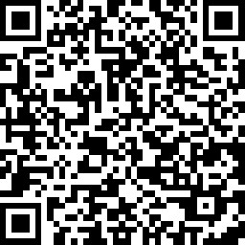
STARTER QUESTIONS
SCAN THE QR CODE TO START
True or False:
7 in 10 Americans believe that young adults today have a harder time than their parents’ generation did when it comes to buying a home?

Slide 3
STARTER QUESTION
ANSWER - TRUE
7 in 10 Americans believe that young adults today have a harder time than their parents’ generation did when it comes to buying a home?
According to a Pew Research Center survey conducted in October 2021, 70% of Americans believe that young adults have a hard time buying a home today than their parents’ generation did. These findings come at a time when younger Americans are more likely than previous generations to have taken on student debt with tuition costs steadily rising, and to face an affordable housing crisis as rent and housing prices have grown markedly faster than incomes in the last decade.

Slide 4
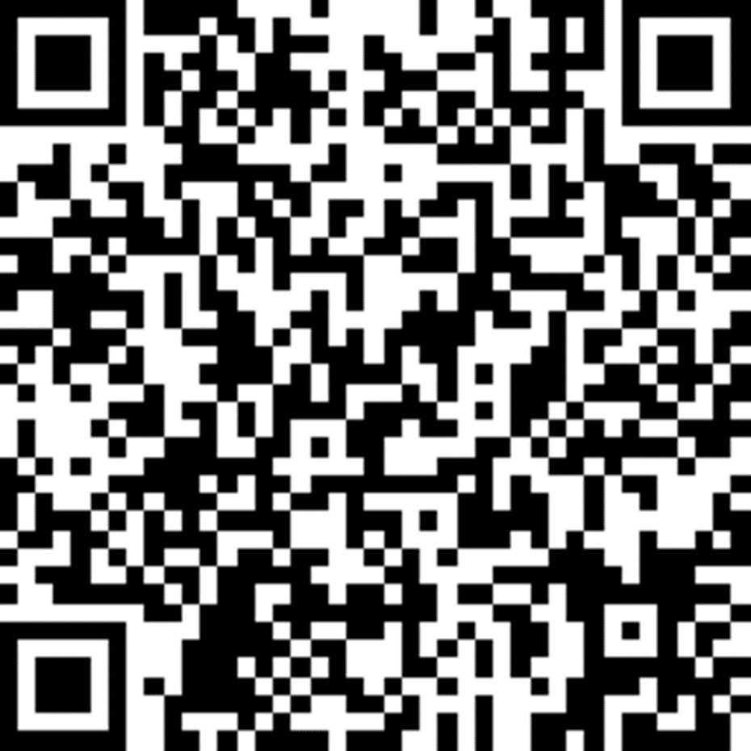
QUESTION #2
SCAN THE QR CODE TO START
What is the largest barrier to purchasing a home reported by millennials ?

Slide 5
QUESTION #2
ANSWER
What the largest barrier to purchasing a home reported by millennials?
Thinking that they do not have enough saved to make a down payment. A report published by the Urban Institute shows the largest reported reason that was prevent young adults from purchasing a home was feeling like they did not have enough money saved up to make a down payment.

Slide 6
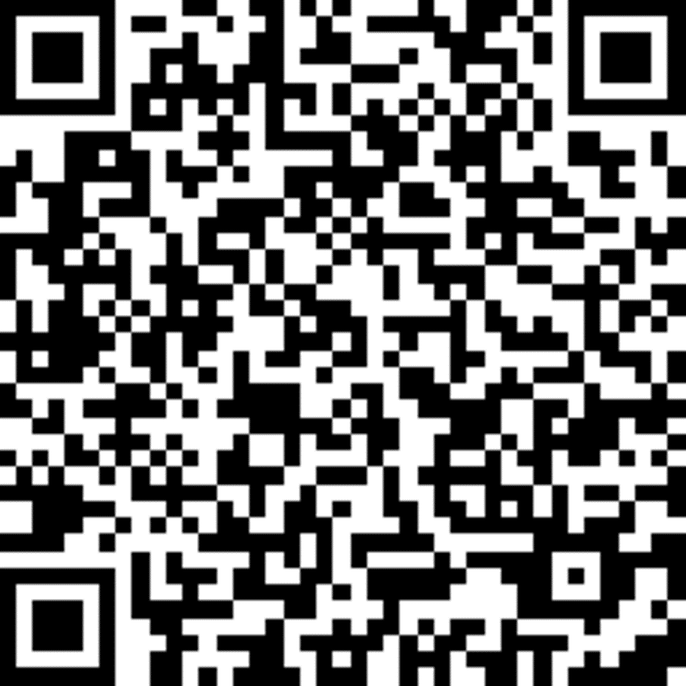
QUESTION #3
SCAN THE QR CODE TO START
What is the minimum down payment required to purchase a home?

Slide 7
QUESTION #3
ANSWER
What is the minimum down payment required to purchase a home?
There is no true minimum. There are plenty of homebuyer assistance programs that require smaller down payments to purchase a home. FHA loans require as little as 3.5 percent (with a 580 credit score), and VA loans and USDA loans have no down payment requirement at all. However, you must consider closing costs as well .

Slide 8
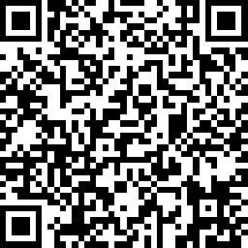
QUESTION #4
SCAN THE QR CODE TO START
What is the minimum credit score to purchase a home?

Slide 9
QUESTION #4
ANSWER
What is the minimum credit score required to purchase a home?
It varies… Different loans and homeowner assistance programs can require different minimum credit scores, but it is often lower than what you likely think it is. A conventional mortgage usually requires a score of at least 620, but many government-backed loans and grants will require a score that can be as low as 500.

Slide 10
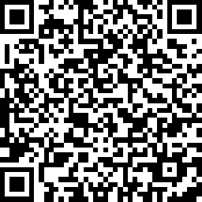
QUESTION #5
SCAN THE QR CODE TO START
What is the biggest factor in determining your credit score?

Slide 11
QUESTION #5
ANSWER
What is the biggest factor in determining your credit score?
According to Experian, the calculations that produce credit scores are closely kept trade secrets, but the underlying factors they consider (as well as how they're weighted) are public knowledge. The following factors and percentage weightings apply to the FICO® Score, which is used by 90% of top lenders. 1. Payment History: 35% 2. Amounts Owed: 30% 3. Length of Credit History: 15% 4. Credit Mix: 10% 5. New Credit: 10%

Slide 12
THANK YOU

