Slide 1

BREAKING BARRIERS WORKSTREAM

Slide 2
Mary Adams, Chairperson
& Dawnita S. Roberts, Co-Chairperson
Breaking Barriers: Identifying affordable housing tools and removing restrictive zoning and cost challenges

Slide 3
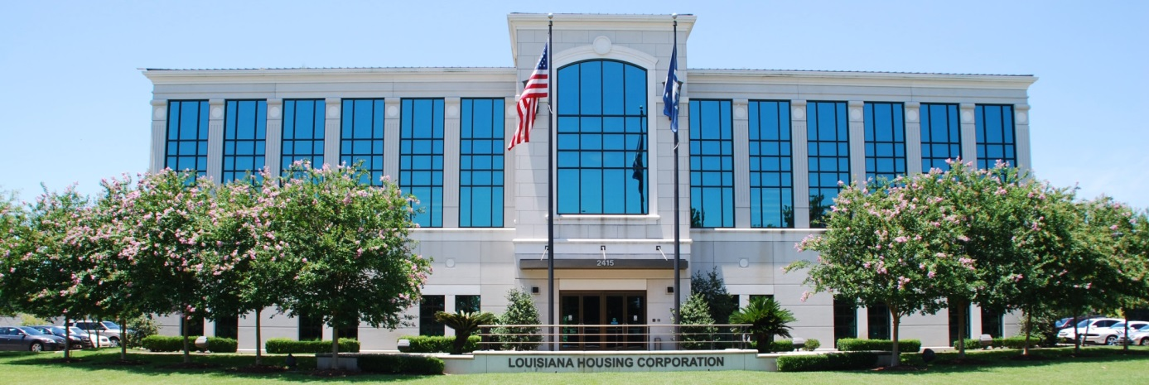
OUR TEAM
BARRIERS & SUBCOMMITTEES
Lack of Knowledge of being a homeowner & the Fear
Terri Gage, Crystal Jones-Taylor, Mary Adams
Student Loan and MIP – Mortgage Insurance
Mary Adams, Denise Washington
Lack of funds for downpayment & closing cost, using Choice Voucher (HCV) for Homeownership --Credit Poor-Lack of it-low scores ……… Denise Washington, Crystal Jones Taylor, Linda Moore, Marian C. Burks, Sophia Philizaire, Eric McGlothen, Da’Shon Bell, Chandler Roberts, Tish Allen, Dawnita S. Roberts
Lack of inventory, the cost of homes/development, removing restrictive zoning and cost challenges, Insurance …………………………….Dawnita S. Roberts, John Boudreaux, Toni Jackson, Eric McGlothen
Fair Housing, Discrimination in lending & borrowing practices and appraisal, Generational wealth
Toni Jackson, Tanya L. Domino, Eric McGlothen, Mary Adams Thomas,

Slide 4


Our Task

Slide 5

Objective/Phases
• Objective: Understand existing trends in regulatory and local decisions that create barriers and limit the market’s ability to produce affordable housing
• - Phase 1: Investigate identified obstacles and challenge where necessary
• - Phase 2: Review recent efforts by federal and state agencies, and local communities to reduce regulatory control
• - Phase 3: Educate communities and individuals on opportunities that help close the housing gap.

Slide 6

Lack of Knowledge
Potential Homebuyer/Homeowner
Lack of awareness of first-time homebuyer process,
programs, services, and resources, and of potential
eligibility
Fear of the unknown
Practitioners
Lack of shared knowledge of first-time homebuyer programs, services, and resources among public and private agencies, lenders, and other housing professionals
Fear of investing in low to moderate income families and not wanting to deal with extra paperwork.

Slide 7
RECOMMENDATIONS
Attention-getting PSA campaign that links via QR code to resource information and video testimonials of first-generation LMI homeowners.
Informational mailers to targeted geographic areas identified by homeownership rates and income.
Regularly scheduled learning and collaboration opportunities to bring together LMI homeownership stakeholders.
Enhanced CRA credits for investment in homeownership opportunity for LMI families

Slide 8

Student Loan & MIP BARRIERS
Student Loan
Underwriting guidelines/student loan debt calculations
The amount of debt owed from college
Lack of financial literacy before/during and after college
Parent Plus Loan Regulations
MIP-MORTGAGE INSURANCE
Underwriting guidelines
Amount of mortgage insurance premiums

Slide 9
RECOMMENDATIONS
Change student debt calculation underwriting guidelines to honor income-base re payment letters for all borrowers including borrowers who are currently in deferment status and borrowers who have monthly payments in the amount of zero and, parent plus loans.
Regulate student loan services to provide income base payment letters verifying a borrower’s maximum monthly obligation based on their current income . This regulation extend to parent plus loans.
Provide annual financial literacy education and counseling to students and parents.
Expand public/private paid internship opportunities for students.
Expand public/private grant opportunities to students.

Slide 10

Lack of funds for downpayment & closing, using Housing Choice Voucher (HCV)
Objective: Understand existing trends in regulatory and local decisions that create barriers and limit the market’s ability to produce affordable housing .
Lack of savings, lack of credit and poor credit scores, inadequate funding, improper prioritization of funding allocations, and impaired program policies and procedures.
Review recent efforts by federal and state agencies, and local communities to reduce regulatory control .
REFERENCE HUD 2022-2026 Strategic Plan
Strategic Goal 3: Promote Homeownership
Promote homeownership opportunities, equitable access to credit for purchase and improvements, and wealth building in underserved communities.
3A: Advance Sustainable Homeownership
Advance the deployment of tools and capital that put sustainable homeownership within reach.
3A – Major Initiative: Expand Homeownership Opportunities
Promote financing for innovative ownership models to increase the availability of affordable housing
3B: Create a More Accessible and Inclusive Housing Finance System
Advance new policy, programs, and modernization initiatives that support a more equitable housing finance system. Promote the preservation and creation of affordable housing stock

Slide 11
RECOMMENDATIONS
Reevaluate and improve programs policies and procedures with input and resources from public and private sectors to ensure these programs are designed and allocated to meet the needs of communities they are intended to serve.
Utilize HUD Certified Housing Counseling Agencies provide credit education and credit counseling.
Massive marketing demystifying available programs and service . Partner with civic and faith- based organizations, and institutions , to provide educational opportunities for financial literacy , generational wealth building, and information on available programs services.
Integrating systems with practitioners of public and private sectors.
HUD public housing division reevaluate and improve the HCV program guidelines regarding lease up regulations concerning PHA’s to function in the same capacity and provide same funding regardless of whether recipient is utilizing the voucher to rent or buy. Further-more PHA’s should be regulated to provide program recipients the option to rent or buy.

Slide 12
Lack of inventory , the cost of homes/development removing restrictive zoning and cost challenges
Regulatory Burdens for Zoning affordable housing.
Lack of housing inventory.
Dramatically Increased construction / development cost ( the cost of material challenges housing developers)
Reevaluate and increase homeownership development options
The need for better understanding of the resources for disaster recovery, development, and home renovations.
Reference July 27, 2023
Biden-⁠Harris Administration Announces Actions to Lower Housing Costs and Boost Supply
Launches first-of-its-kind program to address land use and zoning barriers that limit housing
Reducing barriers to build housing like restrictive and costly land use and zoning rules;
Expanding financing for affordable, energy efficient and resilient housing.
New Biden- Harris Housing Supply Action Plan to help close the housing supply gap in five years
Under the plan, the administration will:
Reward jurisdictions that have reformed zoning and land use
Expand and improve existing forms of federal financing
Work with the private sectors to address supply chain challenges and improve building techniques.
Reference HUD:PATHWAYS TO REMOVING OBSTACLES TO HOUSING (PRO HOUSING) https://www.hud.gov/program_offices/comm_planning/pro_housing

Slide 13
RECOMMENDATIONS
Increase state and local government partnerships with HUD Certified Counseling Agencies to empower developers for success.
Leverage Public/Private Partnerships and Resources.
Re-Label Affordable Housing – as workforce housing and mix income. mixed use developments.
Enhancing Relationships between parish governments, planning/ zoning , affordable housing, developers and advocates.
Massive marketing demystifying available programs , service and resources.

Slide 14
Discrimination in lending & borrowing practices and appraisal
Black homeownership rate: 44.9%, White rate: 74.5%, American Hispanic homeownership rate: 48.5%
Appraisal Bias: According to the Brooking corporation: Black neighborhoods are valued roughly 21% to 23% below what their valuations would be in non-Black neighborhoods.
Modern Day Redlining – People of color applicants with the same income, credit and loan amount as white are denied. Since 2008 we have seen a dramatic decrease in loan denials. We are happy to see this, however, Black denials still remain 2-½ times greater than white denials.
Reviewed recent efforts by federal and state agencies, and local communities to reduce regulatory control .
Reference: March 2022 PAV Action Plan pav.hud.gov
Reference :MOU on redressing discriminatory housing practices and policies.

Slide 15

FAIR HOUSING / IS IT FAIR ?
The Black- White homeownership gap is wider today (30%) than in 1968 when the Fair Housing Act was initially passed, prohibiting discrimination when selling, renting, or financing a home
The Black homeownership gap in Louisiana, the Stacker February 10, 2022 (Reference)

Slide 16


Generational wealth
Homeownership is a path to Building
Generational Wealth
Financial Education on mortgage principal reduction
Work with Partner t establish Power of Attorney, Living Will and Will (example: Legal Aid, SU law, and Housing Clinic
Adequate insurance (home, flood, auto, life)

Slide 17
FUTURE IMPACT
Increase Homeowners in Louisiana,
Close the racial gap in Homeownership in Louisiana
Create Wealth for the Next Generational Wealth
If you want to work on this work-stream
Sign up at:
https://www.lhc.la.gov/la-homeownership-think-tank
QR CODES AND RESOURCE LINKS WILL BE PROVIDED AT THE BREAKING BARRIERS WORKSTREAM EXHIBIT TABLE!!!

