Slide 1
Louisiana Rural Development

Slide 2
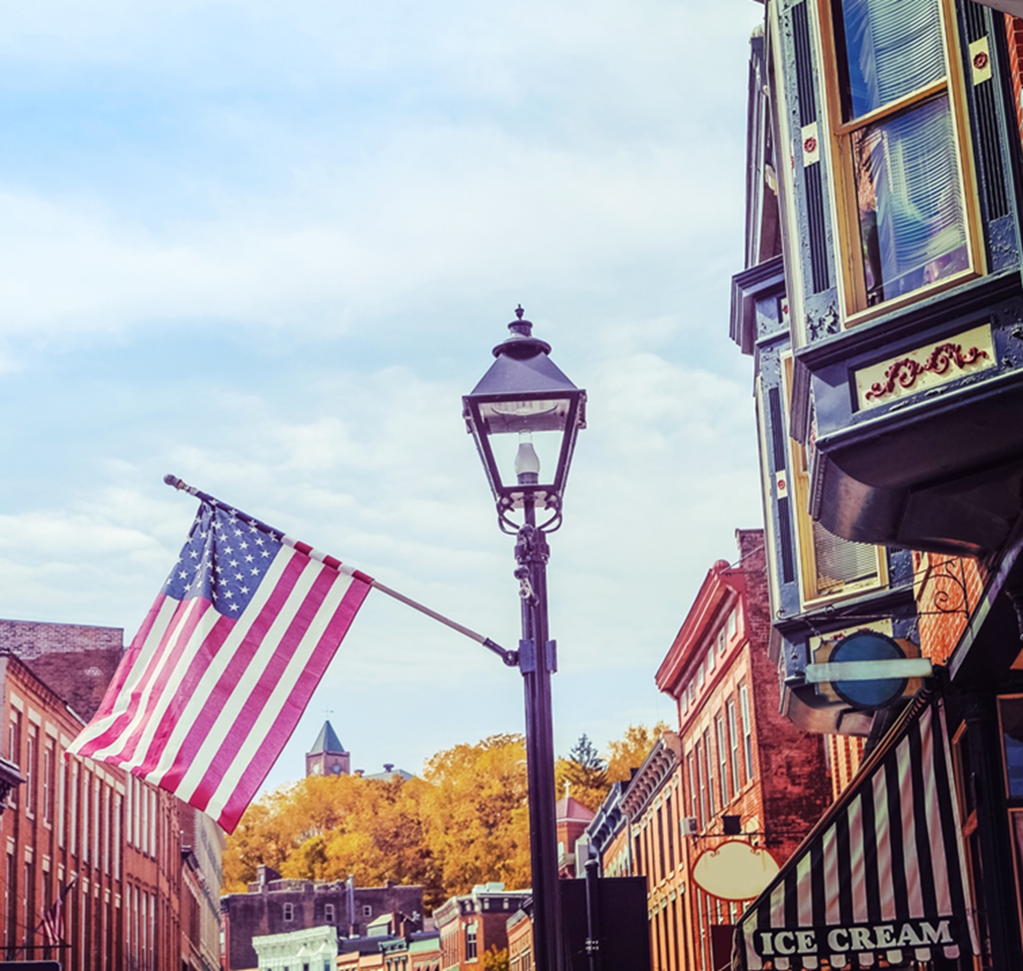
USDA Rural Development
USDA Rural Development is committed to helping improve the economy and quality of life in rural America. Through our programs, we help rural Americans in many ways.
Notes:
USDA Rural Development is one of the 8 Mission Areas within the Department. Through its three agencies, the Rural Housing Service, Rural Business-Cooperative Service, Rural Utilities Service offer loans, grants and loan guarantees to help create jobs and support economic development and essential services such as housing; health care; first responder services and equipment; and water, electric and communications infrastructure.
We promote economic development by supporting loans to businesses through banks, credit unions and community-managed lending pools. We offer technical assistance and information to help agricultural producers and cooperatives get started and improve the effectiveness of their operations.
We help rural residents to buy or rent safe, affordable housing and make health and safety repairs to their homes, support water and sewer systems, access to broadband and a wide array of business development activities.
All of these activities are critical to helping rural communities prosper..
Next Slide.

Slide 3
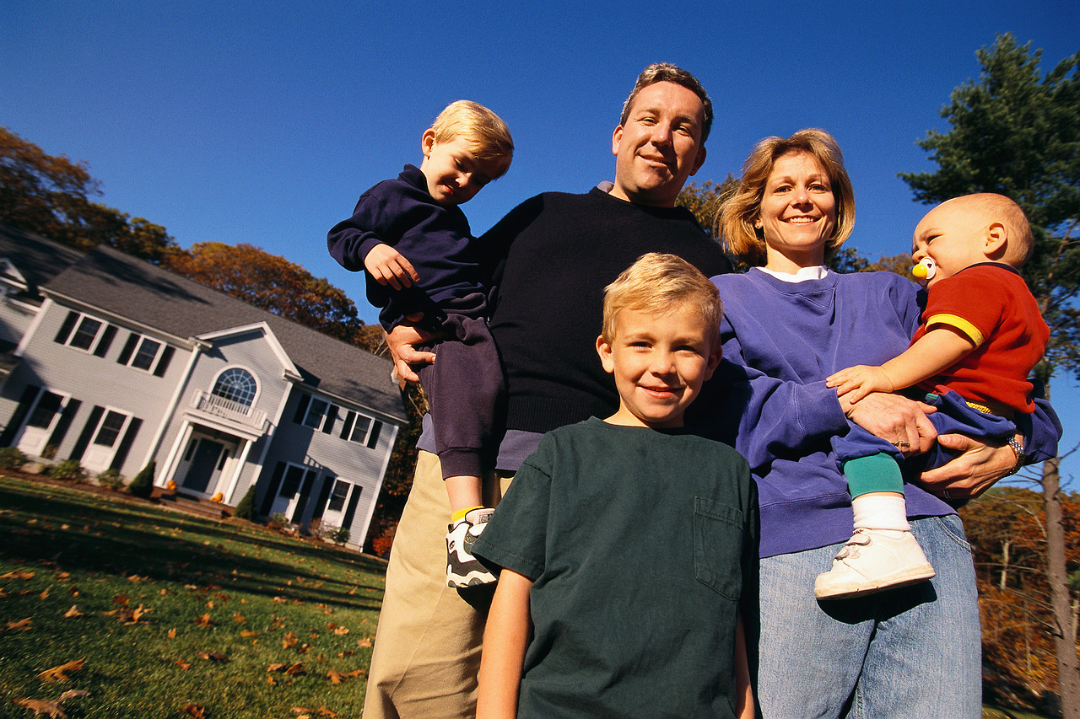
Housing Programs
Notes:
SFH Housing programs – 502 Direct, 504 Repair, GRH Housing Loans, Self-Help and Housing Preservation Grants.

Slide 4
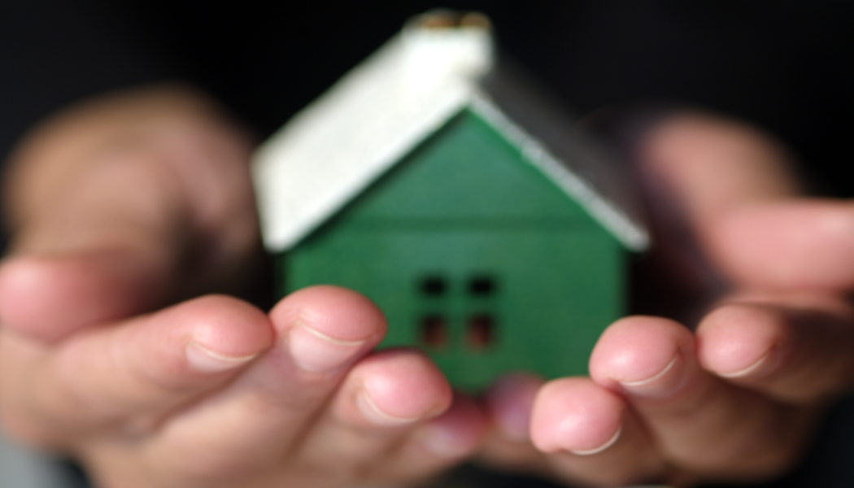
Housing
Our innovative housing programs include the Single Family Housing program which can provide assistance to buy, build, and repair homes, as well as partner with local lending institutions to guarantee housing loans.
Notes:
Our innovative housing programs include the Single Family Housing program which can provide assistance to buy, build, and repair homes, as well as partner with local lending institutions to guarantee housing loans.

Slide 5
The American Dream - 502 Direct Loan Program
Direct loans to assist very-low and low income families in rural areas
Payment based on income
No down payment required
Fixed rate financing – up to 33 years
Homes must be located in eligible rural areas
Agree to occupy the property
Descriptions and maps are available on the internet: http://eligibility.sc.egov.usda.gov/eligibility.welcomeAction.do?Home
First-time homebuyers to complete Homeownership Education Training.
Notes:
The Section 502 Direct Loan Program, this program assists low- and very-low-income applicants obtain decent, safe and sanitary housing in eligible rural areas by providing payment assistance to increase an applicant’s repayment ability. Payment assistance is a type of subsidy that reduces the mortgage payment for a short time. The amount of assistance is determined by the adjusted family income.
Who may apply for this program? A number of factors are considered when determining an applicant’s eligibility for Single Family Direct Home Loans. At a minimum, applicants interested in obtaining a direct loan must have an adjusted income that is at or below the applicable low-income limit for the area where they wish to buy a house and they must demonstrate a willingness and ability to repay debt.
Applicants must:
Be without decent, safe and sanitary housing
Be unable to obtain a loan from other resources on terms and conditions that can reasonably be expected to meet
Agree to occupy the property as your primary residence
Have the legal capacity to incur a loan obligation
Meet citizenship or eligible noncitizen requirements
Not be suspended or debarred from participation in federal programs
Properties financed with direct loan funds must:
Generally be 2,000 square feet or less
Not have market value in excess of the applicable area loan limit
Not be designed for income producing activities
Borrowers are required to repay all or a portion of the payment subsidy received over the life of the loan when the title to the property transfers or the borrower is no longer living in the dwelling.
Applicants must meet income eligibility for a direct loan. Please select your state from the dropdown menu above.
What is an eligible rural area? Utilizing the USDA Eligibility Site you can enter a specific address for determination or just search the map to review general eligible areas.
How may funds be used? Loan funds may be used to help low-income individuals or households purchase homes in rural areas. Funds can be used to build, repair, renovate or relocate a home, or to purchase and prepare sites, including providing water and sewage facilities.
How much may I borrow?
Using the Single Family Housing Direct Self- Assessment tool, potential applicants may enter information online to determine if the Section 502 Direct Loan Program is a good fit for them prior to applying. The tool will provide a preliminary review after a potential applicant enters information on their general household composition, monthly income, monthly debts, property location, estimated property taxes, and estimated hazard insurance. Potential applicants are welcome to submit a complete application for an official determination by USDA Rural Development (RD) regardless of the self-assessment results. Upon receipt of a complete application, RD will determine the applicant’s eligibility using verified information and the applicant’s maximum loan amount based on their repayment ability and the area loan limit for the county in which the property is located.
What is the interest rate and payback period?
Effective July 1, 2022, the current interest rate for Single Family Housing Direct home loans is 3.50% for low-income and very low-income borrowers.
Fixed interest rate based on current market rates at loan approval or loan closing, whichever is lower
Interest rate when modified by payment assistance, can be as low as 1%
Up to 33 year payback period - 38 year payback period for very low income applicants who can’t afford the 33 year loan term
How much down payment is required? No down payment is typically required. Applicants with assets higher than the asset limits may be required to use a portion of those assets.
Is there a deadline to apply? Applications for this program are accepted through your local RD office year round.
How long does an application take? Processing times vary depending on funding availability and program demand in the area in which an applicant is interested in buying and completeness of the application package.
What governs this program?
The Housing Act of 1949 as amended, 7 CFR, Part 3550,
HB-1-3550 - Direct Single Family Housing Loans Field Office Handbook
Why does USDA Rural Development do this? USDA Rural Development’s Section 502 Direct Loan Program provides a path to homeownership for low- and very-low-income families living in rural areas, and families who truly have no other way to make affordable homeownership a reality. Providing these affordable homeownership opportunities promotes prosperity, which in turn creates thriving communities and improves the quality of life in rural areas.
The Agency requires applicants who are first-time homebuyers to complete homeownership education training as early in the application process as possible since the training will prepare them for shopping, buying, financing, and owning a home. While the training should be completed by the applicant prior to them entering into a contract to purchase or construct a home, the applicant should be encouraged to take the training as soon as they express an interest in homeownership for maximum benefit. Course must be completed prior to closing.
The Guaranteed Home Loan program assists approved lenders in providing low- and moderate-income households the opportunity to own adequate, modest, decent, safe, and sanitary dwellings as their primary residence in eligible rural areas. Eligible applicants may build, rehabilitate, improve, or relocate a dwelling in an eligible rural area. The program provides a 90% loan note guarantee to approved lenders in order to reduce the risk of extending 100% loans to eligible rural homebuyers.

Slide 6
The American Dream – Guaranteed Loan Program
Guaranteed loans to assist low to moderate
income families in rural areas
Loans made by a regional or local bank
No down payment required
Applicants must:
Household income not to exceed 115% of median income.
Agree to occupy dwelling as primary residence.
US Citizen, non-citizen national, or qualified alien.
Unable to get conventional financing
Not be suspended or debarred from participating in federal programs
Where to Apply
Approved Lender, link below:
Single Family Housing Guaranteed Loan Program | Rural Development (usda.gov)
Notes:
The Guaranteed Home Loan program assists approved lenders in providing low- and moderate-income households the opportunity to own adequate, modest, decent, safe, and sanitary dwellings as their primary residence in eligible rural areas. Eligible applicants may build, rehabilitate, improve, or relocate a dwelling in an eligible rural area. The program provides a 90% loan note guarantee to approved lenders in order to reduce the risk of extending 100% loans to eligible rural homebuyers.
This program helps approved lenders make 100 percent-financed, no-money-down mortgage loans to eligible low- and moderate income applicants. Backed by USDA Rural Development, the 90 percent loan note guarantee encourages lender participation by helping them minimize risk. With a Single Family Housing Guaranteed Loan, applicants can buy an existing home (including the cost of rehabilitating, improving, or relocating the dwelling) or they can build new. T he home must be used as their primary residence, and must be modest, decent, safe, and sanitary. This program is not restricted to first-time home buyers.
The Section 502 Guaranteed Loan Program assists approved lenders in providing low- and moderate-income households the opportunity to own adequate, modest, decent, safe and sanitary dwellings as their primary residence in eligible rural areas. Eligible applicants may purchase, build, rehabilitate, improve or relocate a dwelling in an eligible rural area with 100% financing. The program provides a 90% loan note guarantee to approved lenders in order to reduce the risk of extending 100% loans to eligible rural homebuyers – so no money down for those who qualify!
Who may apply for this program? Applicants must:
Meet income-eligibility (cannot exceed 115% of median household income) ( 1-4 person household is $103,500 and 5-8 person household is $136,600 as of 6-8-2022)
Agree to personally occupy the dwelling as their primary residence
Be a U.S. Citizen, U.S. non-citizen national or Qualified Alien
The interest rate is negotiated between the applicant and the lender, and must be a 30-year fixed rate.
Program lending extends to100 percent of the property’s appraised value, not the purchase price. Thus, borrowers potentially can include closing costs and home repair expenses into the financing.
In addition to closing costs and eligible repairs, funds can be used for reasonable and customary expenses associated with the purchase, including items such as utilities connection fees, tax and insurance escrows, essential household equipment, and site preparation.
What is an eligible rural area? Utilizing this USDA's Eligibility Site you can enter a specific address for determination or just search the map to review general eligible areas.
Why does Rural Development do this?
This program helps lenders work with low- and moderate-income households living in rural areas to make homeownership a reality. Providing affordable homeownership opportunities promotes prosperity, which in turn creates thriving communities and improves the quality of life in rural areas.

Slide 7
504 Home Improvement
Loans to assist very-low income homeowners in rural areas for essential repairs
1% interest rate – Max 20 yr. term
Terms based on repayment ability
Maximum Loan amount = $40,000
Grants to assist very-low income rural homeowners
62 years or older
Rehabilitate substandard housing
Grant assistance not to exceed $10,000
Notes:
The Section 504 Home Repair program, this provides loans to very-low-income homeowners to repair, improve or modernize their homes or grants to elderly very-low-income homeowners to remove health and safety hazards.
Who may apply for this program? To qualify, you must:
Be the homeowner and occupy the house
Be unable to obtain affordable credit elsewhere
Have a household income that does not exceed the very low limit by county.
For grants, be age 62 or older and not be able to repay a repair loan
What is an eligible rural area? Utilizing the USDA Eligibility Site you can enter a specific address for determination or just search the map to review general eligible areas.
How may funds be used?
Loans may be used to repair, improve or modernize homes or remove health and safety hazards
Grants must be used to remove health and safety hazards
How much money can I get?
Maximum loan is $40,000
Maximum grant is $10,000
Loans and grants can be combined for up to $50,000 in assistance
What are the terms of the loan or grant?
Loans are termed for 20 years
Loan interest rate is fixed at 1%
Full title service is required if the total outstanding balance on Section 504 loans is greater than $25,000
Grants have a lifetime limit of $10,000
Grants must be repaid if the property is sold in less than 3 years
If applicants can repay part, but not all of the costs, applicants may be offered a loan and grant combination
Is there a deadline to apply?
Applications for this program are accepted through your local RD office year round
How long does an application take? Approval times depend on funding availability in your area. Talk to a USDA home loan specialist in your area for help with the application
Who can answer questions and how do I get started? Contact a USDA home loan specialist in your area
What governs this program?
The Housing Act of 1949 as amended, 7 CFR Part 3550
HB-1-3550 - Direct Single Family Housing Loans and Grants Field Office Handbook
Why does USDA Rural Development do this? Helping people stay in their own home and keep it in good repair helps families and their communities. Homeownership helps families and individuals build savings over time. It strengthens communities and helps many kinds of businesses that support the local economy.

Slide 8
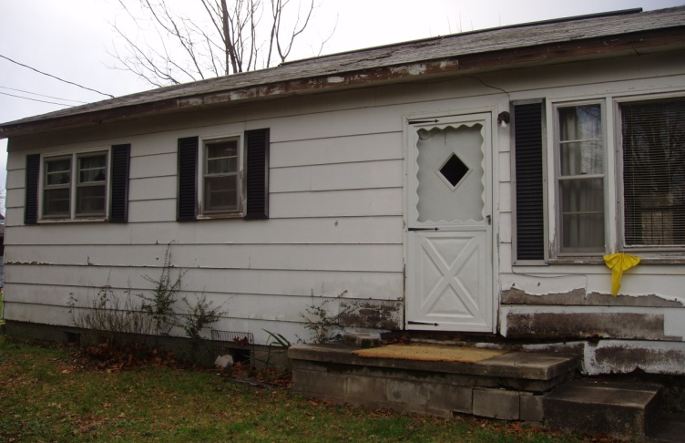
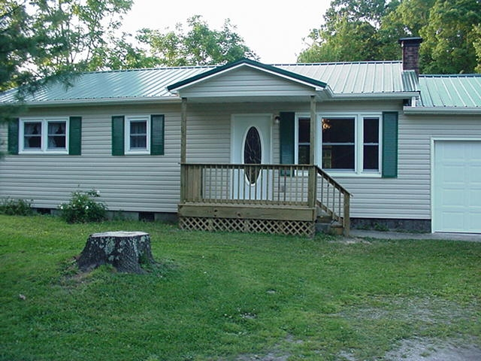
Home Improvement
Home Repair Loan –
Before and after photographs of a home which received a Rural Development Direct 504 Loan/Grant to make much-needed siding, gutter, electrical and flooring home repairs.
Before
After
Notes:
A before and after of repairs on home for 504 loan/grant program.

Slide 9
Rural Development Single Family Housing Office Locations
Office Telephone
Monroe 318-343-4467 ext 4 opt 1
Natchitoches 318-352-7100 ext 4
Lafayette 337-262-6601 ext 4
Amite 985-748-8751 ext 4
Alexandria State Office 318-473-7630
Faye Hornsby, Housing Program Director
faye.hornsby@usda.gov
Mack McCraney, Area Director
mack.mccraney@usda.gov

Slide 10
www.rd.usda.gov
USDA is an equal opportunity provider, employer, and lender.
Notes:
All of our programs are listed on our website at www.rd.usda.gov
Like to thank you for your time. Does anyone have any questions?

