Slide 1
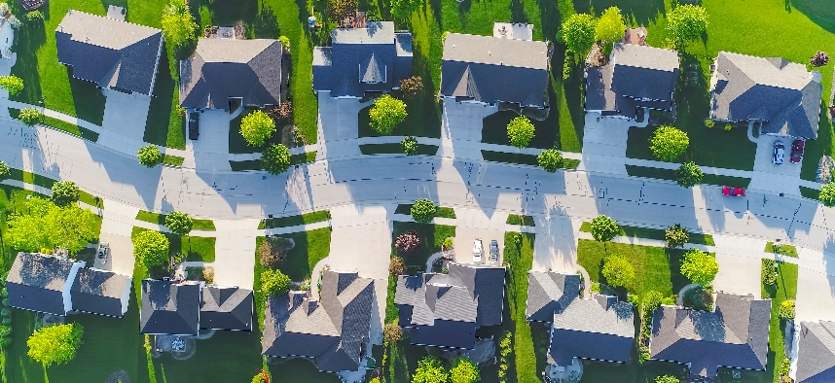

Single-Family Housing Programs:
Access to Affordable Resources
Louisiana Statewide
Homeownership Think Tank Roundtable
Southern University A&M College ~ Baton Rouge, LA
September 8, 2033

Slide 2
Access to Affordable Housing Resources
Presented By:
Nicole Barnes
Executive Director

Slide 3

Access to Affordable Resources
The Need:
13,000 Homeownership Units
Median Home Price: $192,800
Median Household Income:
$52,087

Slide 4
Access to Affordable Resources
The Cost:
On average, the total development cost, for a new construction home, ranges from $225K to $275K. This for a 1400 sq. ft. a home that is energy efficient and features requisite building code compliance for climate resiliency.

Slide 5
Access to Affordable Resources
The Solution:
An intentional, willful and concerted effort by the relative partners to center the collective goal providing affordable homeownership for low-to-moderate income homebuyers.

Slide 6
Access to Affordable Resources
  The Partners & Resources:
  Governmental Entities
    Publicly-owned Land
    Development Resources
    Homebuyer Resources

Slide 7
Access to Affordable Resources
Nonprofits, Community Housing Development Organizations and Community and Community Development Corp. Counseling Agencies
  Home Development
  Construction
  Homebuyer Preparation and on-going Support
  Identification of Resources (buyers)

Slide 8
Access to Affordable Resources
Philanthropy
  Development Resources
  Homebuyer Resources
  Nonprofit Operating Support

Slide 9
Access to Affordable Resources
Financial Institutions
  Construction Financing (Patient Financing)
  Mortgage Financing (Various Products)
  Alternative Credit Analysis

Slide 10
Access to Affordable Resources
We’ve done this before:
The government via the FHA in the 1950s and 1960s:
Created redline laws to limit residency and home purchases in the suburbs to whites.

Slide 11
Access to Affordable Resources
Created underwriting criteria to prevent non-white families and individuals from qualifying for mortgages.
Made FHA and VA loans available to whites only.

Slide 12
Access to Affordable Resources
Relocated whites from segregated public housing to suburban white-only communities with government subsidies and houses that they were able to purchase for no more that twice the median income at the time.

Slide 13
Access to Affordable Resources
Homes that are now worth an estimated $300,000 to $400,000.
Amassing equity to send their children to college…
Amassing equity to start their own businesses…
Passing on generational wealth to their children…

Slide 14
Access to Affordable Resources
More information regarding the history of segregation and redlining and the lasting impact on housing and wealth generation can be found in :
The Color of Law
By Richard Rothstein

Slide 15
Access to Affordable Resources
There is a foundation to start with:
  The Various USDA Programs
  Soft – second Mortgage Programs
  The Housing Choice Voucher Program
  Missing link:
  An intentional, willful and concerted effort…

Slide 16
Access to Affordable Resources
Development of intentional land use development and disposition policies by the municipality that prioritizes affordability.
Cultivating funding sources for affordable development.
Supporting Small developers in the creation of affordable housing opportunities
Committing to an annual development goal with the requisite support.

Slide 17
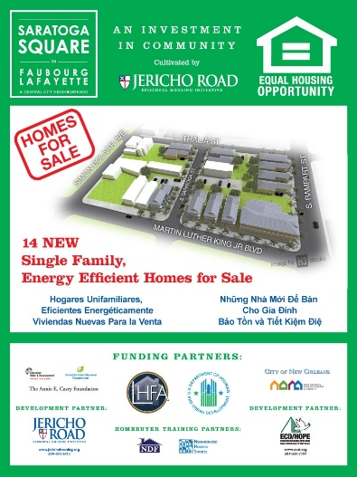

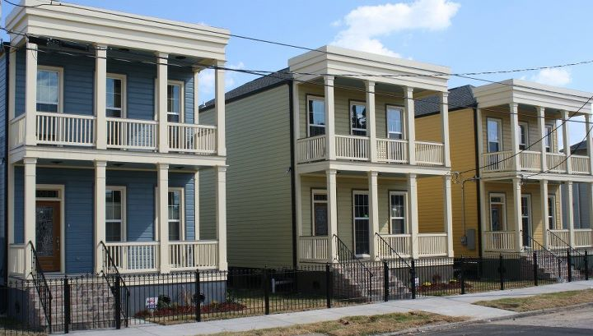
Saratoga Square
Started in January 2012 and Completed May 2013
14 total single-family homes
One square block and a facing street with the homes built contiguous to one another creating a definite neighborhood feel
Located in the Saratoga Square subdivision (originally conceptualized by Jericho Road) in the hub of the Oretha Castle Haley renaissance
Co-developed with EDC Hope Credit Union

Slide 18


Slide 19
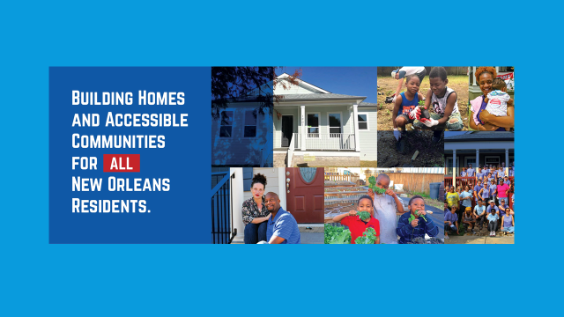

Slide 20
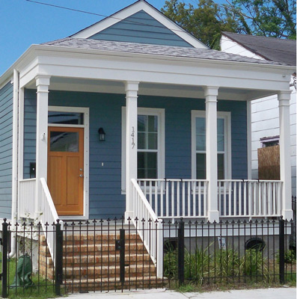
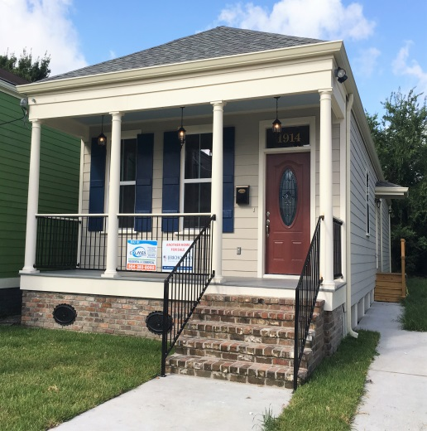
Housing Development
Jericho Road offers high quality, affordably priced homes to low-to-moderate income working families.
The core tenets of Jericho Road’s homebuilding include
  Construction that is reflective of the historical architectural trends characteristic of New Orleans
  Using sustainable, environmentally-friendly materials and energy efficient appliances and fixtures for construction to pass along greater savings to the homeowner
  Elements of Universal Design that provide an opportunity for people with a variety of physical abilities to live comfortably and to age-in-place in the home

Slide 21
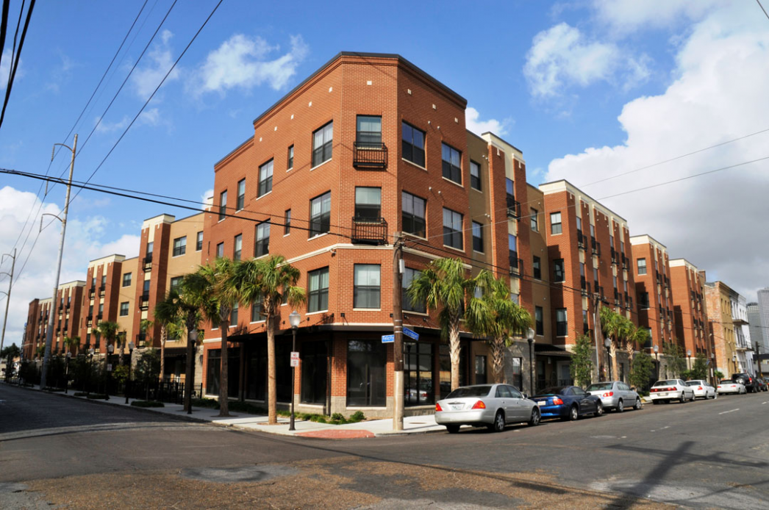
The Muses
Role: Co-developer
Muses I and II
New construction of affordable rental units in Central City New Orleans
Units Size
263 Affordable Units 301,452 SF

Slide 22
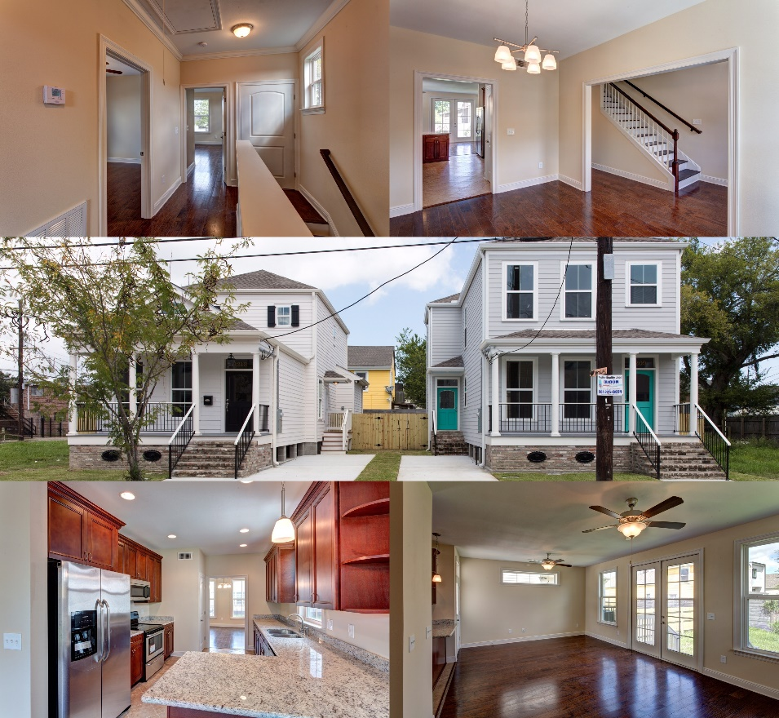
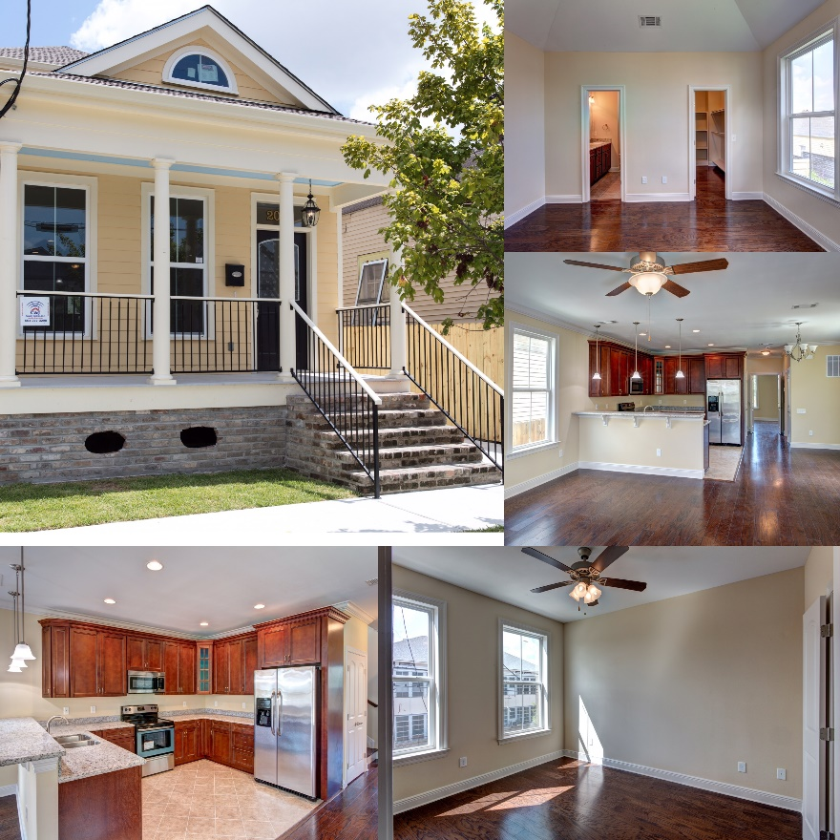
Central City Infill Housing
Cost Size
$15 million + 90,000 sq. ft.+

Slide 23
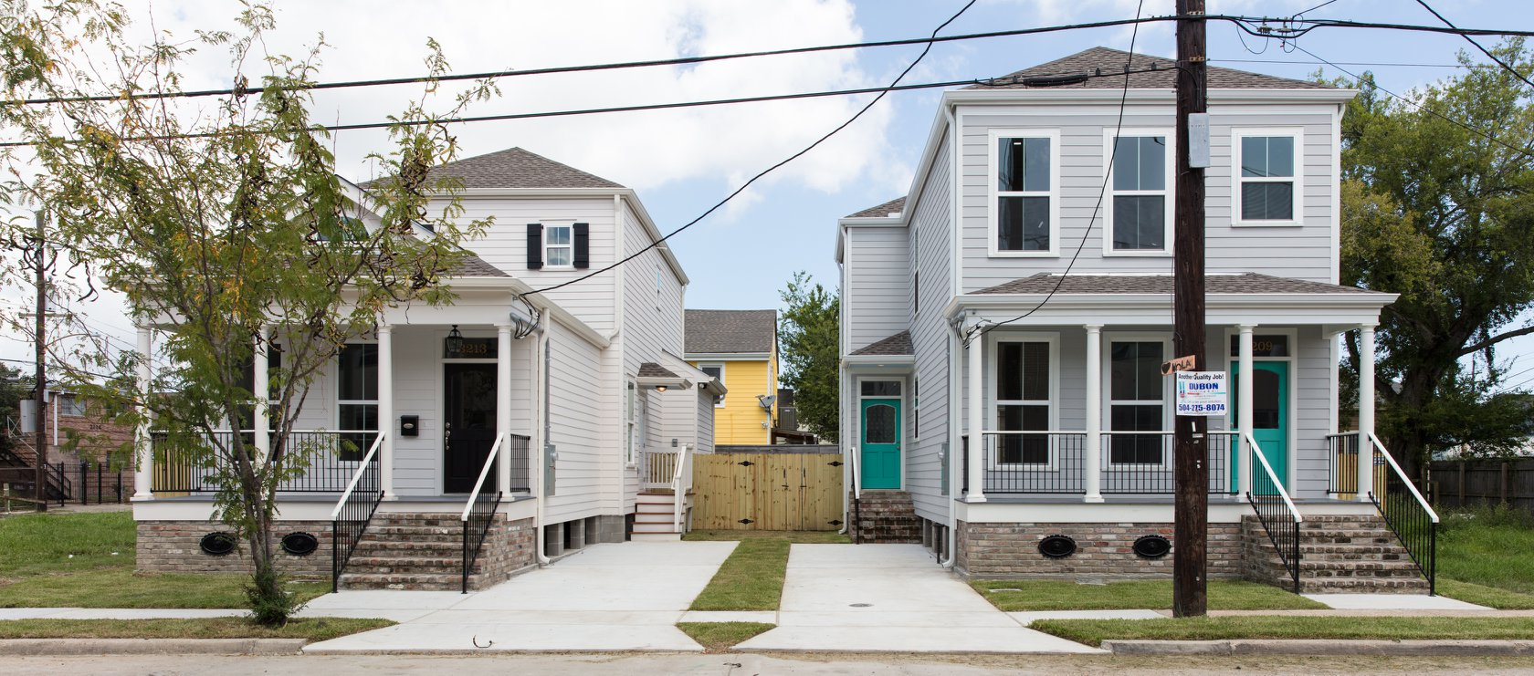

Slide 24


Slide 25
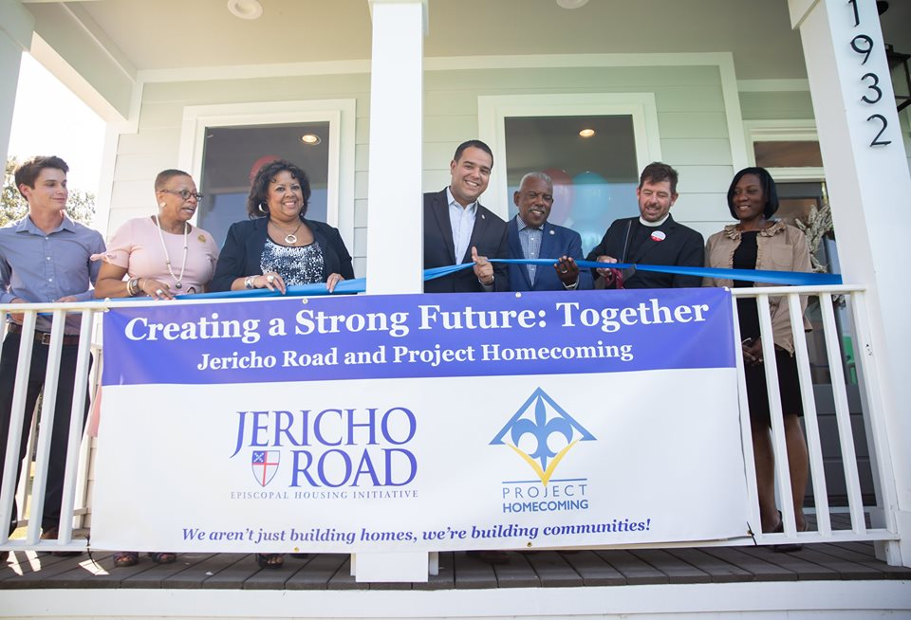

Slide 26
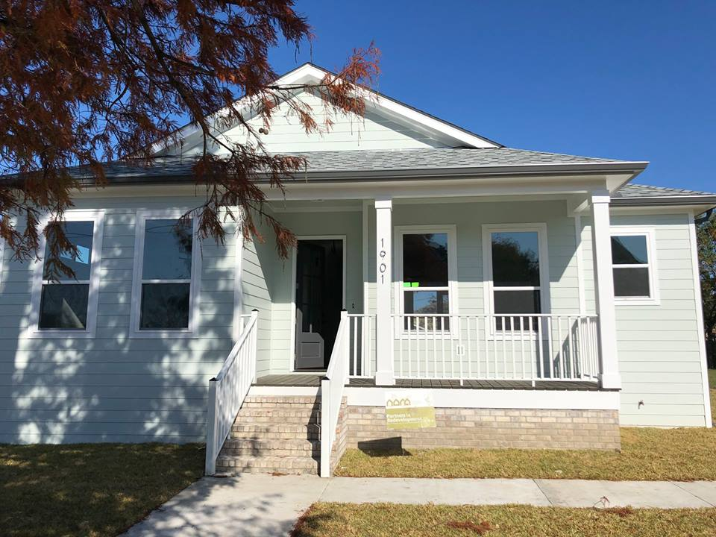
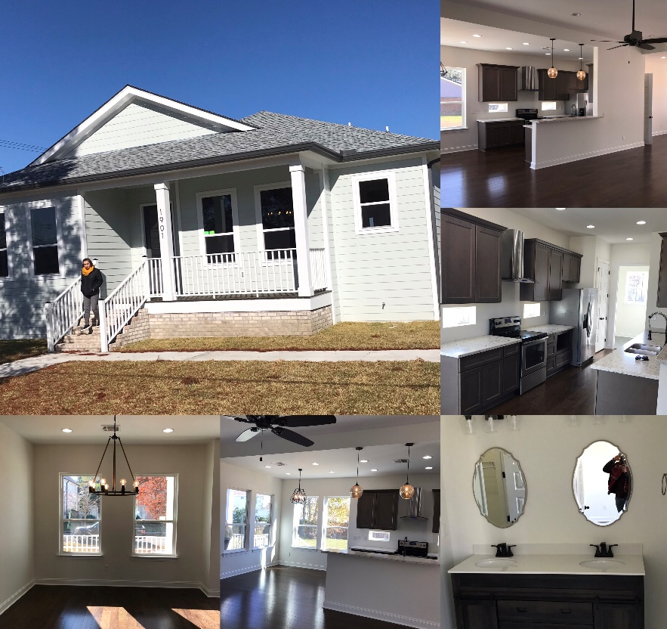
Mirabeau Gardens
Cost Size
$1.1 million 8,500 sq. ft.

Slide 27
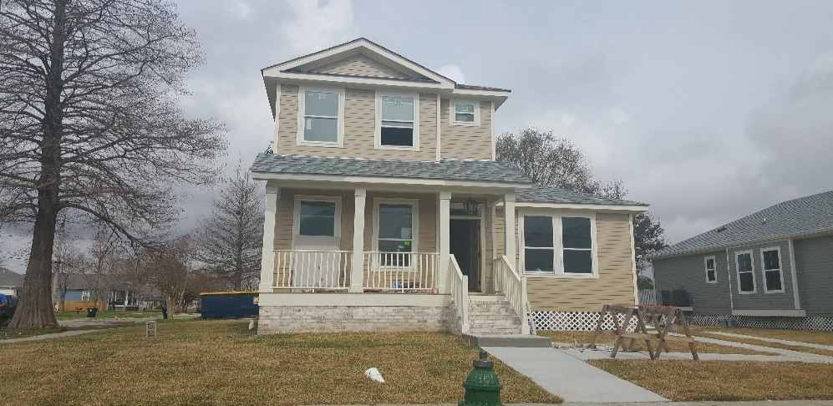
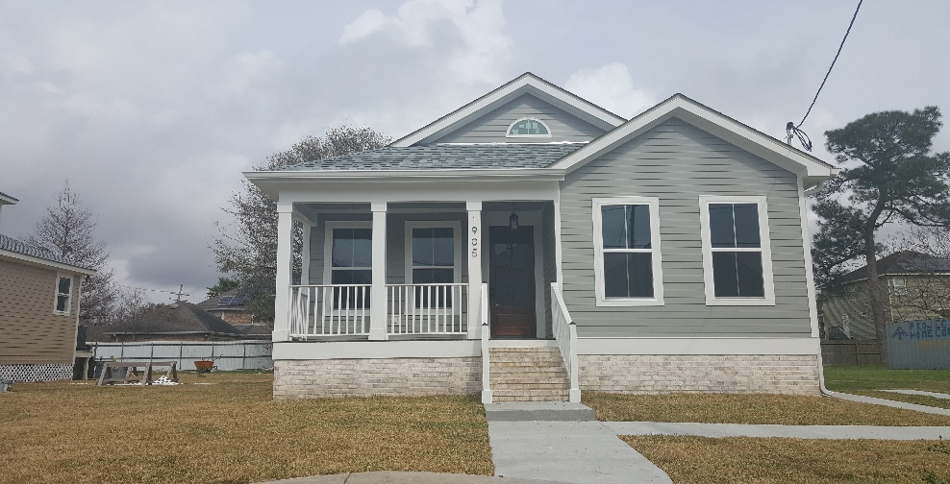
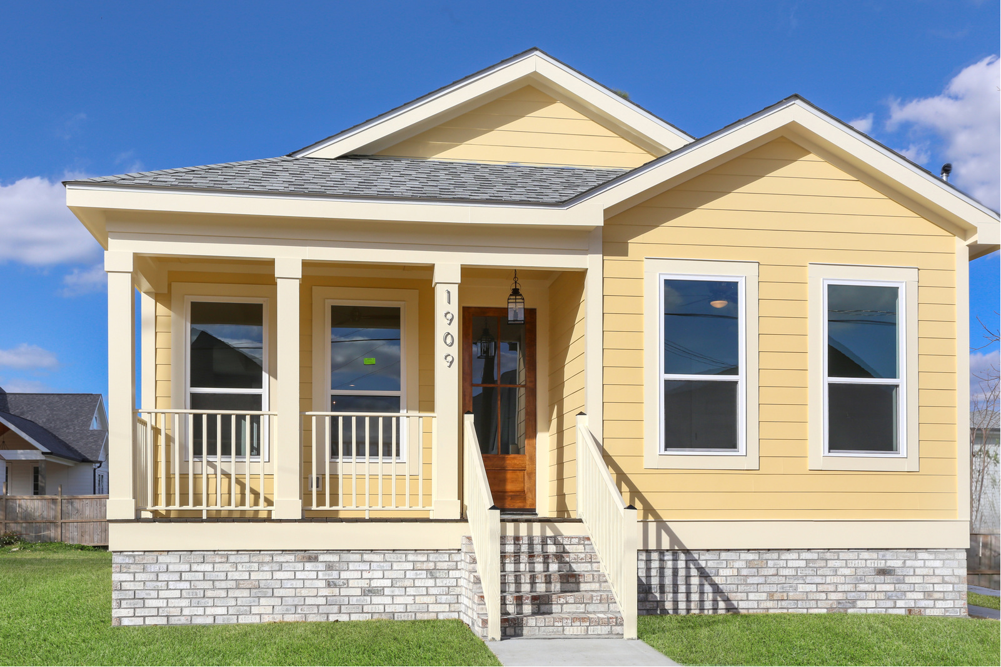
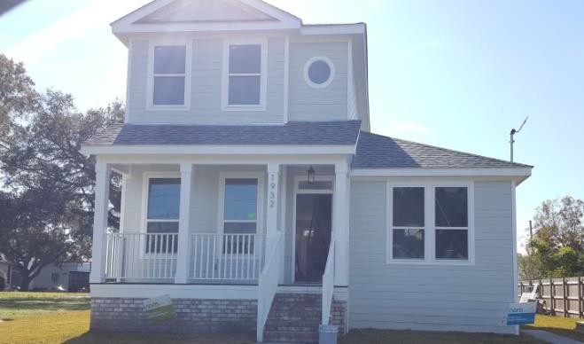
Mirabeau Gardens

Slide 28
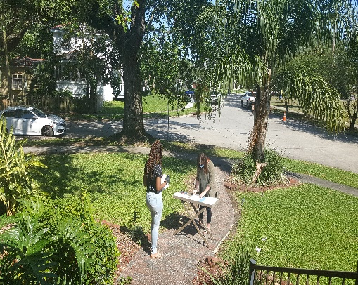
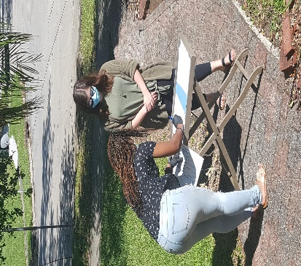
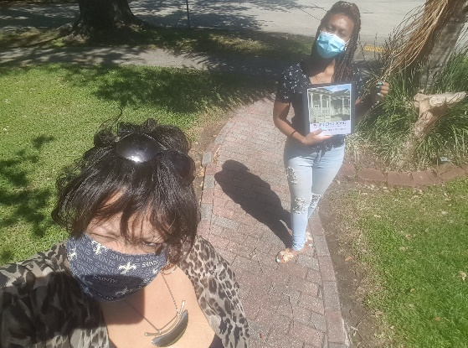
COVID 19 Curbside Closing for 1905 Wilton!!!

Slide 29
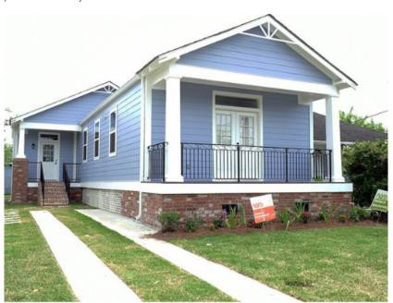
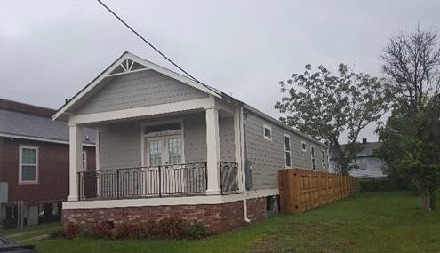
7th Ward Revitalization Project
Jericho Road served as co-developer with NewCorp Inc.

Slide 30
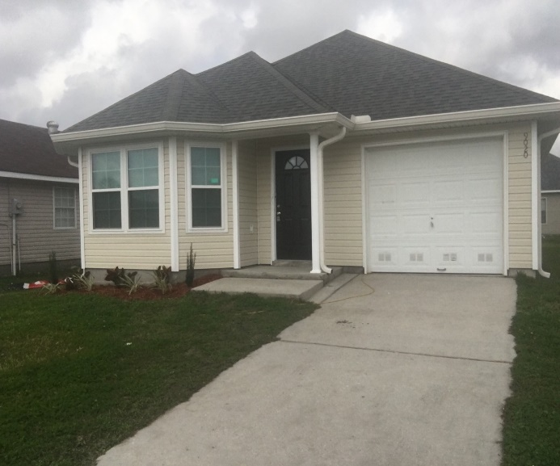
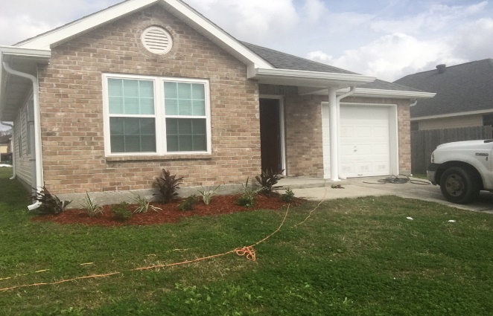
BeechGrove Properties
Westwego, LA

Slide 31
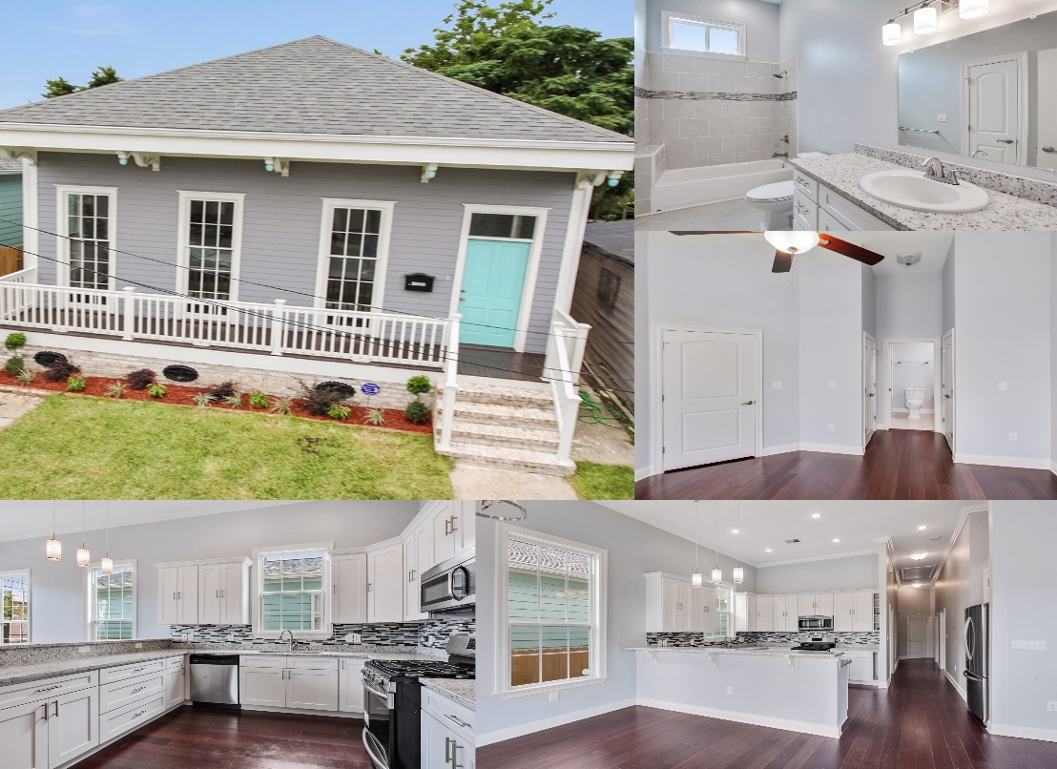
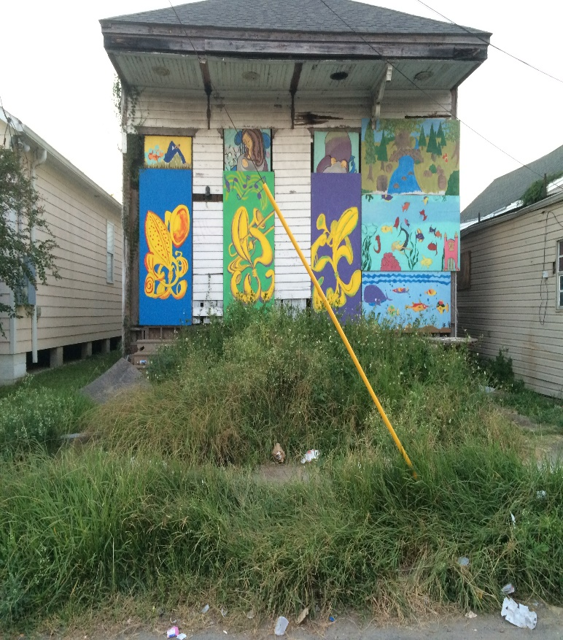
Historic Renovations

Slide 32
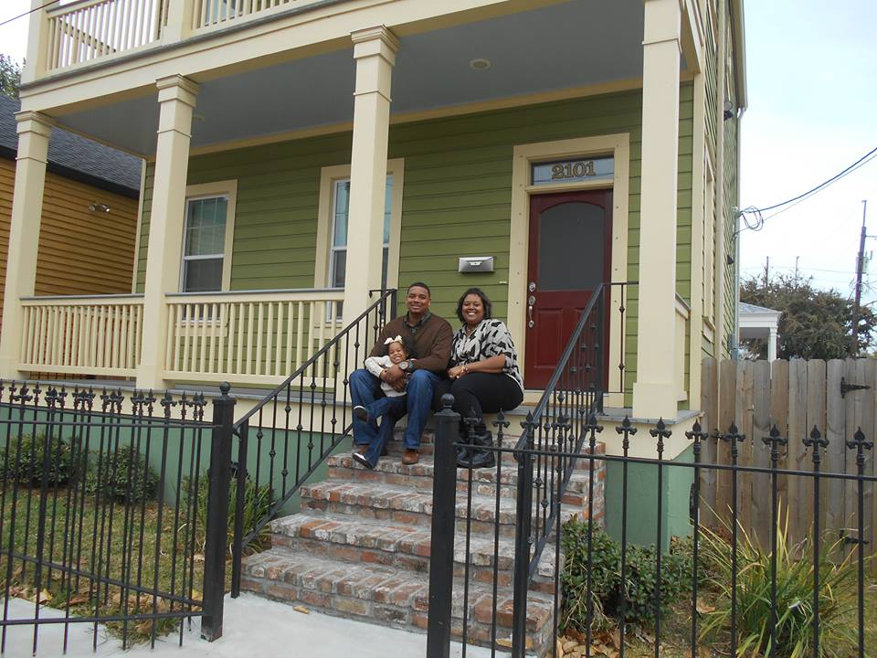

Slide 33
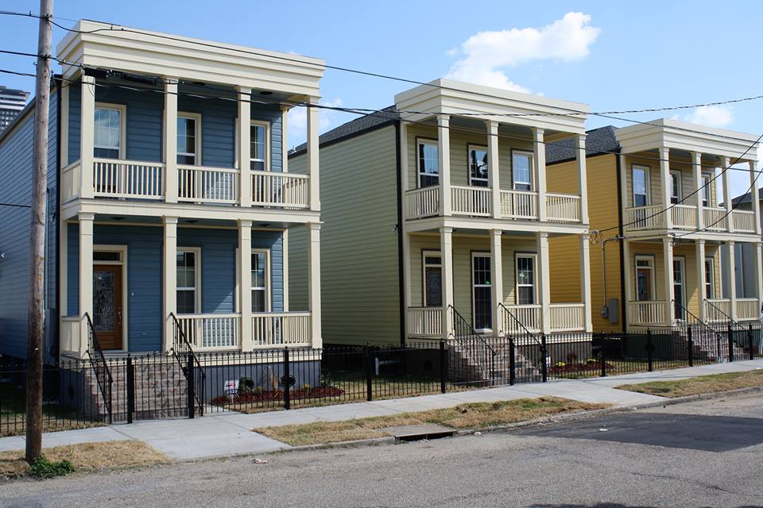

Slide 34

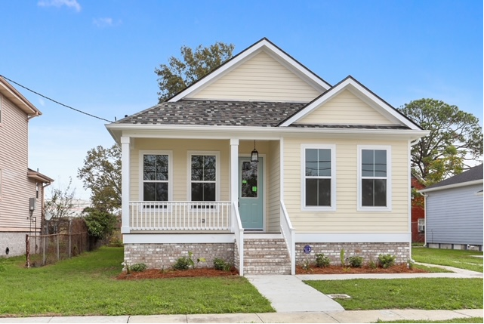
Pontchartrain Park
Two homes in the historic Pontchartrain Park subdivision include the new fortified construction standards. This will translate into a more weather resistant home and lower insurance rates.

Slide 35
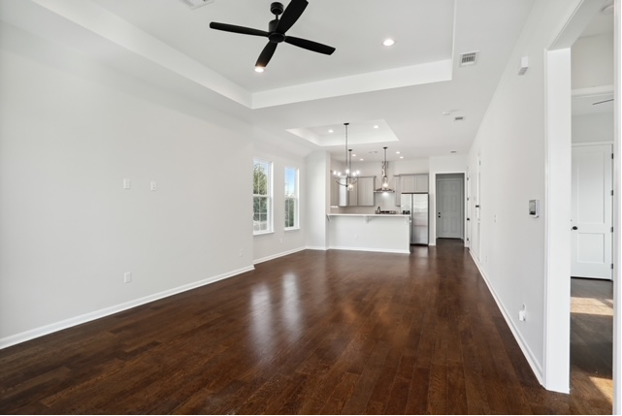
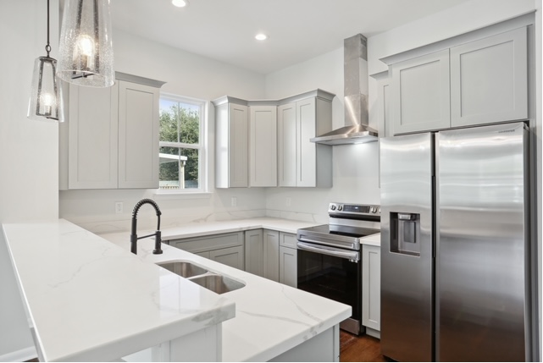
Pontchartrain Park

Slide 36
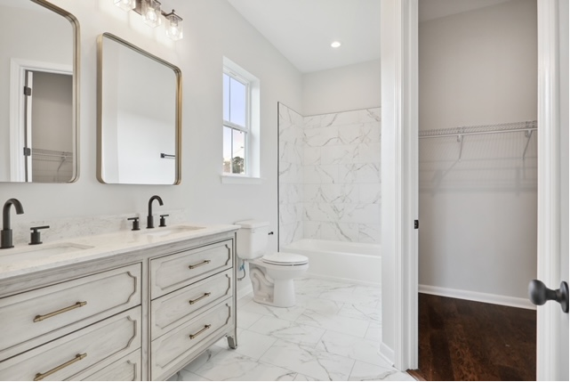
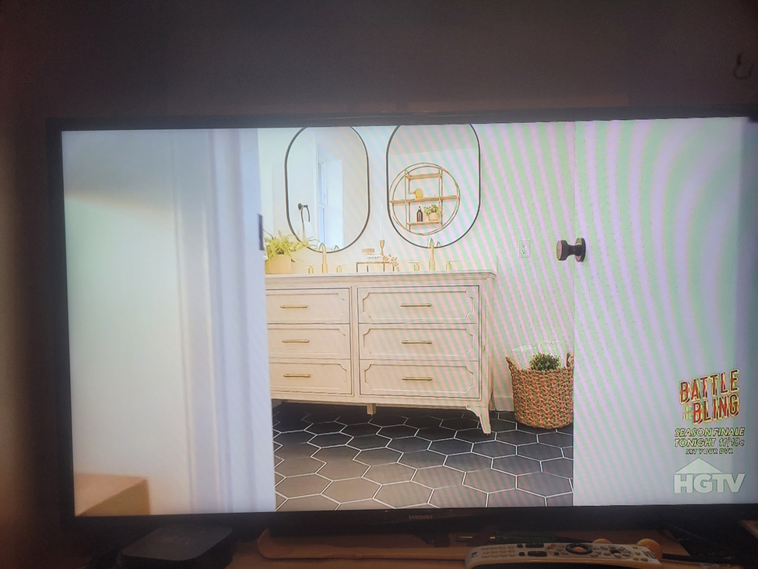
Pontchartrain Park

Slide 37
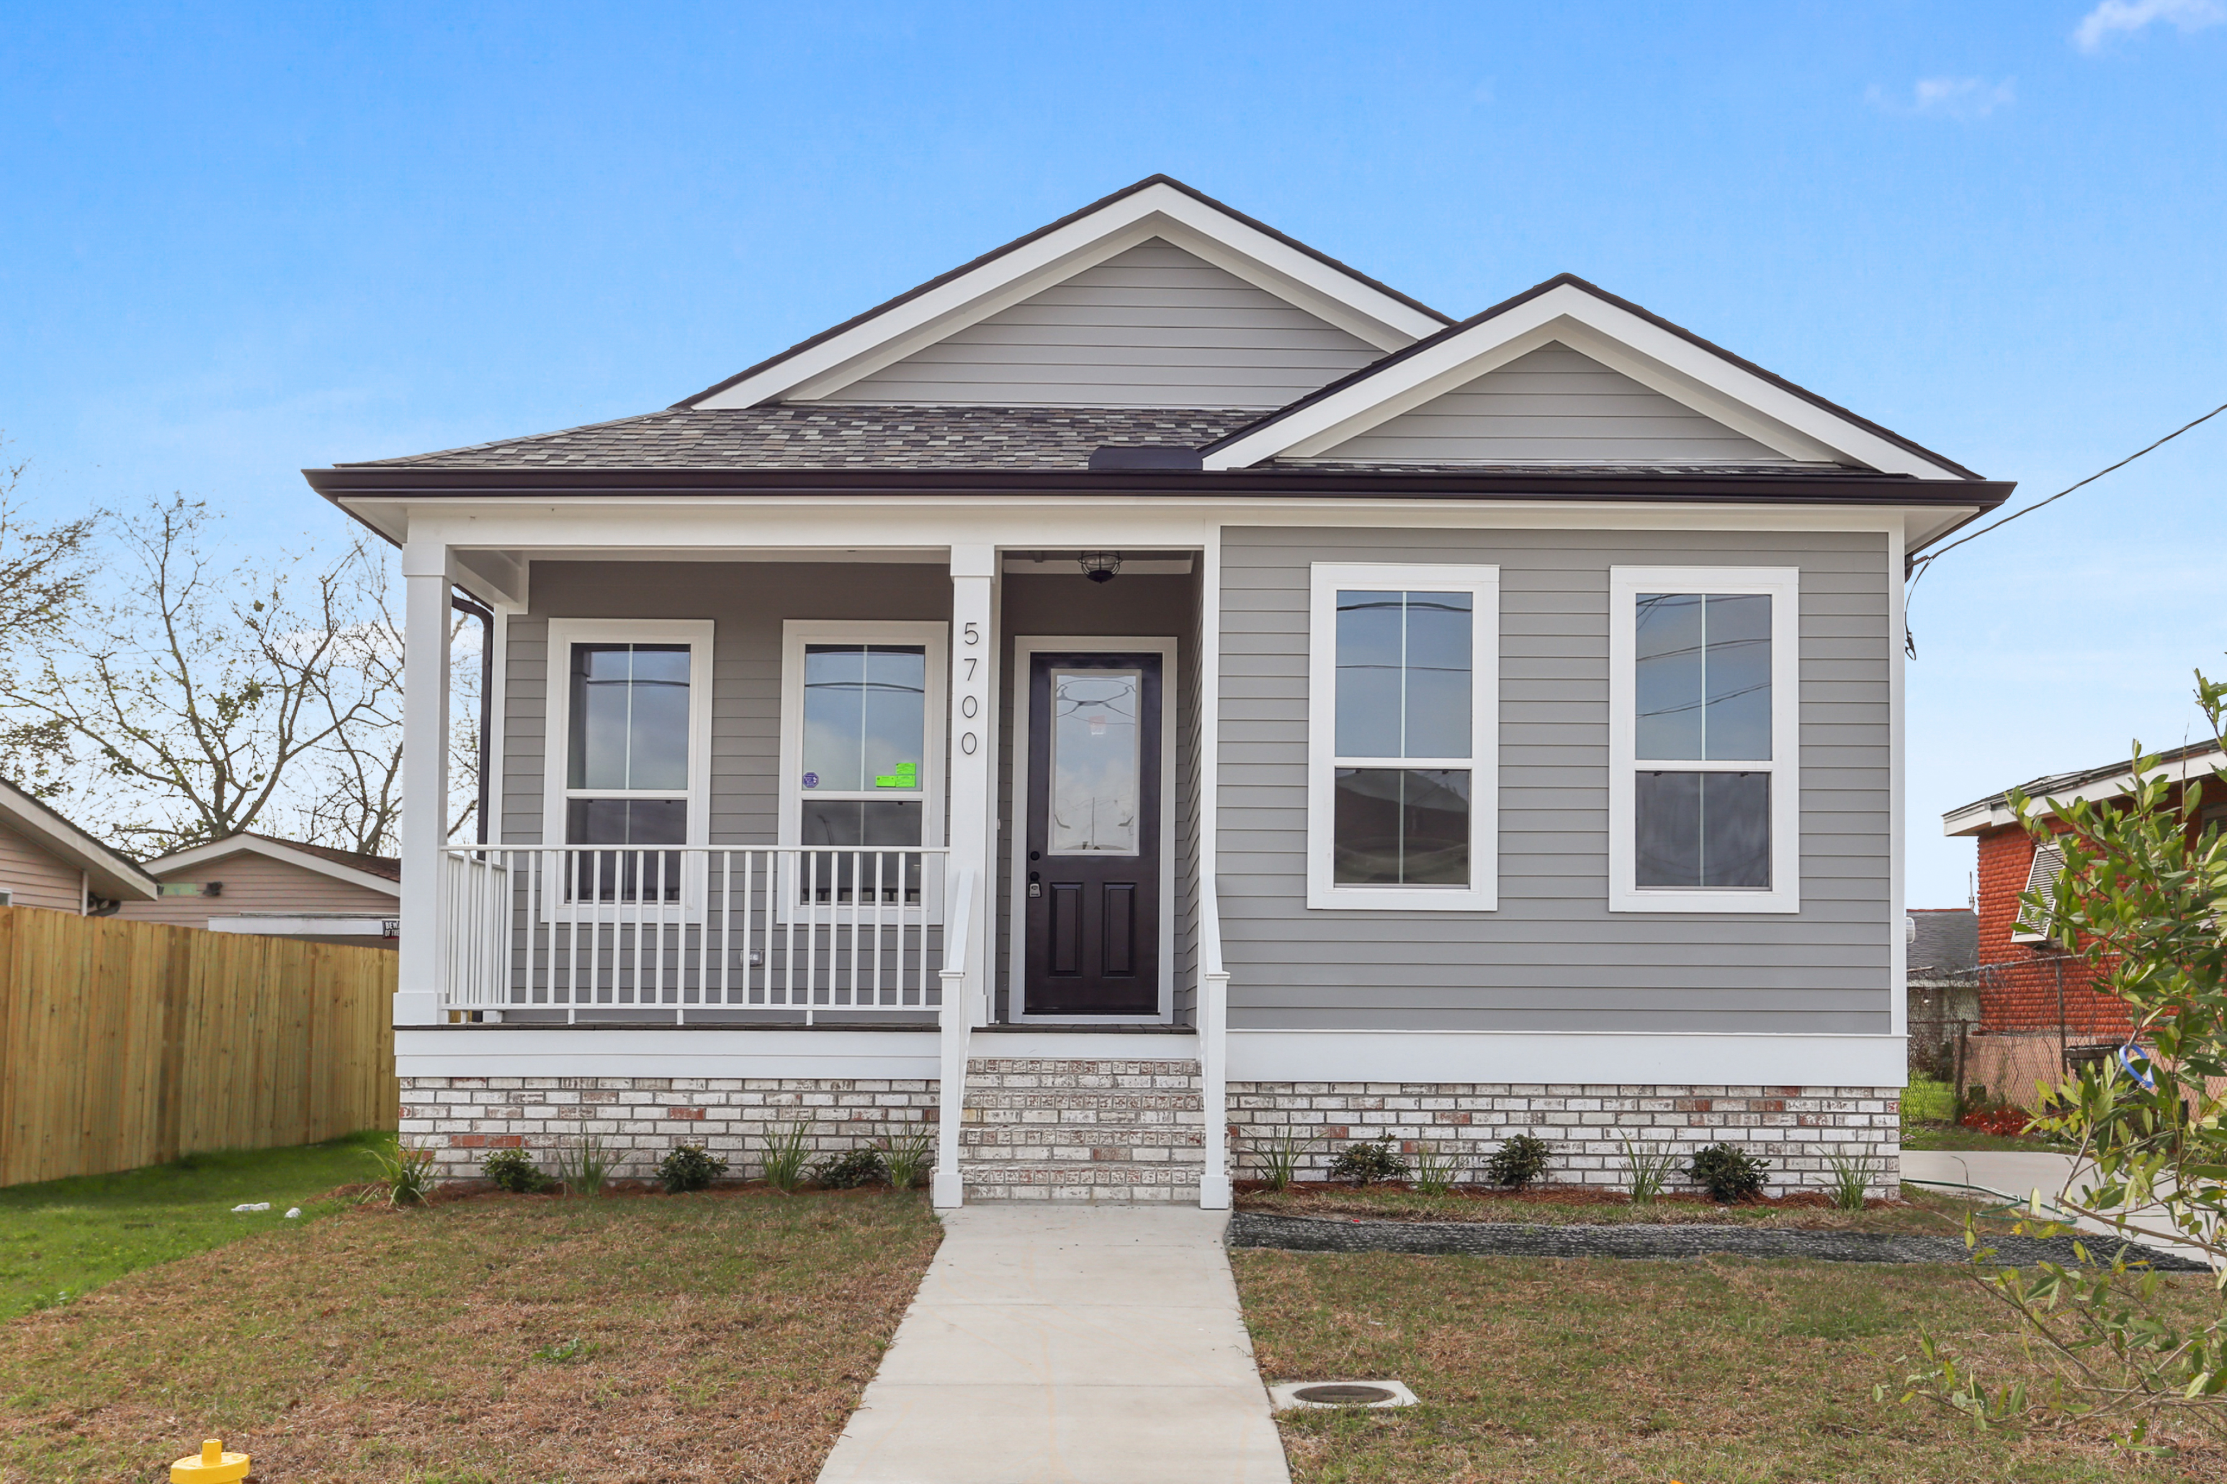
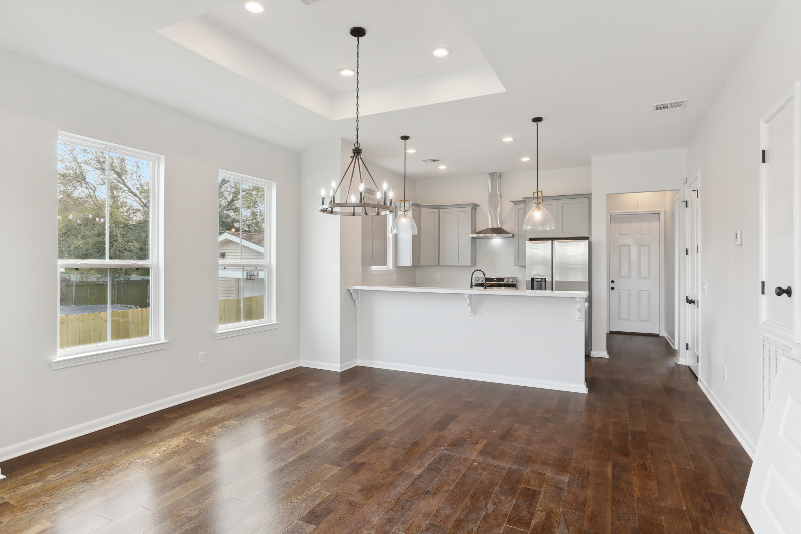
Pontchartrain Park

Slide 38
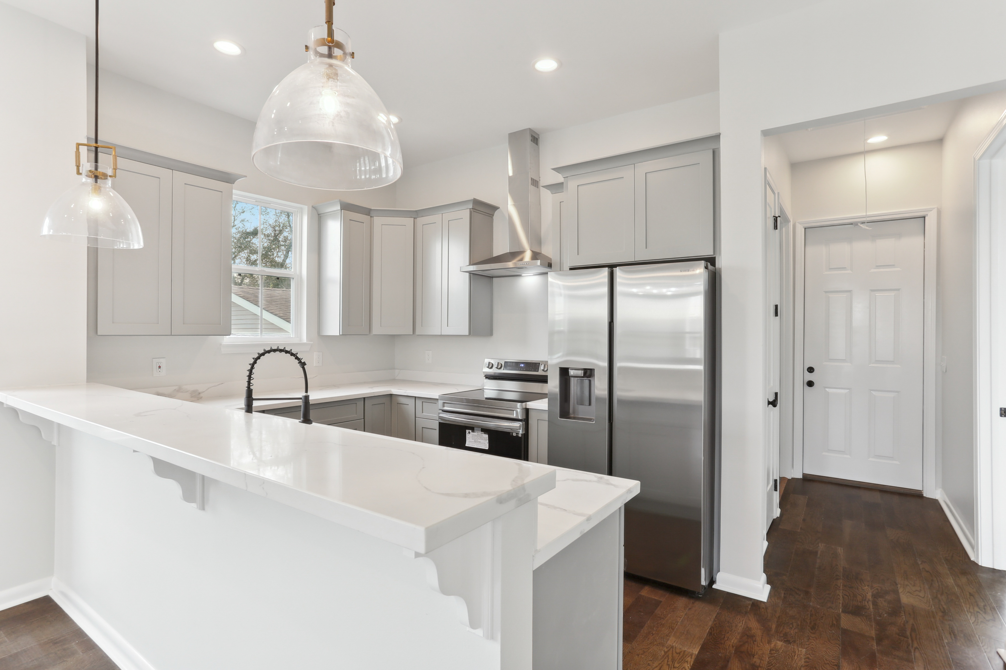
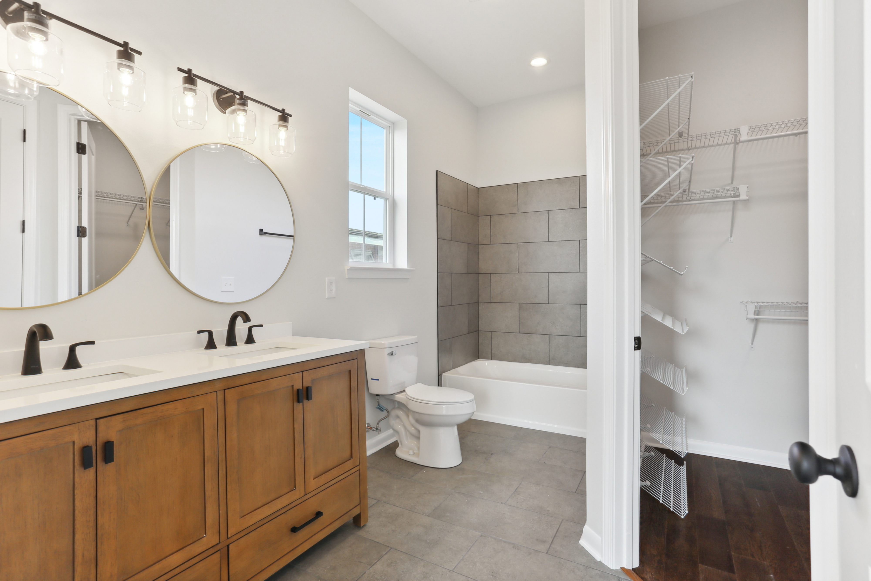
Pontchartrain Park

Slide 39
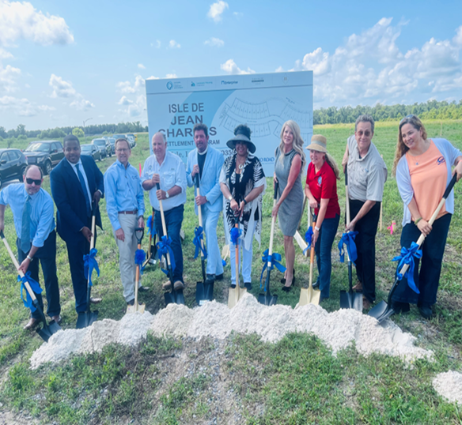
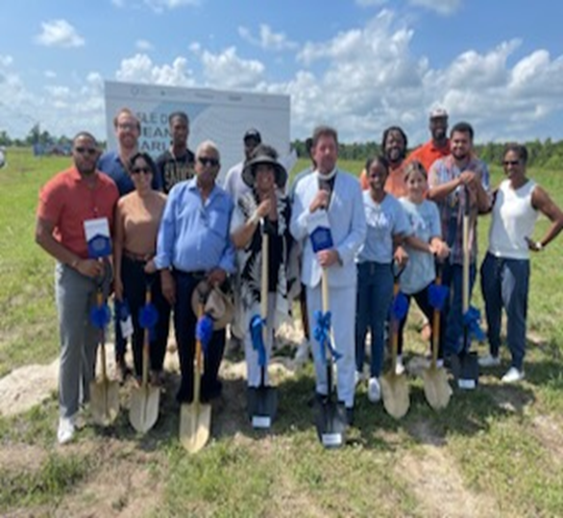
New Isle de Jean Charles

Slide 40
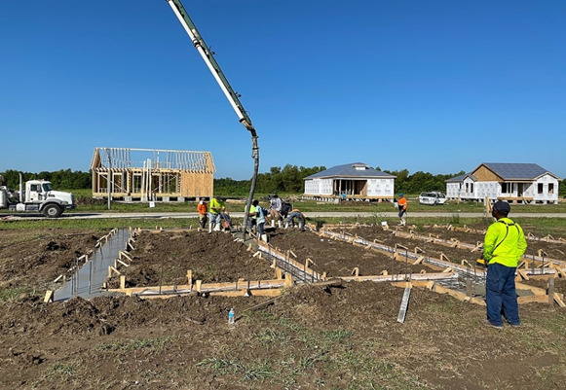
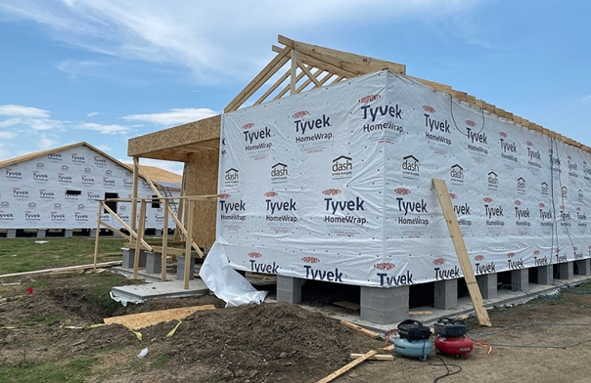
New Isle de Jean Charles

Slide 41


Slide 42
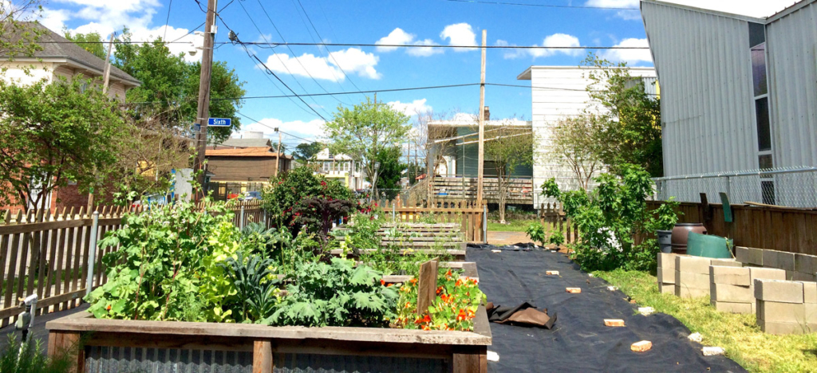

Slide 43
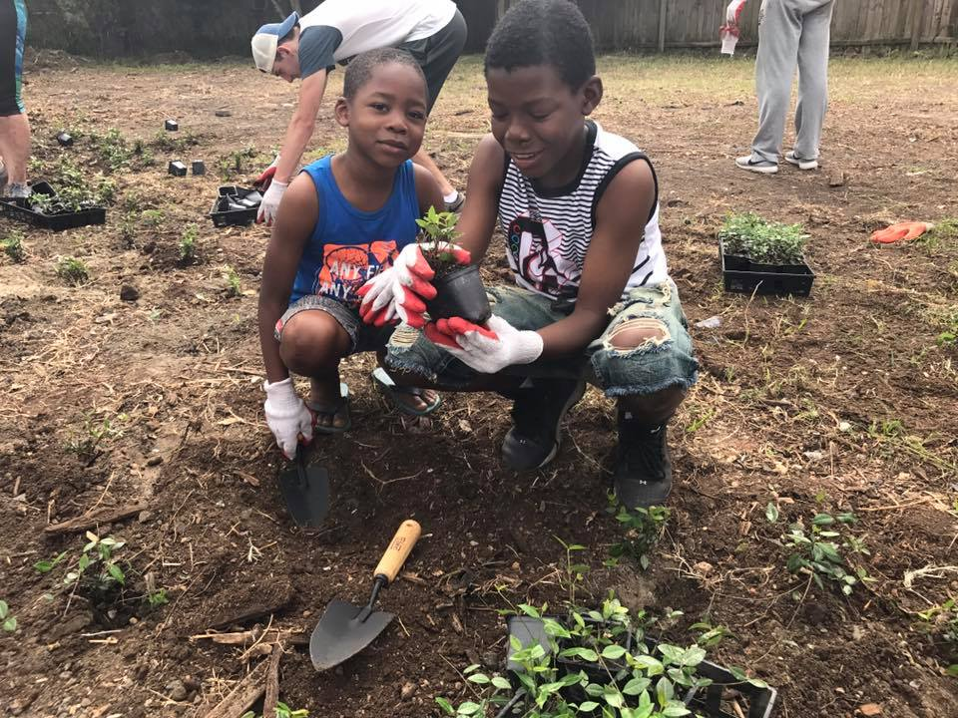

Slide 44
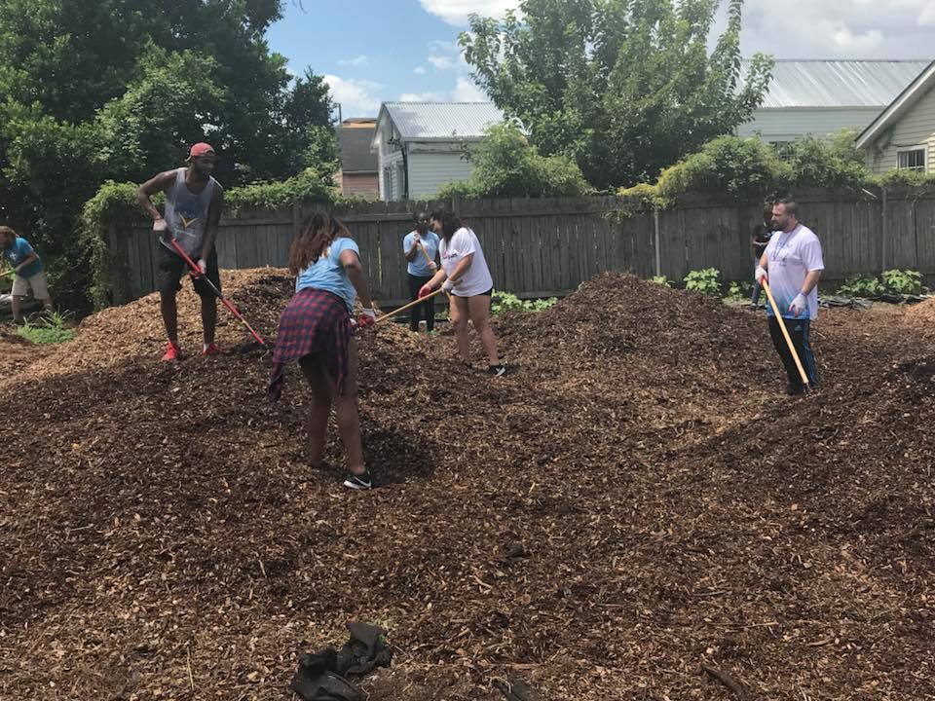

Slide 45
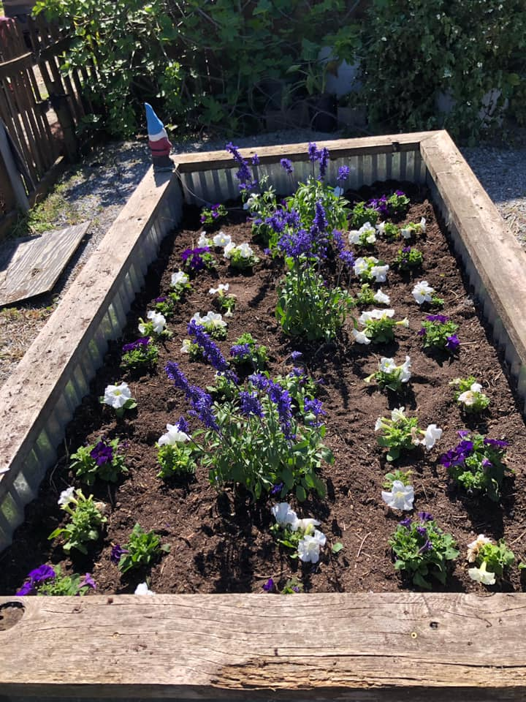

Slide 46


Slide 47
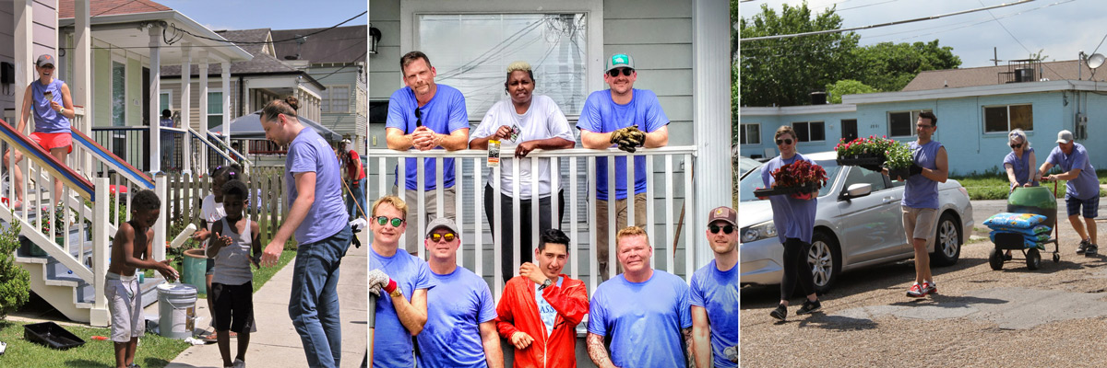
Community Engagement
Jericho Road has worked to support collaborations and establish lines of communication between neighborhood stakeholders, private businesses, and civic leaders. Informing and educating residents has transformative power.
Empowering residents cultivates ownership, giving people a vested interest in the things that happen in their community.
Engagement Includes:
Neighborhood Associations
“Central Circle” Monthly Stakeholder Meetings
Jericho Road’s “Bling your Block” Beautification program

Slide 48
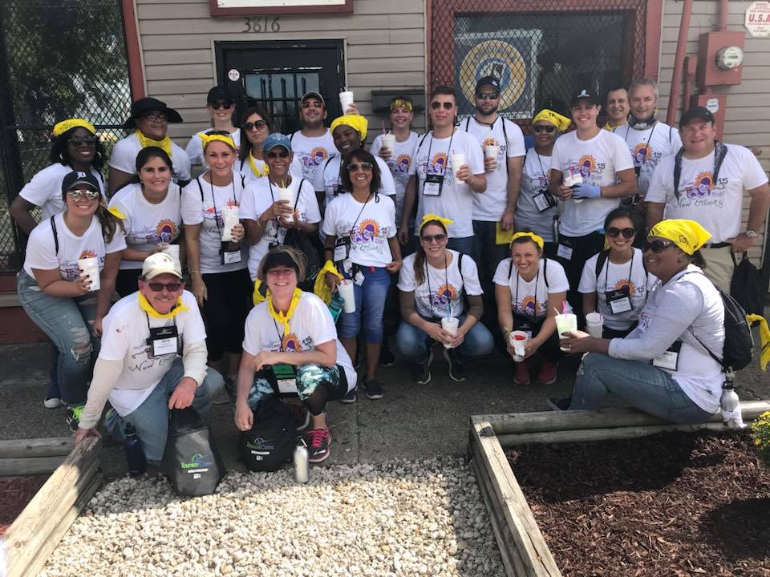

Slide 49
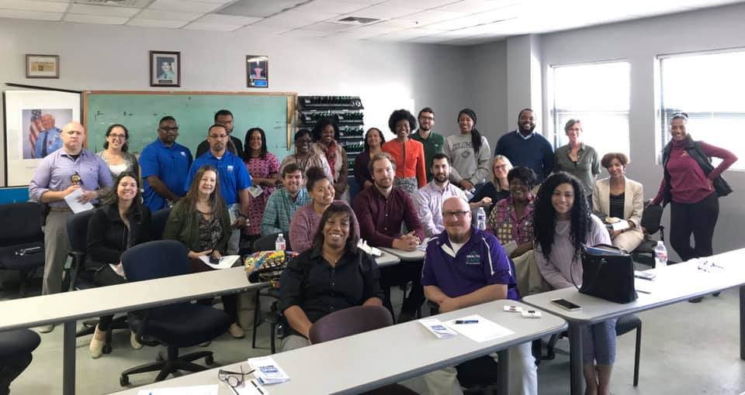

Slide 50
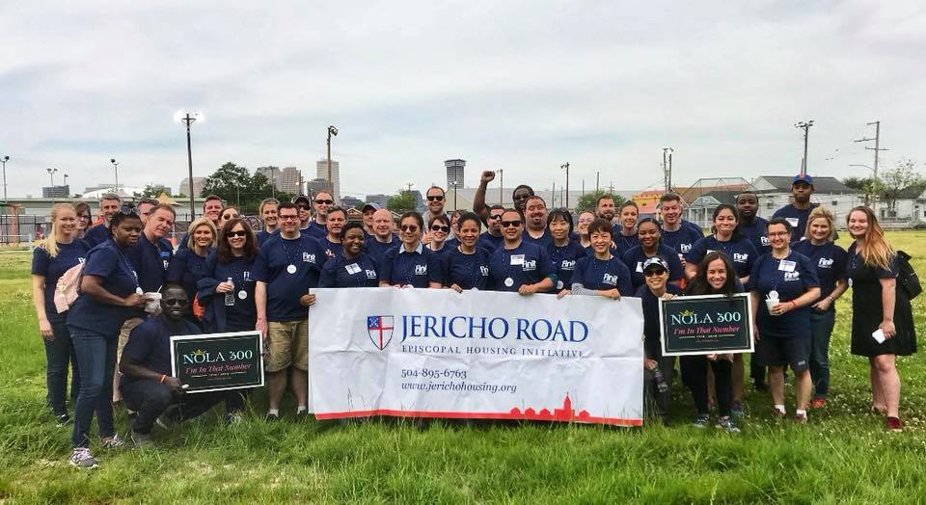

Slide 51
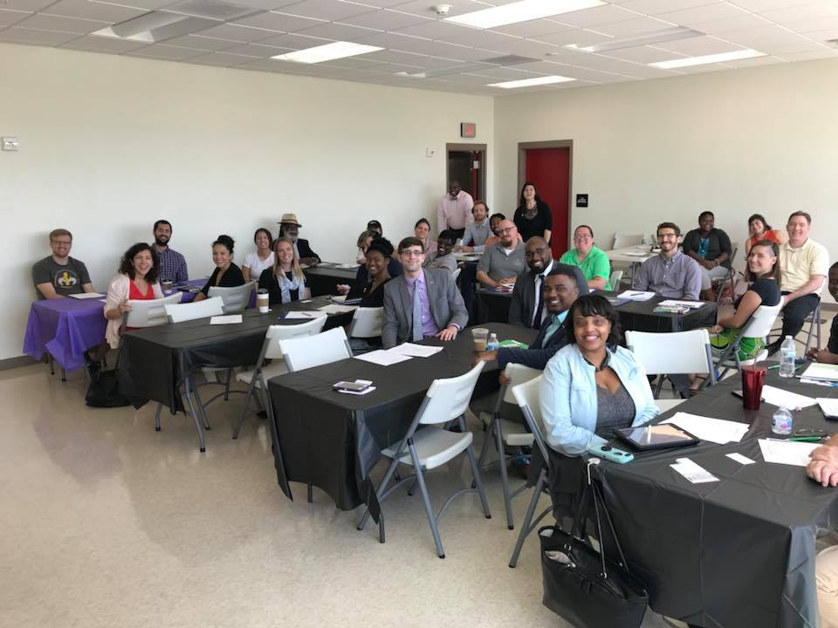

Slide 52


Slide 53


Slide 54


Slide 55


Slide 56


Slide 57


Slide 58


Slide 59



Slide 60


Slide 61


Slide 62


Slide 63


Slide 64

Living Wages = Homeownership

Slide 65



Homeowner Workshops

Slide 66


Homeowner Virtual Summits

Slide 67






Our Impact

Slide 68
Learn more about Jericho Road:
www.jerichohousing.org
Instagram: @jerichohousing
Facebook: @jerichoroadepiscopalhousinginitiative
Twitter: @jerichohousing

