Slide 1
Scalable Housing Models
Sustainable, Affordable, Resilient, Climate Proof
Preserving the Past: Building Wealth through Homeownership

Slide 2
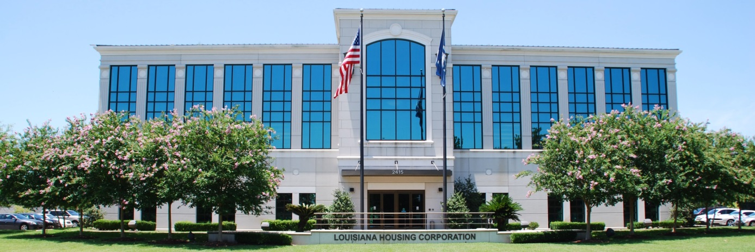
Scalable Housing Models Workstream
Louisiana Affordable Housing Innovation Solutions(LAHIS)
After receiving and reviewing the six (6) titles on the Think Tank Workstreams list, I chose to facilitate the Scalable Housing Models Workstream because I felt this subject matter would be a consuming, arduous research project and the most challenging.
Professional Construction practitioners were recruited to serve as chair and co-chair, who were willing to share their Construction expertise building with products in the following categories: On Site, Offsite, Prefab, Modular, Shipping Container, Cement, Metal , Bullet Proof, Sips and 3D Robotic Computer Printed Homes.
We also recruited a Regional Bank partner to engage in possibly financing affordable homes built with resilient materials.

Slide 3
When in doubt, Research!
The Committee had to take into consideration the Gulf Coast Climate Changes (G3C’s), to identify building products that could withstand Cat 5 hurricanes winds, rain , tornados, floods, termites, fire, etc. It was the Research that guided the outcome of our Work.
We consumed and catalogued Fourteen (14) National Housing studies and reports which shaped the path we had to take to address our States critical affordable housing shortage. A call to Action by President Biden, and HUD Secretary-Marcia Fudge, gave relevance to using manufactured housing to meet the critical 4.3 million housing shortage in our nation.
But how many homes were needed in the State of Louisiana? what about the increasing cost of building materials, labor shortages, rising interest rates and insurance costs, who could afford to purchase a home post covid, Ida, tornados etc. ? There were so many unknowns.

Slide 4
What is the Research Saying?
A June 2023, Zillow Monthly Real Estate report identified low-median income households as the largest home buying segment of the population. The 2020 HUD PG&R Report recommended Manufactured housing as an affordable housing option based on cost benefits, time, and resiliency. The Bipartisan study suggested using manufactured housing to build affordable starter homes to Scale, 2022.
To build a starter home in our state varies by zip codes, land cost, flood zones, appraised values and cost per sq. ft. The current 2023 cost per sq foot in Louisiana ranges $130.00.-$160.00. Defining affordability was easy. A 1280 sq. ft. starter home @ $130.00 per sq. add lot cost 20,000) sells for $186,000 add PITI (10,000) = $196,000 - $60,000 soft second/subsidies, first mortgage is $136,000. Is it possible for House notes to be cheaper than rent?
My colleagues on the other five (5) workstreams were tasked with addressing barriers to homeownership which included, zoning, appraisals, interest rates, land cost, insurance, lack of subsidies, housing discrimination all of which are critical pieces to creating housing affordability. During our research, It was literally impossible to find current housing statistics in Louisiana.

Slide 5
Finding the Facts!
Bloomberg Black Wealth Data Center, and Stacker reports the Black Homeownership rate in Louisiana was 48.8 %, fifth highest among all states, compared to 76.55% rate of homeownership among whites. Our wealth gap is 27.8 %, 11th lowest in the nation. Our wealth gap rate is holding steady compared to the decline in Black Homeownership rates nationwide.
Homeownership is in great demand, yet our State has a underproduction of 9.4 k homes. (University of Utah, Innovators affordable Housing Program Study 2022). This number does not reflect older homes in need of preservation that could be placed back into commerce.

Slide 6
Map

Slide 7
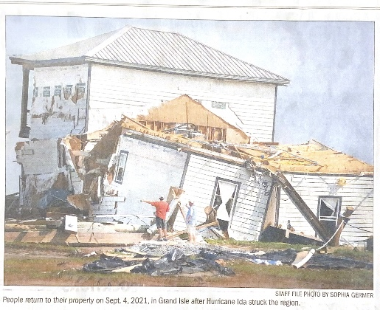
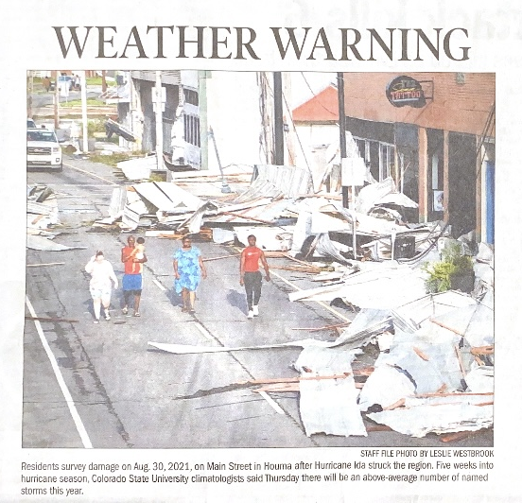
A picture tells a thousand words!

Slide 8
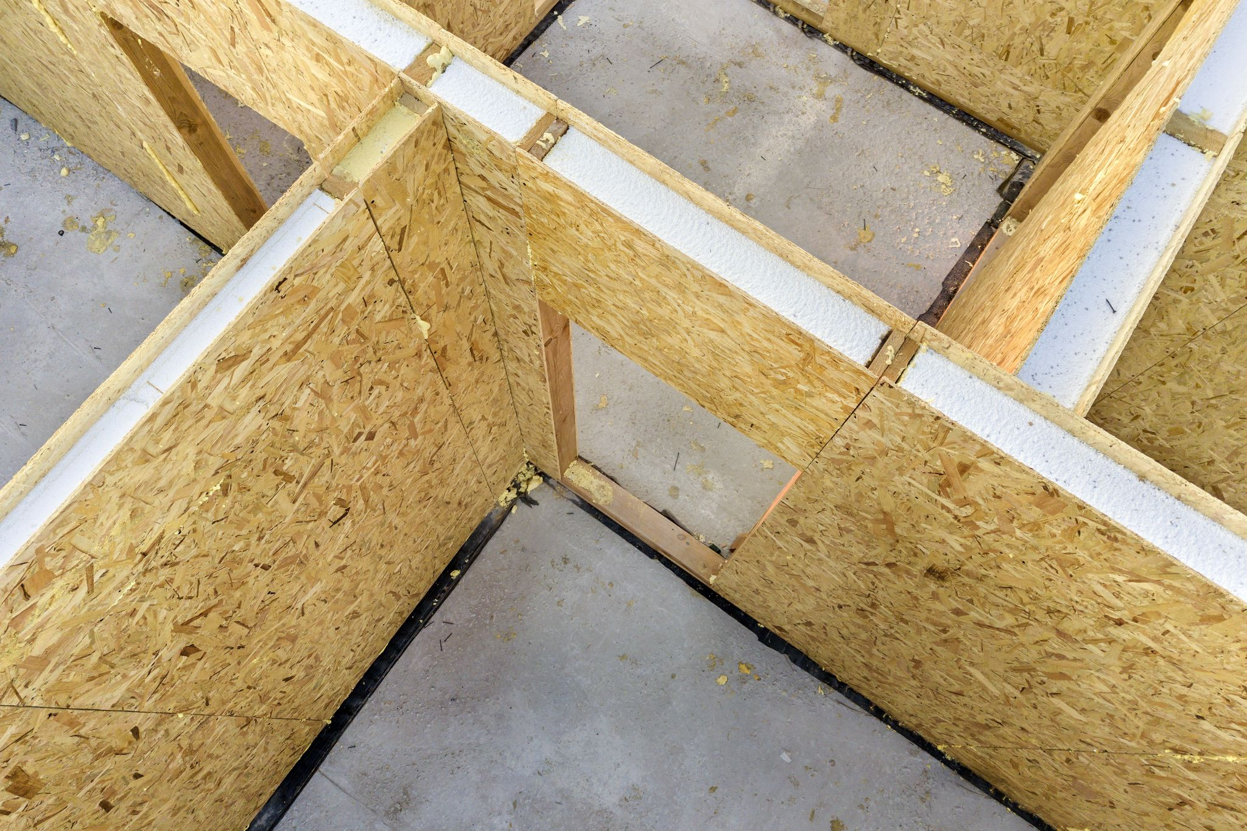
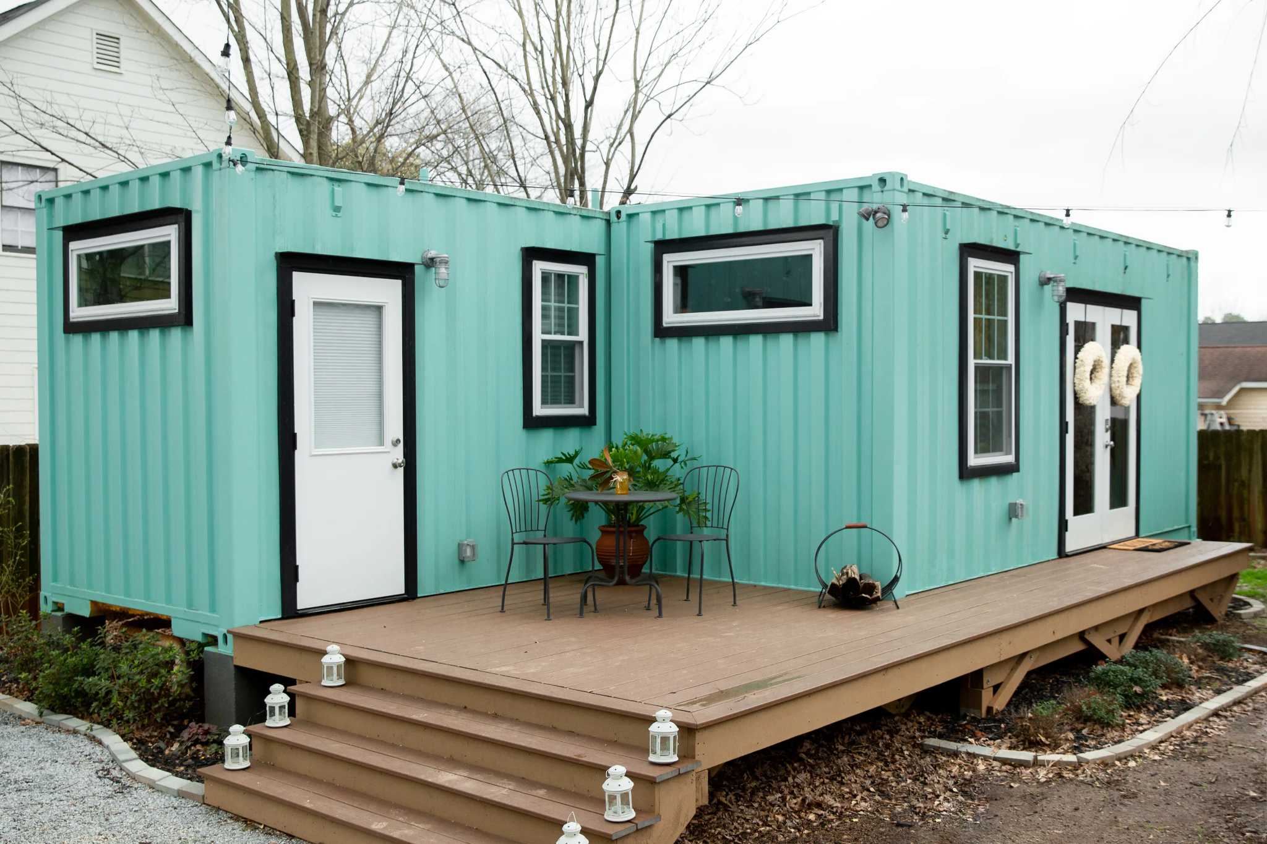
Structural Insulated Panels
Shipping Container

Slide 9
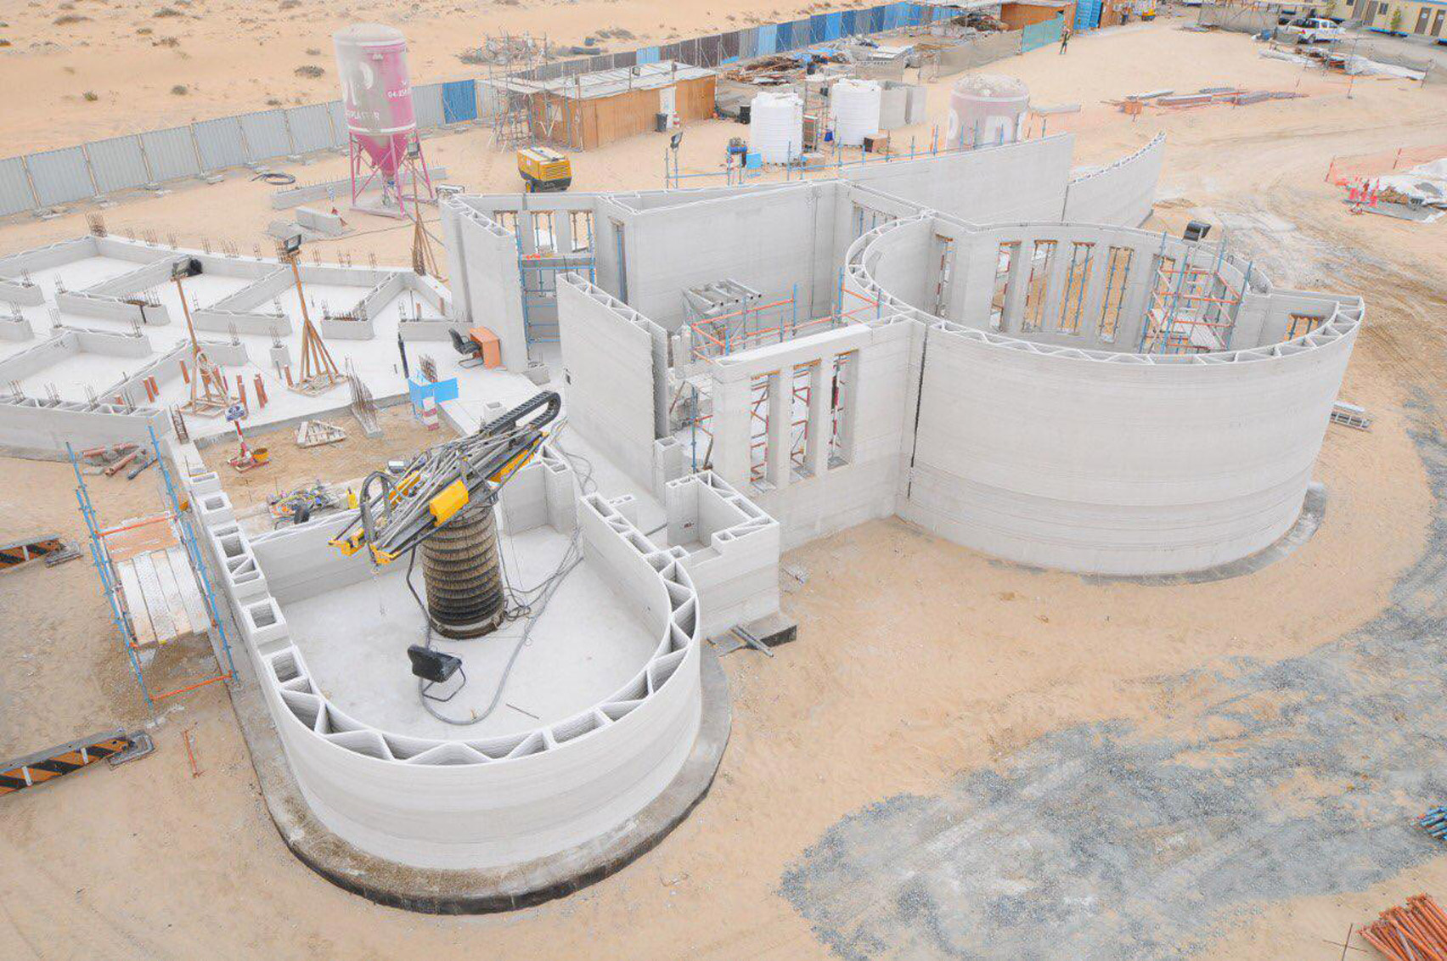
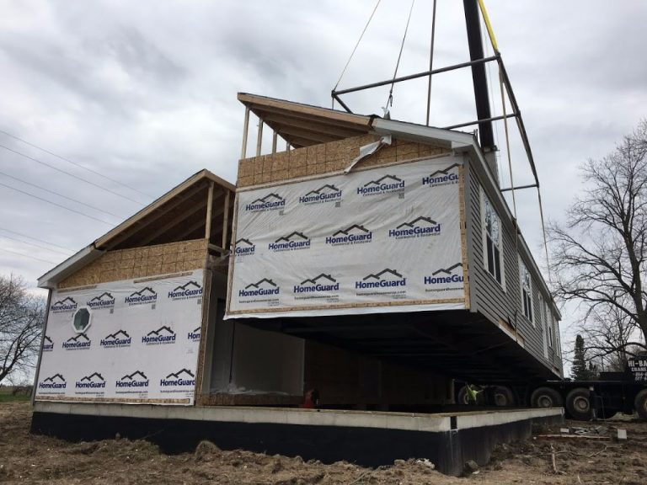
3D Printer
Modular Homes

Slide 10
Our work has only just begun. The Louisiana Statewide Homeownership Think Tank, Scalable Housing Workstream and its partners recommends the Louisiana Housing Corporation, Office of Community Development, FEMA, Banks, Corporations and the Philanthropic community to:
1. ﻿﻿﻿Fund a Statewide Resilient Single Family Homeownership Model Program, incorporating the use of On and Off site Manufactured Housing Materials: Cement, Sips, Modular Components, Shipping Containers and 3D Robotic Computer Print homes, etc., 2. ﻿﻿﻿Unite Workforce Development, Community Colleges, State, and HBCUs- Schools of Architect, Construction, Computer Technology and Engineering to partner with us on all methods of Resilient manufactured housing development to increases affordable housing supply, create new careers and jobs in our State. 3. ﻿﻿﻿Produce a Comprehensive Statewide Housing Assessment Study 4. ﻿﻿Create a Center for Disaster Housing Recovery 5. ﻿﻿﻿Be the first to lead the Nation in Resilient Housing Development 6. ﻿﻿﻿Increase Statewide homeownership rates for low median income families and communities of color 7. ﻿﻿﻿Support preserving the past: Building wealth through Homeownership! 8. ﻿﻿﻿Reduce insurance rates for homes built with resilient materials Special Thanks to all (18) committee members who contributed their time and curiosity to this subject. And Now, please join me in Welcoming a distinguished panel of forward thinking Innovating Housing Visionaries.

