Slide 1
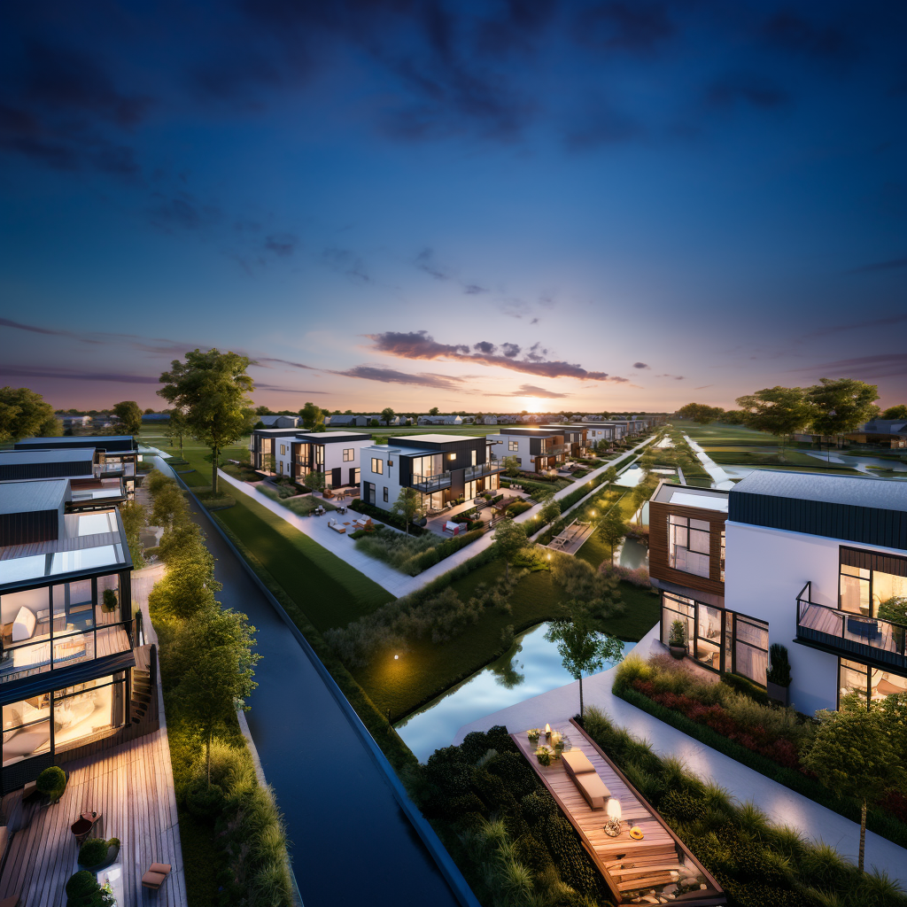
EcoVista: Resilient Agri-communities
A Hurricane-Resistant Oasis in Louisiana
The CleanTech Development Institute
Notes:
Slide presentation on a 400-unit hurricane-resistant DER (Distributed Energy Resources) smart agri-community in Louisiana.

Slide 2
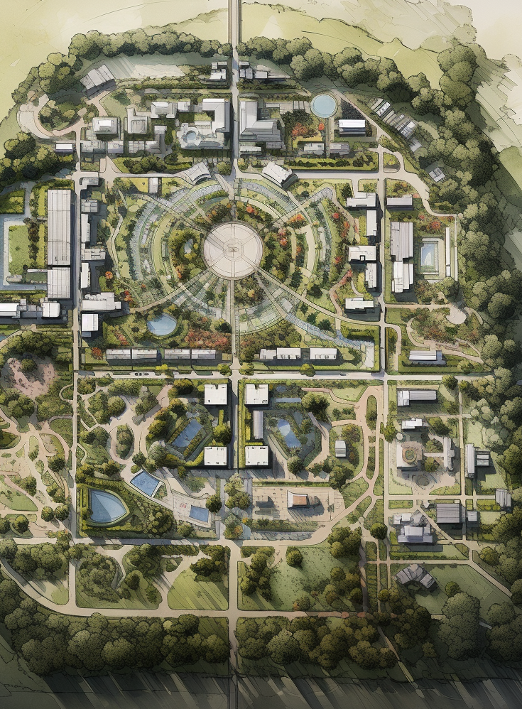
Table of Contents
Introduction
Who we are
What we do
Project I (Community Prototype)
Smart and Connected Community-LA
Welcome to Resilience
Sustainable Agriculture
Regenerative Design Resilience
Smart and Connected Infrastructure
Independent WET Nexus Microgrid: Distributed Energy Resource
Infrastructure
Gray Water Systems
Internet Connectivity**
Healthcare
Community Storehouse
Environmental Impact
Benefits
Conclusion

Slide 3
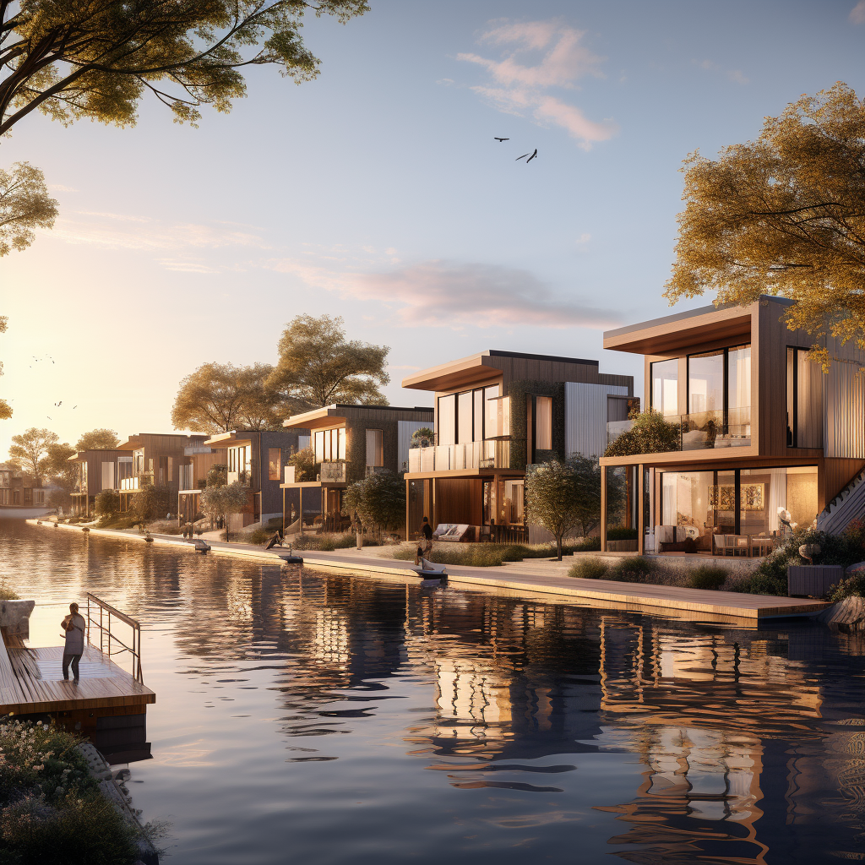
Who Is The CleanTech Development Institute?
Mission
Core values
Value Proposition
TEAM
Dawnita M. Roberts
J. Reid Gorman
Derrick Clyburn Ballard

Slide 4
Services
Design
Development
Energy Management
Economic Development
Voucher Program Assistance
Home Ownership Assistance
Clean Energy Solutions Homes
Municipalities

Slide 5
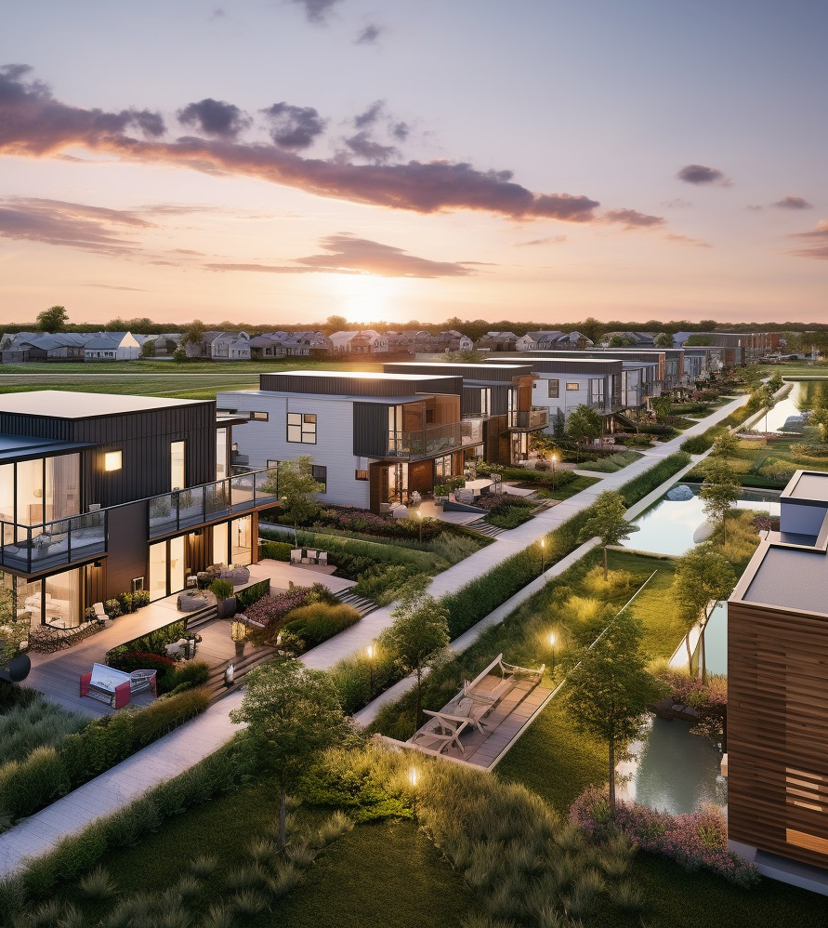
Belle Point Resilient Agrihood:
A Smart and Connected Hurricane-Proof Housing Development**
Notes:
Welcome to the future of sustainable living at Belle Point Resilient Agrihood, a cutting-edge, hurricane-proof housing development situated in the heart of Louisiana. Embracing innovation and sustainability, this community redefines modern living by combining regenerative design principles, a smart and connected infrastructure, and an independent WET (Water, Energy, and Technology) nexus microgrid to create an unparalleled living experience.

Slide 6
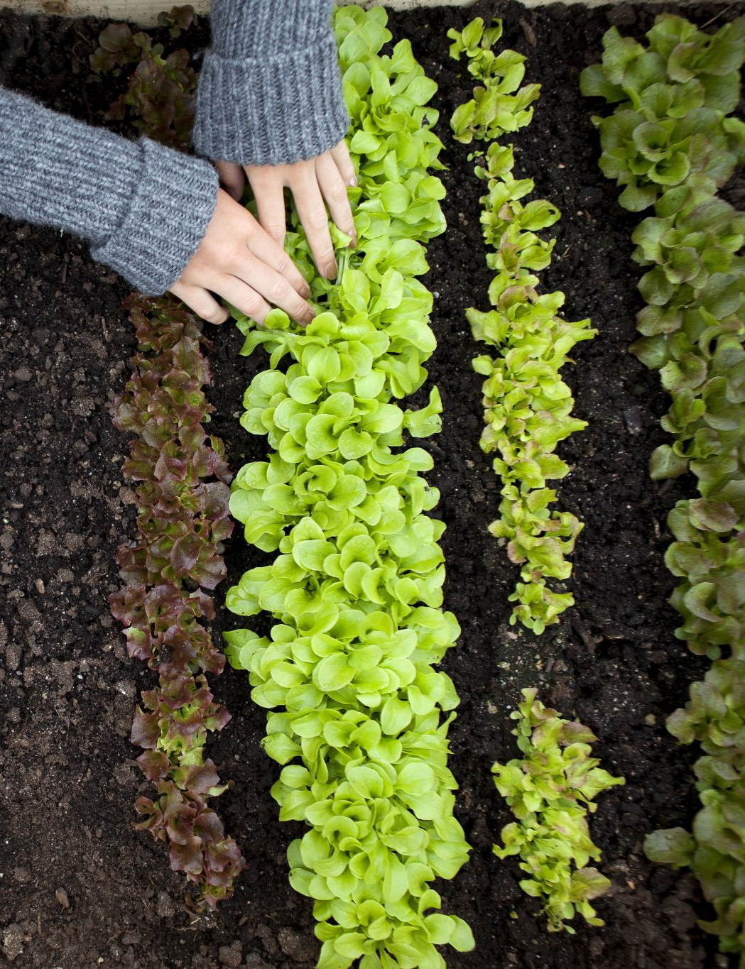
Sustainable Agriculture
Incorporating advanced agricultural practices
Local food production
Community gardens

Slide 7
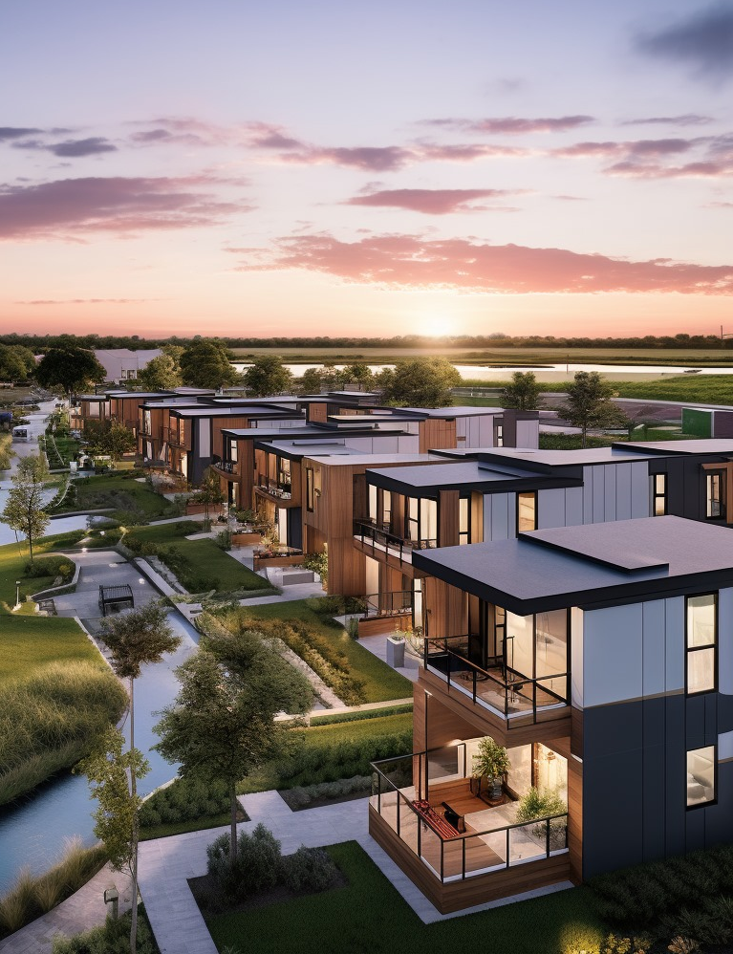
Regenerative Design
For CDI. sustainability is more than just a buzzword—it's a way of life. Our expert architects and planners have meticulously crafted each home and community structure to optimize energy efficiency, reduce waste, and promote a harmonious relationship with nature. The architecture seamlessly blends into the surrounding landscape, minimizing its ecological footprint while enhancing the overall aesthetic appeal.
The agrihood concept fosters a self-sustaining ecosystem, encouraging residents to actively participate in organic farming, biodiversity conservation, and responsible land management practices.

Slide 8
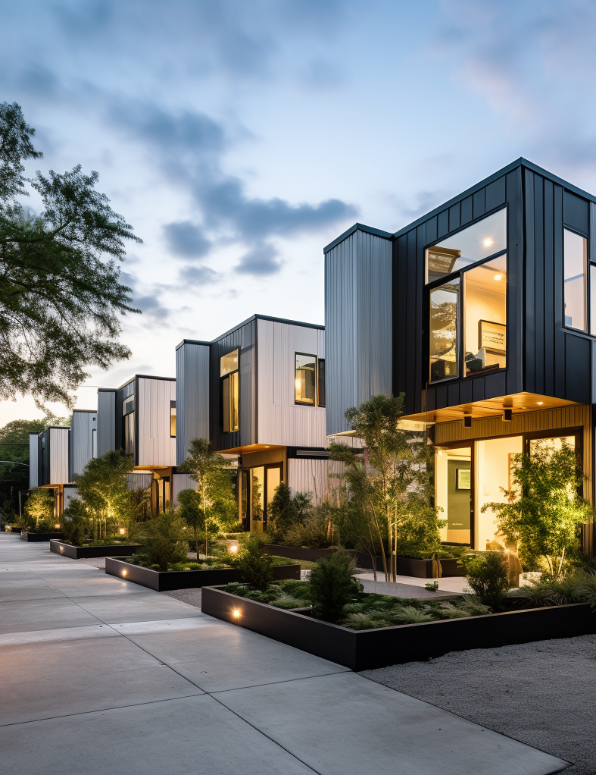
Resilience
Hurricane-resistant design
Building materials and construction techniques
Disaster preparedness
Hurricane-Proof Housing:
Located in a region prone to hurricanes, the safety and security of our residents are of utmost importance. The housing development boasts a pioneering hurricane-proof design, featuring robust materials and structural reinforcements that can withstand extreme weather events. Additionally, the strategic layout incorporates natural barriers to minimize storm impact and incorporates a comprehensive emergency response plan to ensure residents' safety during adverse conditions.

Slide 9
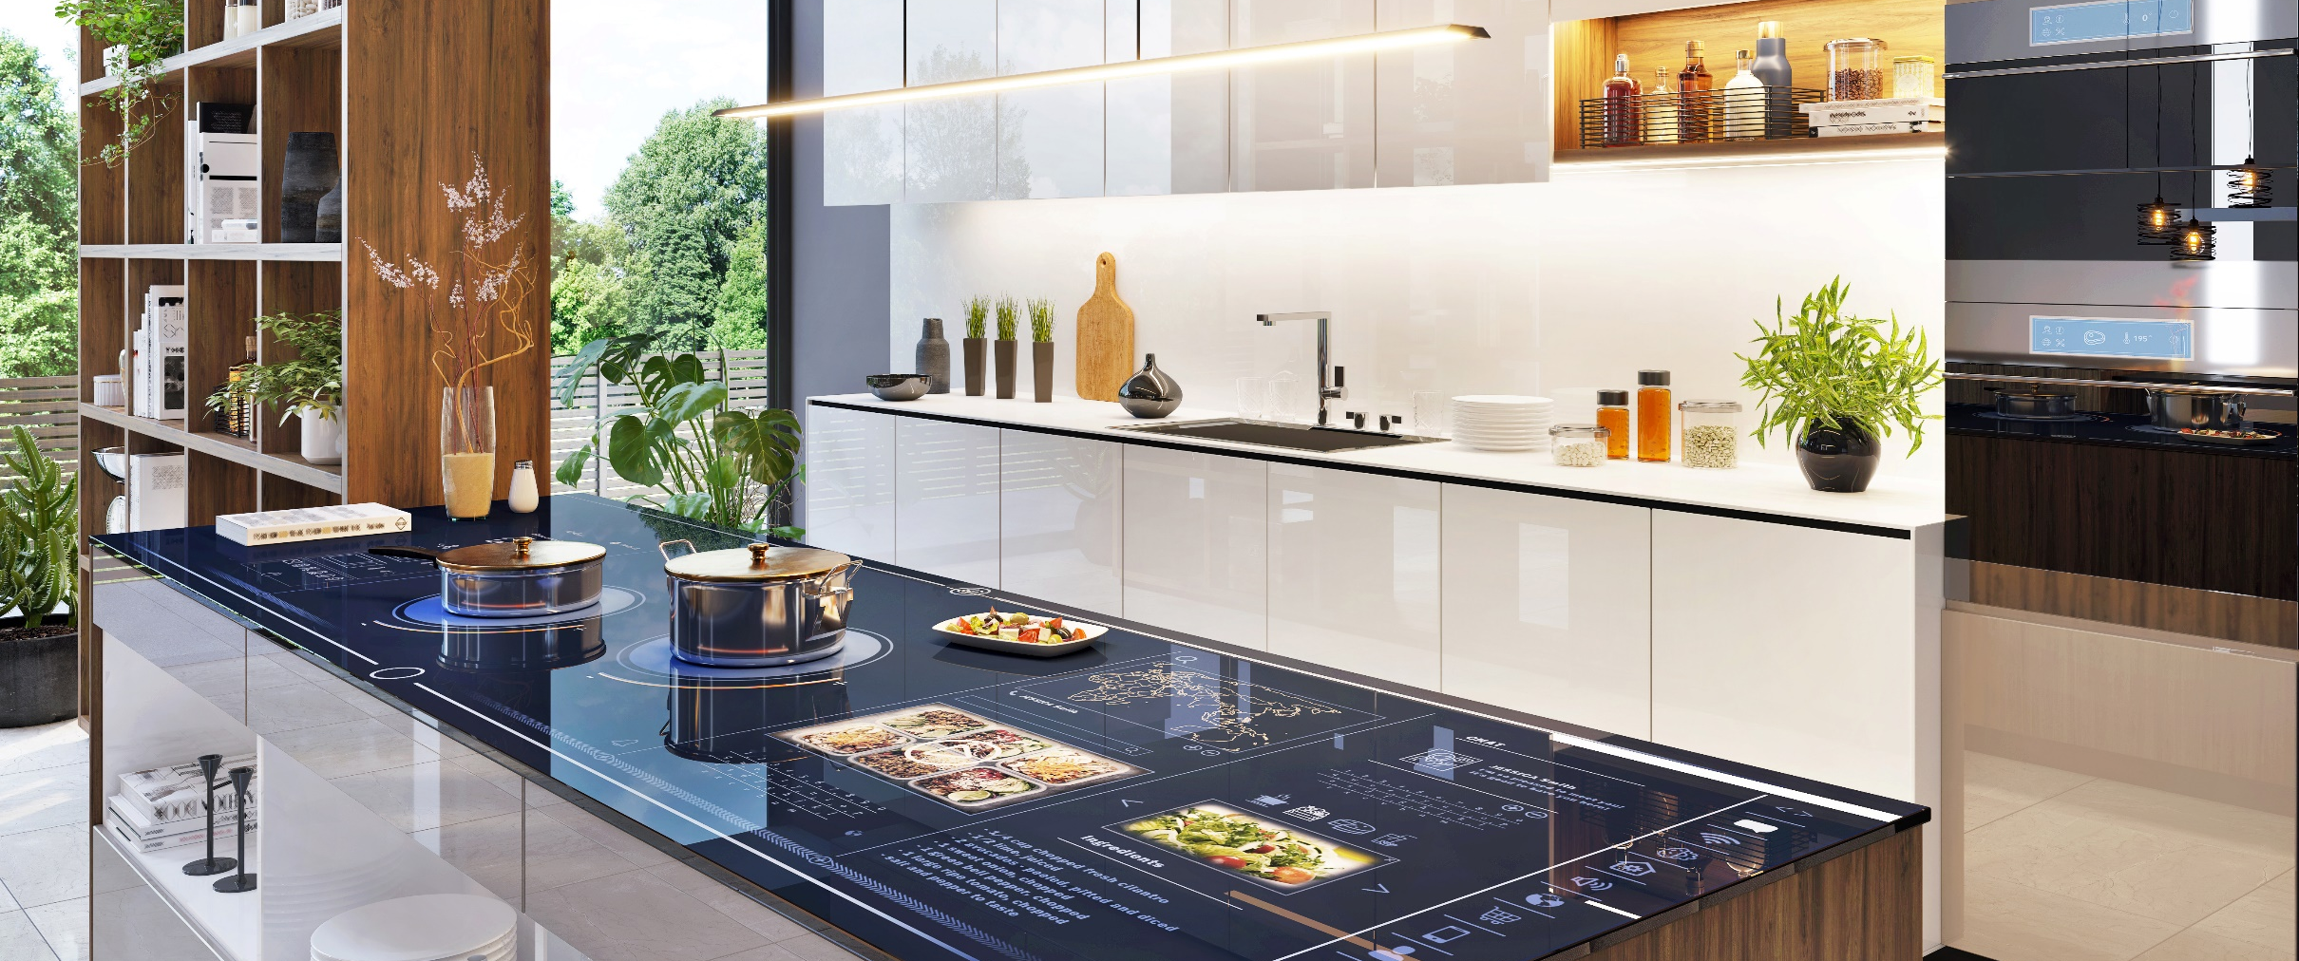
Smart and Connected Infrastructure
Our Resilient Agrihoods are havens of smart technologies that work in unison to simplify daily living and enhance comfort.
Every home is equipped with cutting-edge IoT (Internet of Things) devices, enabling residents to control lighting, climate, security, and appliances remotely through integrated smart home systems. Moreover, an AI-powered central management platform optimizes resource usage, ensuring energy efficiency and waste reduction across the community.

Slide 10
Independent
WET Nexus
Microgrid
At the core of our energy infrastructure lies the innovative WET nexus microgrid—an independent, self-sustaining system that efficiently harnesses and manages the essential resources of Water, Energy, and Technology. This groundbreaking microgrid integrates solar panels, wind turbines, and advanced energy storage solutions to harness renewable energy and reduce dependence on the conventional grid. Rainwater harvesting and graywater recycling systems promote water conservation, making Belle Point a model for resource management and resilience.
Gray Water Systems
Utilizing retention ponds
Water recycling
Sustainable water management
Smart Grid
Self-healing smart grid infrastructure
Efficient energy distribution
Grid resilience
Internet Connectivity
Free high-speed internet for all residents
Promoting digital inclusion

Slide 11
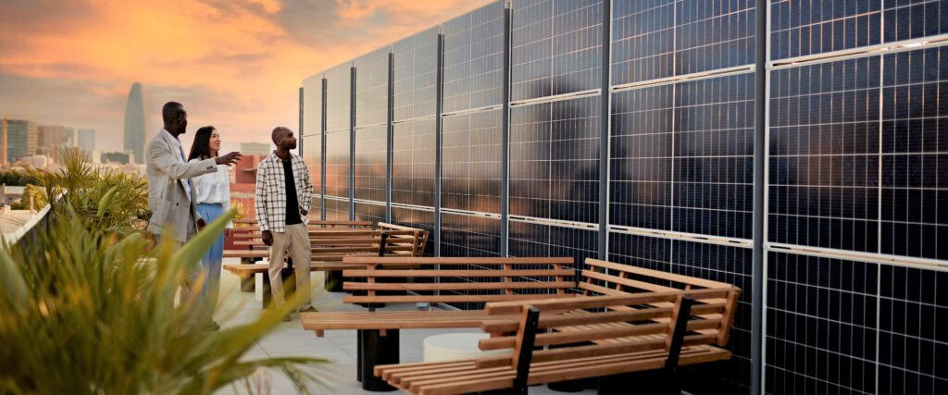
Distributed Energy Resource Infrastructure Master Plan
This plan orchestrates the integration of various renewable energy sources, storage technologies, and intelligent energy management systems, creating a robust, reliable, and decentralized energy network. This not only ensures a consistent power supply but also paves the way for the agrihood to share surplus energy with neighboring communities, fostering regional sustainability and collaboration.
Integration of solar panels
Wind turbines
Energy storage systems
Energy independence
Modern utilities companies are under growing pressure to reduce carbon emissions and transition to renewable energy sources. For the first time in history, utilities are not the sole energy providers, as distributed energy resources (DERs) owned by third parties and prosumers are also producing power for the grid. Lower costs for photovoltaic (PV) solar equipment and other renewable energy assets, along with government incentives, are driving the growth of DERs in the energy sector.
Leading the charge toward these new operational models are prosumers. As a whole, prosumers demand more from their utility service providers, including more control over on-demand services, improved self-sufficiency, and transparency on their own terms. While DER asset owners may at first seem like a competitor on the energy market, the most innovative and fearless utilities industry leaders not only accept that these changes are coming but are already seizing new opportunities for growth and industrial diversification.

Slide 12
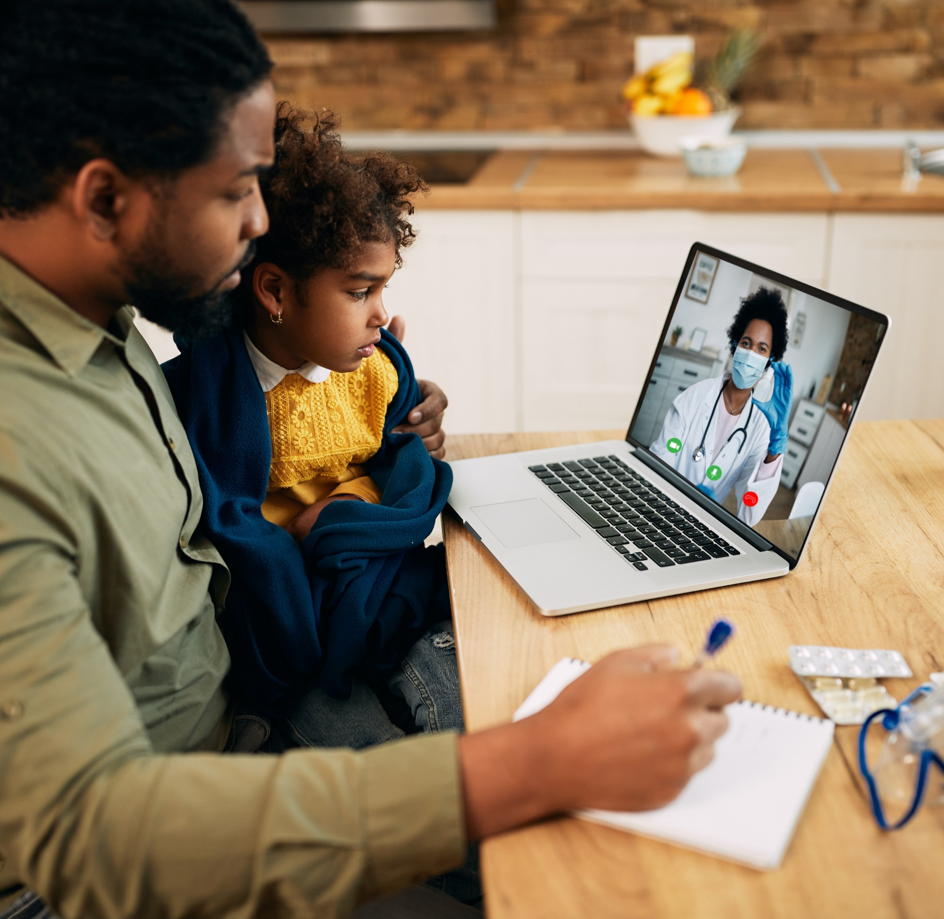
Telemedicine
Healthcare
On-site healthcare facilities
Tele-present healthcare services
Promoting community well-being

Slide 13
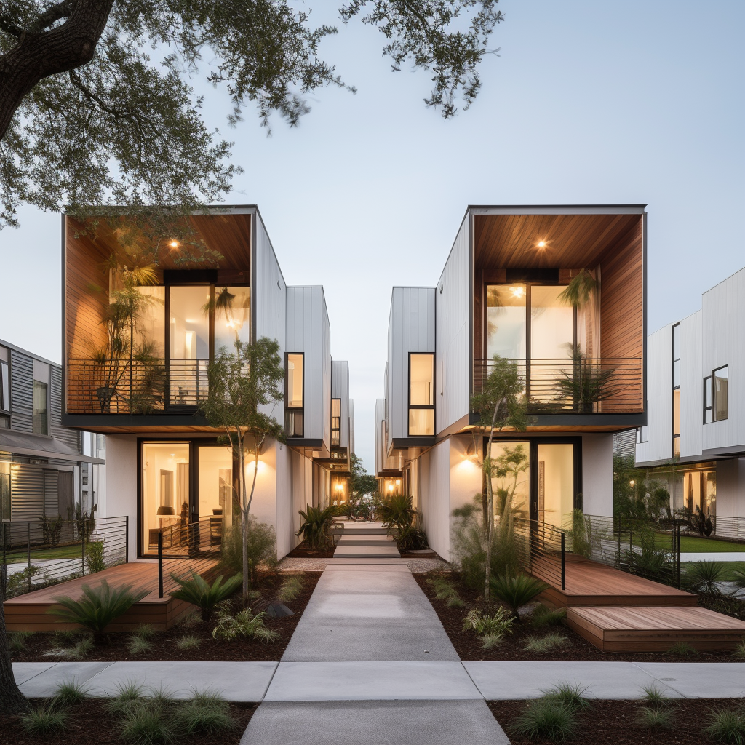
Community Storehouse
Central storehouse and hurricane shelter
Food and supply storage
Emergency response readiness

Slide 14
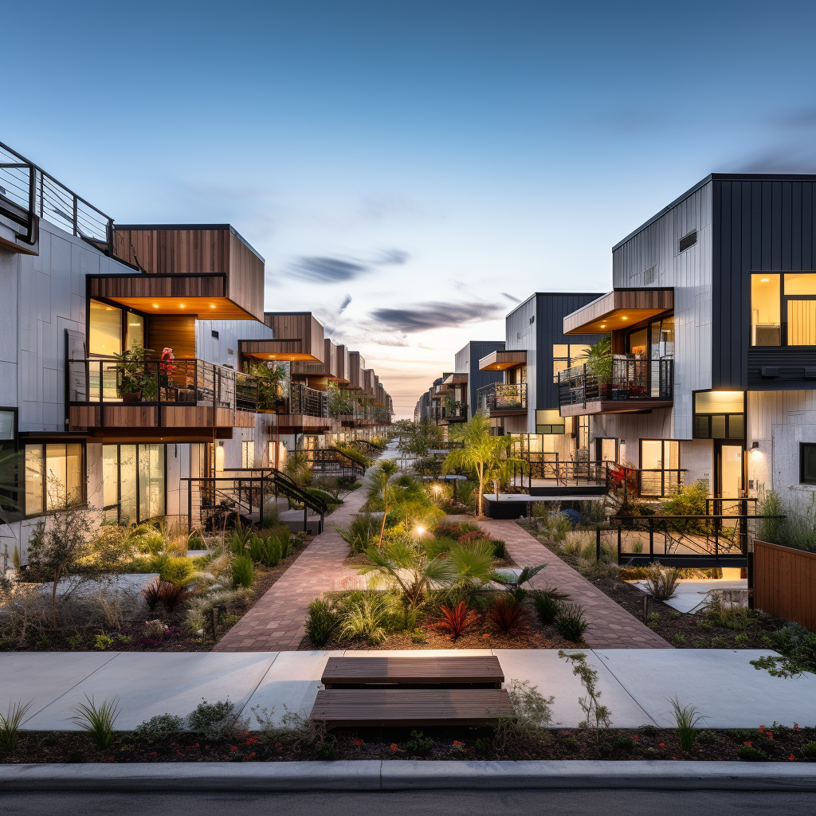
Environmental Impact
Reduced carbon footprint
Ecosystem preservation
Sustainable living

Slide 15
Benefits
Vibrant Community life
Parks, recreational areas
Sustainable transportation options
Economic benefits for residents
Disaster resilience
Sustainable living
Embrace the Future at our Resilient Agrihoods:
Our Resilient Agrihood stands as a testament to the limitless possibilities of sustainable living. Our future-driven approach to smart and connected housing, hurricane-proof design, and WET nexus microgrid sets a new standard for communities. Join us towards a greener, more resilient, and self-sustaining future in Louisiana.

Slide 16
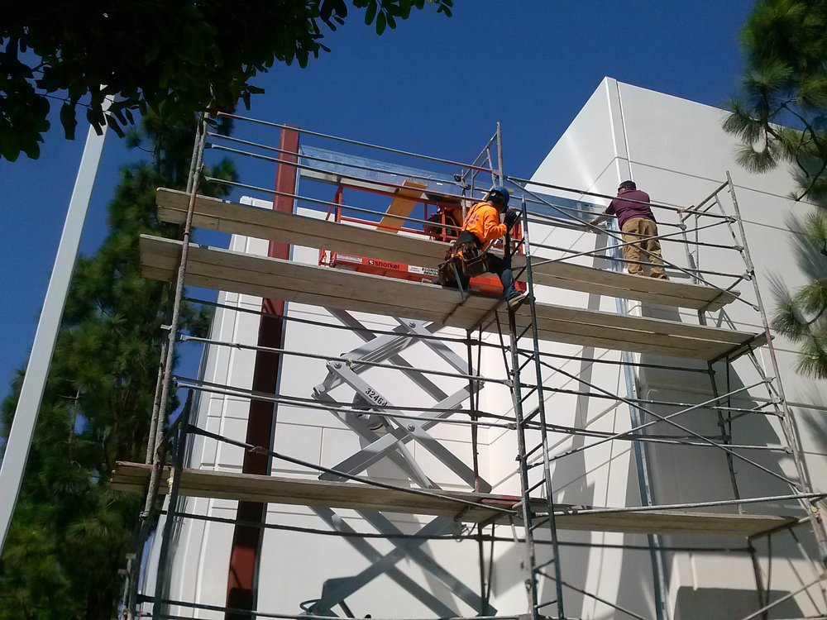
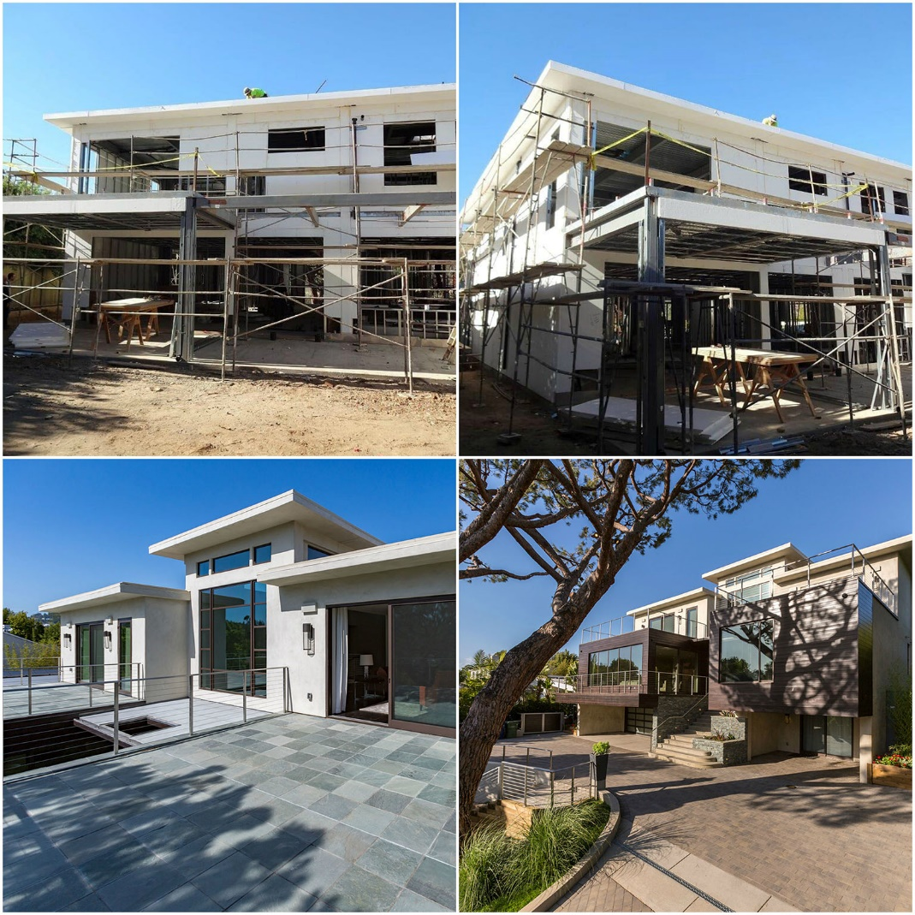
We combine three sustainable and resilient system partners to create a proprietary and unparalleled housing system for areas prone to natural disasters.

Slide 18
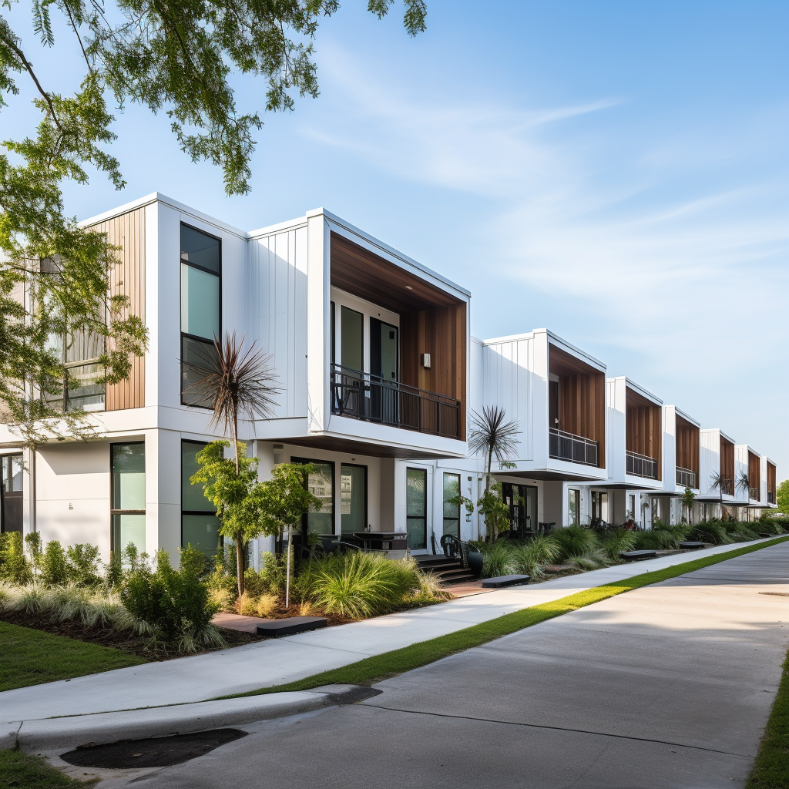
Contact information for inquiries
Dawnita Roberts CEO | Principal
Cleantech Development Institute
Web: https:/www.Cleantech.institute
Email: dawnita@cleantech.Institute
Phone: +1-504-494-5997

