Slide 1
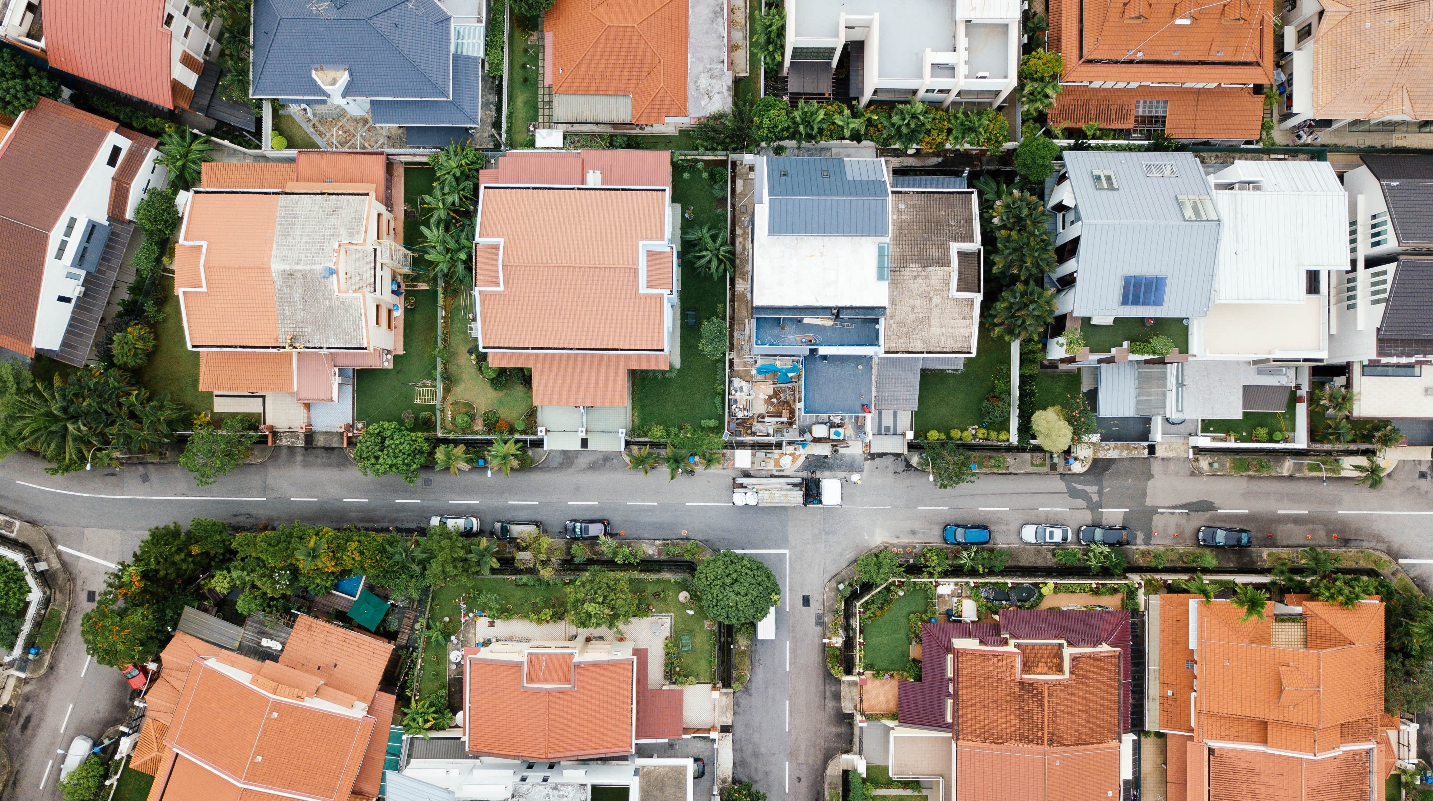
LOUISIANA NEIGHBORHOOD LANDLORD RENTAL PROGRAM PHASE 3 (NLRP3)

Slide 2

PURPOSE OF PROGRAM
The purposes of the Louisiana Neighborhood Landlord Rental Program Phase III (“NLRP3”) are:
To repair damaged housing stock in Eligible Parishes that will be made available at affordable rents for households at or below eighty percent (80%) of area median income (“AMI”).
To produce affordable residential rental housing units outside of a Special Flood Hazard Area (SFHA). Acceptable zones are B, X (shaded), C, X (unshaded), X500 X protected by levee.
To implement the NLRP3 Initiative in a manner that eligible applicants will address impacted properties that have been declared Slum and Blight properties by the planning office in the Parish of the proposed project.

Slide 3

IMPORTANT DATES AND DEADLINES
The NLRP3 Initiative will follow the timeline below:
Date | Event
July 7, 2022 | Notice of Funding Availability (NOFA) published Question/comment period opens
July 14, 2022 | NLRP3 Webinar at 3:00 p.m.
July 21, 2022 | Questions/comments must be submitted by 4:30 PM Central Time
July 26, 2022 | Frequently Asked Questions (FAQ) responses posted
July 27, 2022 | Application Intake/Blackout period begins
September 28, 2022 | Application intake deadline Applications must be submitted by 4:30 PM Central Time LHC may contact applicants for clarification on items contained in the application between 9/28/22 and 10/31/22.
October 31, 2022 | Commitment letters issued continuously after this date, based on prioritization*
July 25, 2024 | Period of performance: All construction must be complete, and all program expenditure requests must be submitted and finalized*
NOTE: The LHC reserves the right to revise this schedule. Any such revision will be formalized by the issuance of an addendum to the NOFA.
*LHC reserves the right to cancel any application that it deems inactive or that is determined to be dormant, by providing a 14-day notice in writing to the applicant. LHC further reserves the right to cancel any project that is initially commitment funds that is later determined to be dormant or unable to move forward by providing a 14 calendar day notice in writing to the applicant in order to meet the period of performance.

Slide 4

Eligible applicants
An Eligible Applicant/Eligible Borrower may be one of the following entities:
Community Housing Development Organization (“CHDO”)
501(c)(3) or 501(c)(4) Not-For-Profit Organization (“NPO”) with a board-approved mission to further affordable housing, or demonstrated through the NPO by-laws mission statement
Local Public Housing Authority (“PHA”)
A Local Development Agency (“LDA”) that is not a parish or municipality
A residential rental property owner (“RRPO”) whose unit either sustained damage due to the Great Floods of 2016 or has been declared a Slum and Blight property by the planning office in the Parish of the proposed project.

Slide 5

Funding Amount
The NLRP3 will have approximately twelve million, six hundred seventy-six thousand, six hundred sixty-eight dollars ($12,676,668) allocated for projects under the program. Should additional funding became available, those additional funds may be awarded through this NOFA.
Awards will be made to qualifying Applicants with preference given to Residential Rental Property Owners (“RRPO’s”) that were property owners at the time of the Great Floods of 2016 or whose property has been declared a Slum and Blight property by the planning office in the Parish of the proposed project.

Slide 6

Maximum NLRP3 Assistance per Applicant
A CHDO, NPO, PHA, LDA, or RRPO may apply for assistance up to seven hundred twenty-five thousand dollars ($725,000) for no more than 7 units.
Only one property is allowed per application.
No applicant may submit more than three (3) complete applications totaling a maximum of 7 units.

Slide 7

Maximum Award
The maximum amount of NLRP3 Initiative funding is based on the number of units in each building. Final award will be the lesser of the cost of construction or other limits that may be set by the NLRP3 Initiative program guidelines and procedures. The maximum NLRP3 funding allowed by unit type is:
NUMBER OF UNITS PER BUILDING | MAXIMUM NLRP3 TAKE-OUT ASSISTANCE
1 Unit | $175,000
2 Units | $315,000
3 Units | $425,000
4 Units | $510,000
5 Units | $575,000
6 Units | $620,000
7 Units | $725,000

Slide 8

Maximum Award Take-out
LHC will fund Take-out Assistance on the Conversion Date only in an amount not exceeding the aggregate advances on a Construction Loan plus accrued interest to the Conversion Date.
Change orders will be reviewed and approved only on an as-needed basis.
Change orders may not be used to exceed the maximum amount of NLRP3 Take-out Assistance; development costs that exceed the maximum Take-out Assistance will be the sole responsibility of the Borrower.
No change order should be undertaken unless there has been expressed written approval by the LHC.

Slide 9

Program requirements
To be eligible under the NLRP3 Initiative, a property must be a residential rental property to be repaired, reconstructed, or newly constructed (residential rental property owners ineligible) and must satisfy each of the following criteria:
Applications involving the construction of New Units may be submitted only by an Eligible Applicant that is a CHDO, NPO, PHA, or LDA
Must be a residential rental structure with up to 7 units;
Properties with more than 7 units contained within a single structure are not eligible under the Program;
Must be a site-built, modular, or manufactured home;
Must be located in one of the Eligible Parishes;
Must be outside of a Special Flood Zone; and
Must complete an environmental review.

Slide 10

AFFORDABILITY REQUIREMENTS
The NLRP3 Initiative requires Qualified Households to occupy the residential housing units in a Qualified Project on and after the Conversion Date for a period of ten (10) complete calendar years (“Affordability Period”). The Affordability Period and percentage of Area Median Income (AMI) for each Qualified Household in a Qualified Project will be specified in the Take-out Commitment and the Permanent Loan documents as of the Conversion Date. This date will normally reflect ten (10) years after the initial, complete lease-up by qualified tenant(s) i.e. 10 years following the date that the last unit is leased to a qualified tenant.

Slide 11

No Choice-Limiting Action Until Environmental Review
Applicant/Borrower and its contractors are prohibited from undertaking or committing any funds or choice-limiting actions, including property acquisition, demolition, movement, rehabilitation, conversion, repair or construction, or leasing or disposition prior to the execution of the “Authority to Use Grant Funds” (HUD 7015.16) or equivalent letter. The violation of this provision may result in the denial of any NLRP3 Funds under this Agreement. Entering a contract obligating the Applicant/Borrower to any of the above constitutes choice-limiting action.

Slide 12

Federal guidelines and requirements
All Qualified Projects will be subject to CDBG Federal Grant Requirements referenced in the Neighborhood Landlord Rental Program Regulatory Agreement (“NLRP Regulatory Agreement”) required to be filed as of record as a covenant running with the land for all Qualified Projects financed under the NLRP3 Initiative. The NLRP Regulatory Agreement will be enforceable against the Eligible Borrower and its successors and assigns during the Affordability Period. Included among the CDBG Federal Grant Requirements are compliance requirements with Section 504 of the Rehabilitation Act of 1973, Fair Housing Act (42 U.S.C. 3601-19) and implementing regulations; and the regulations at 24 CFR Part 107 (Equal Opportunity in Housing); and Title VI of the Civil Rights Act of 1964 (42 U.S.C. 2000d) (Nondiscrimination in Federally Assisted Programs).
Davis-Bacon
Duplication of Benefits (DOB)
Section 3 Requirement
Monitoring Plan

Slide 13
Funding order & evaluation criteria
Awards for NLRP3 will be made to qualifying Applicants whose unit either sustained damage due to the Great Floods of 2016 or has been declared a Slum and Blight property by the planning office in the Parish of the proposed project, with preference given to Residential Rental Property Owner Applicants. Funding for Applicants that are CHDO’s, NPO’s, PHA’s, or LDA’s will be considered once Applicants that are RRPO’s are funded. Accordingly, the scoring criteria for NLRP3 is determined based on the Applicant’s classification: CHDO, NPO, PHA, LDA, or RRPO.

Slide 14

IMPORTANT DATES AND DEADLINES
The NLRP3 Initiative will follow the timeline below:
Date | Event
July 7, 2022 | Notice of Funding Availability (NOFA) published Question/comment period opens
July 14, 2022 | NLRP3 Webinar at 3:00 p.m.
July 21, 2022 | Questions/comments must be submitted by 4:30 PM Central Time
July 26, 2022 | Frequently Asked Questions (FAQ) responses posted
July 27, 2022 | Application Intake/Blackout period begins
September 28, 2022 | Application intake deadline Applications must be submitted by 4:30 PM Central Time LHC may contact applicants for clarification on items contained in the application between 9/28/22 and 10/31/22.
October 31, 2022 | Commitment letters issued continuously after this date, based on prioritization*
July 25, 2024 | Period of performance: All construction must be complete, and all program expenditure requests must be submitted and finalized*
NOTE: The LHC reserves the right to revise this schedule. Any such revision will be formalized by the issuance of an addendum to the NOFA.
*LHC reserves the right to cancel any application that it deems inactive or that is determined to be dormant, by providing a 14-day notice in writing to the applicant. LHC further reserves the right to cancel any project that is initially commitment funds that is later determined to be dormant or unable to move forward by providing a 14 calendar day notice in writing to the applicant in order to meet the period of performance.

Slide 15

QUESTIONS OR COMMENTS

Slide 16
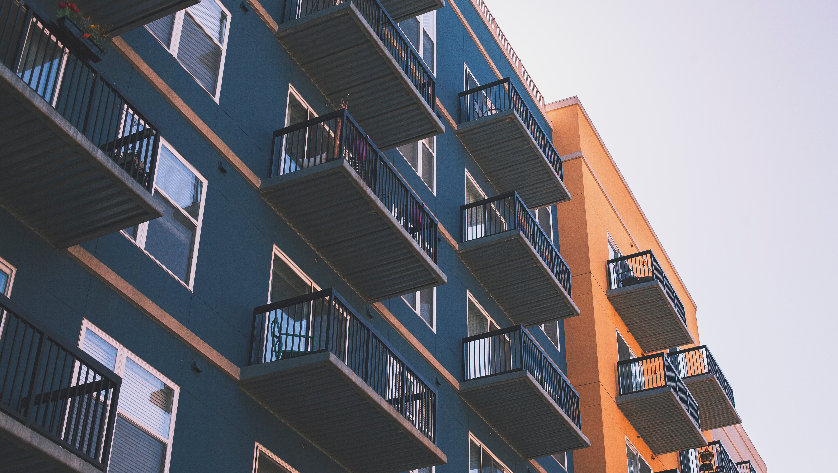

(225) 763-8700 • LHC.LA.GOV

