Slide 1
Rental restoration and development program
2023

Slide 2
agenda
1.
2.
3.
4.
Welcome > introductions > Rental restoration and > adjourn
Development Program
Program Overview
Questions / Answers

Slide 3
Program overview
GOAL
Support the repair, reconstruction, or new construction of residential rental units in qualified areas impacted by Hurricanes Laura, Delta, and Ida and the May 2021 floods
$32 million in Community Development Block Grant Disaster Recovery (CDBG-DR)
Hurricanes Laura & Delta Areas: $16 Million
Hurricane Ida & The May 2021 Floods Areas: $16 Million
FUNDS

Slide 4
Program overview
The Louisiana Housing Corporation (“LHC”) will accept an application from an Eligible Borrower who will construct new residential rental housing units or will repair vacant residential rental housing units in a project that will not exceed seven (7) residential housing units (“Qualified Project”).
An Eligible Borrower must partner with a qualified commercial lender that provides the firm commitment to be included in the Application to provide construction financing for a Qualified Project or must fully fund all development costs of the Qualified Project with the Borrower’s own funds.

Slide 5
Program goals
Repair damaged rental housing stock
Produce affordable residential rental housing
Revitalize communities impacted by disaster

Slide 6
PROGRAM ELIGIBILITY
ELIGIBLE Borrowers _____________________________________________________
Community Housing Development Organization (CHDO)
501(c)(3) or 501(c)(4) Not-For-Profit Organization (NPO)
Local Public Housing Authority (PHA)
Local development agency (LDA) that is not a parish or municipality
Private for-profit property owner (Residential Rental Property Owner)

Slide 7
Eligible borrowers
NEW CONSTRUCTION FINANCING RESTRICTIONS:
May submit applications involving the construction of New Units
NON-PROFIT BORROWERS
(CHDO, NPO, PHA, OR LDA)
May submit applications involving the construction of New Units only in the following rural parishes:
Allen, Beauregard, Jefferson Davis, Natchitoches, Vermilion, Vernon, Assumption, Tangipahoa, Washington, Iberville, Grant, Iberia, Jackson, LaSalle, Lincoln, Morehouse, Sabine, Union, Winn, East Feliciana, Pointe Coupee, and West Feliciana
FOR-PROFIT BORROWERS
(NEITHER A CHDO, NPO,
PHA, OR LDA)

Slide 8
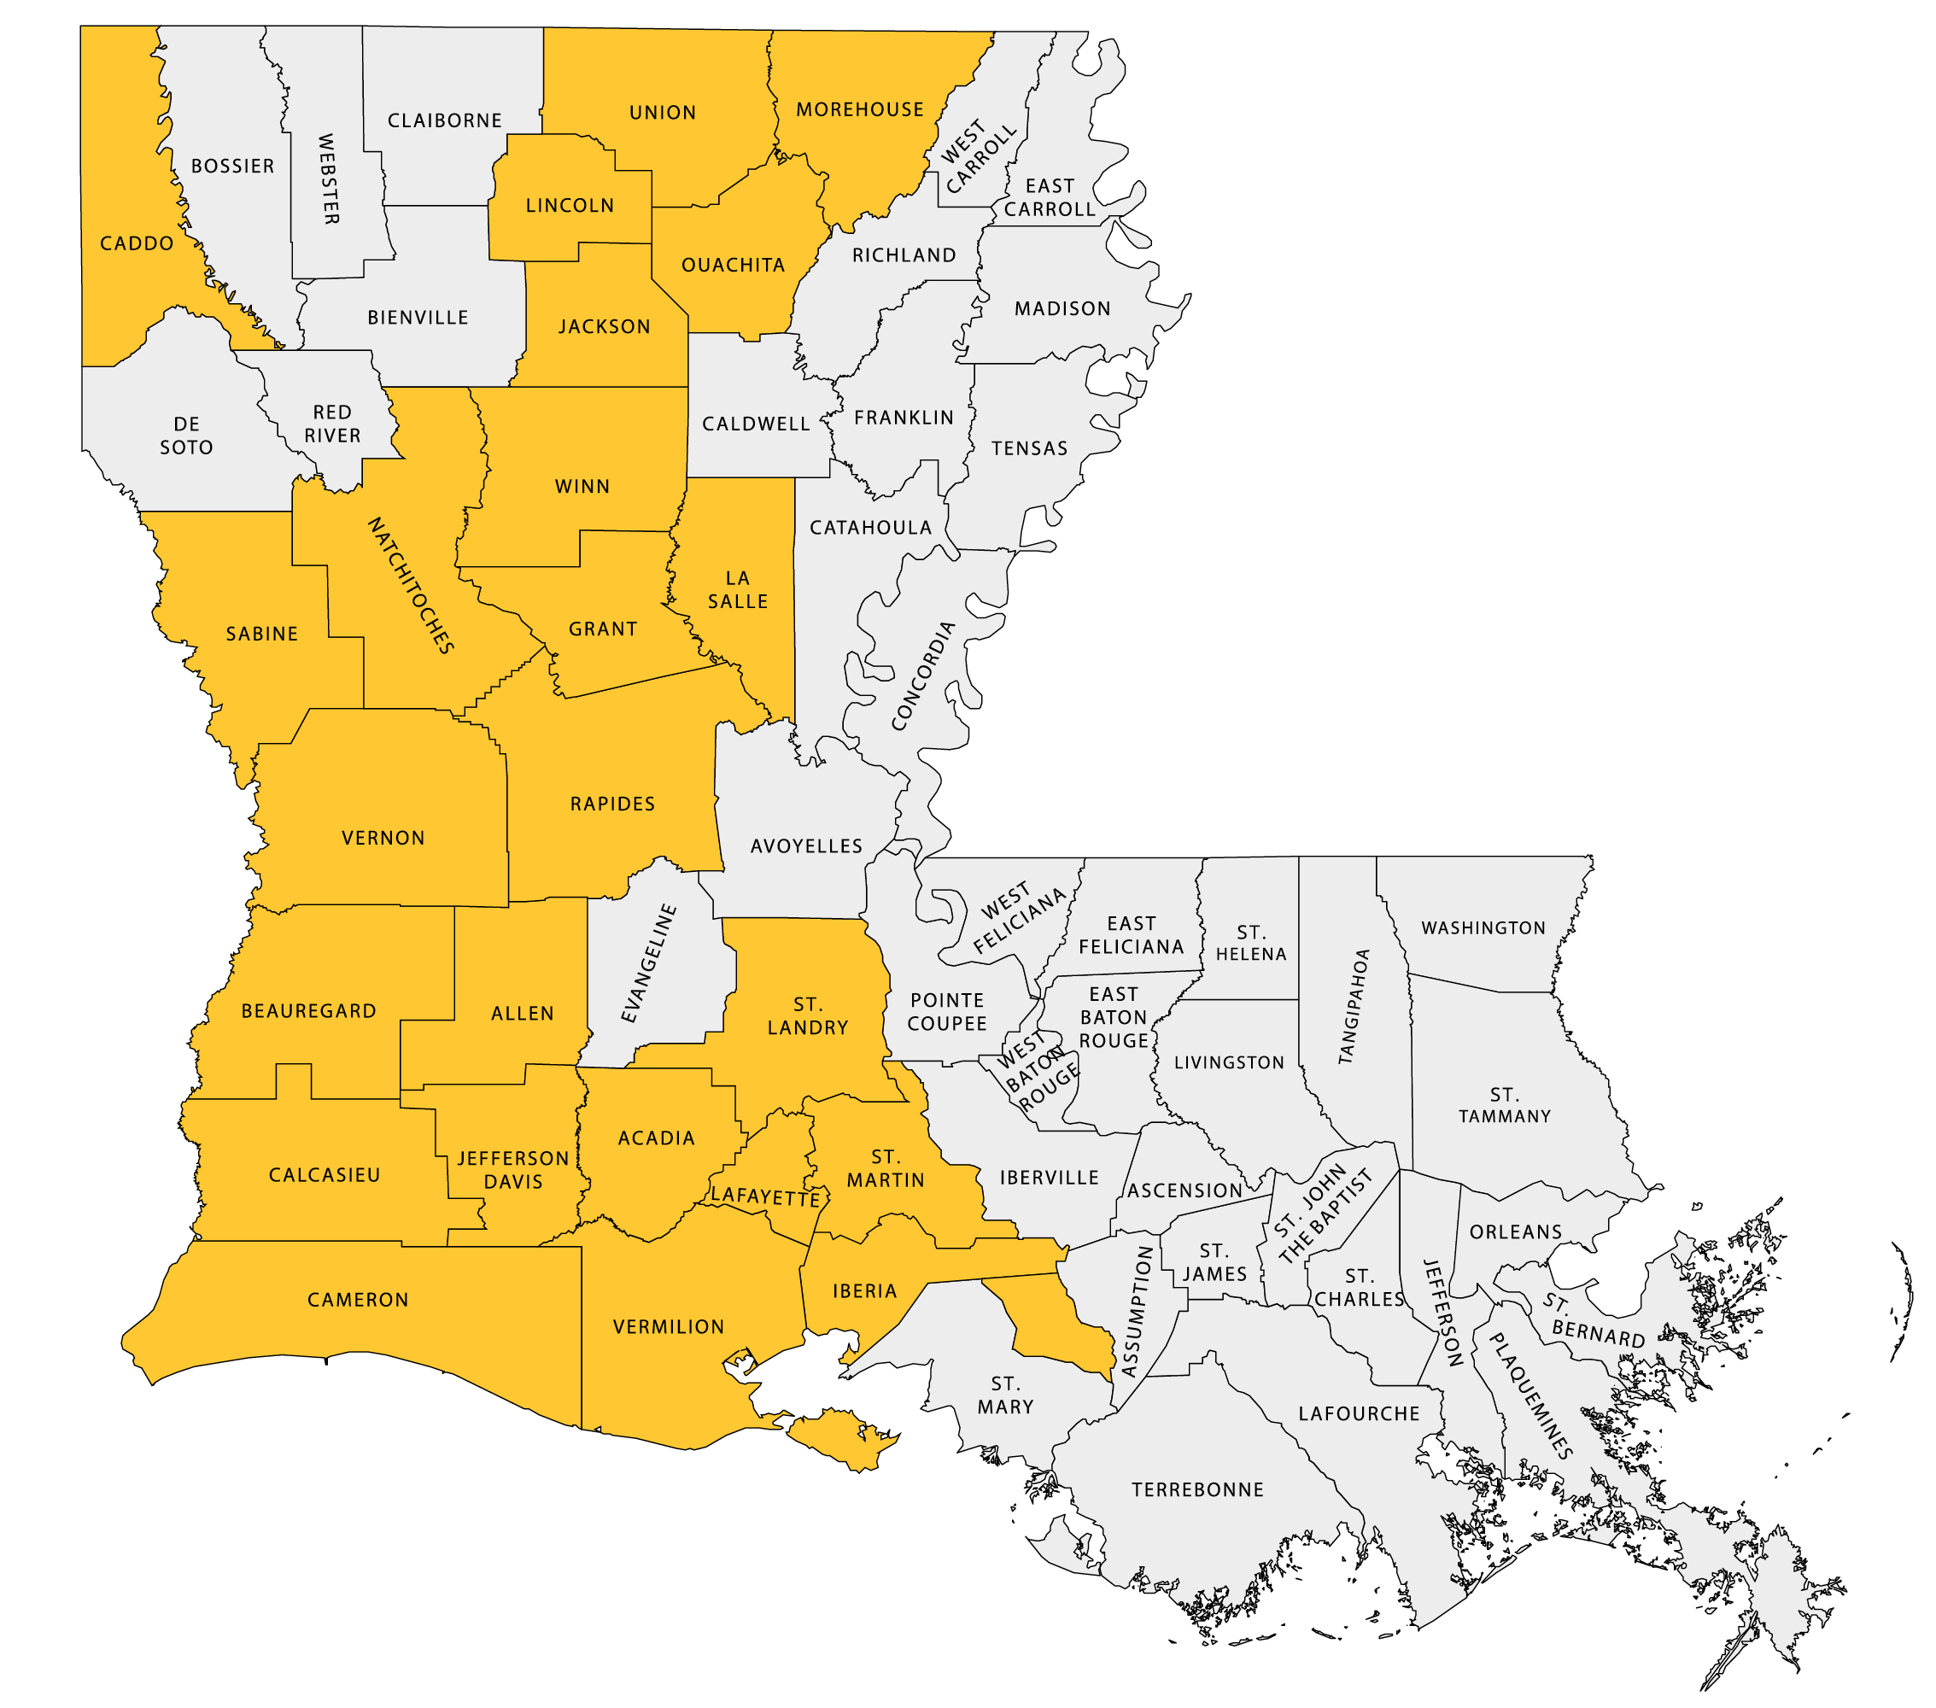
Program
eligibility
FEMA Disaster-Declared Parishes:
Hurricanes Laura and Delta
Acadia
Allen
Beauregard
Caddo
Calcasieu
Cameron
Grant
Iberia
Jackson
Jefferson Davis
La Salle
Lafayette
Lincoln
Morehouse
Natchitoches
Ouachita
Rapides
Sabine
St. Landry
St. Martin
Union
Vermilion
Vernon
Winn
FUNDS
*As defined by HUD

Slide 9
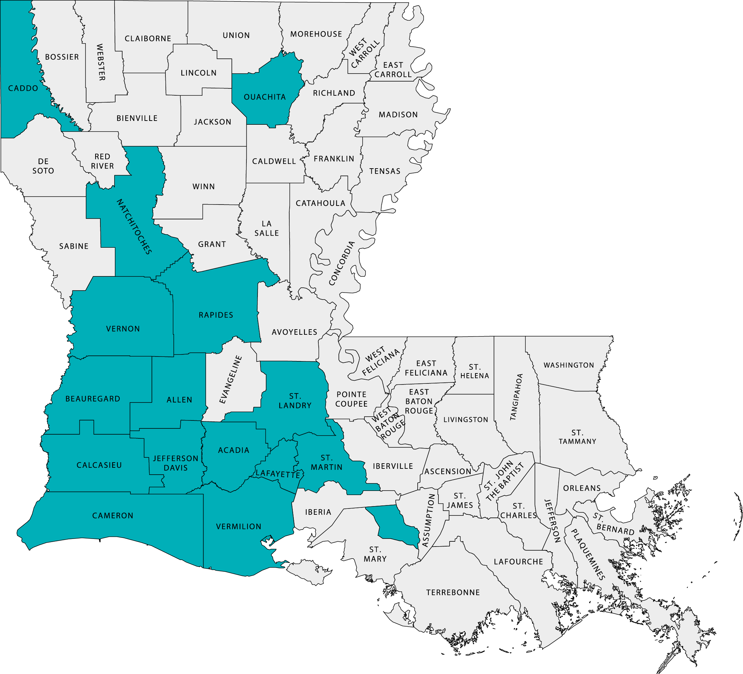
Program
eligibility
Most Impacted & Distressed Areas:
Hurricanes Laura and Delta*
Acadia (Only 70526 & 70578)
Allen
Beauregard
Caddo
Calcasieu
Cameron
Jefferson Davis
Lafayette
Natchitoches
Ouachita
Rapides (Only 71302)
St. Landry (Only 70570)
St. Martin (Only 70517)
Vermilion
Vernon (Only 71446)
FUNDS
*As defined by HUD
*As defined by HUD

Slide 10
Program
eligibility
FEMA Disaster-Declared Parishes:
Hurricane Ida and May 2021 Floods
Ascension
Assumption
Calcasieu
East Baton Rouge
East Feliciana
Iberia
Iberville
Jefferson
Lafayette
Lafourche
Livingston
Orleans
Plaquemines
Pointe Coupee
St. Bernard
St. Charles
St. Helena
St. James
St. John the Baptist
St. Martin
St. Mary
St. Tammany
Tangipahoa
Terrebonne
Washington
West Baton Rouge
West Feliciana
FUNDS
*As defined by HUD

Slide 11
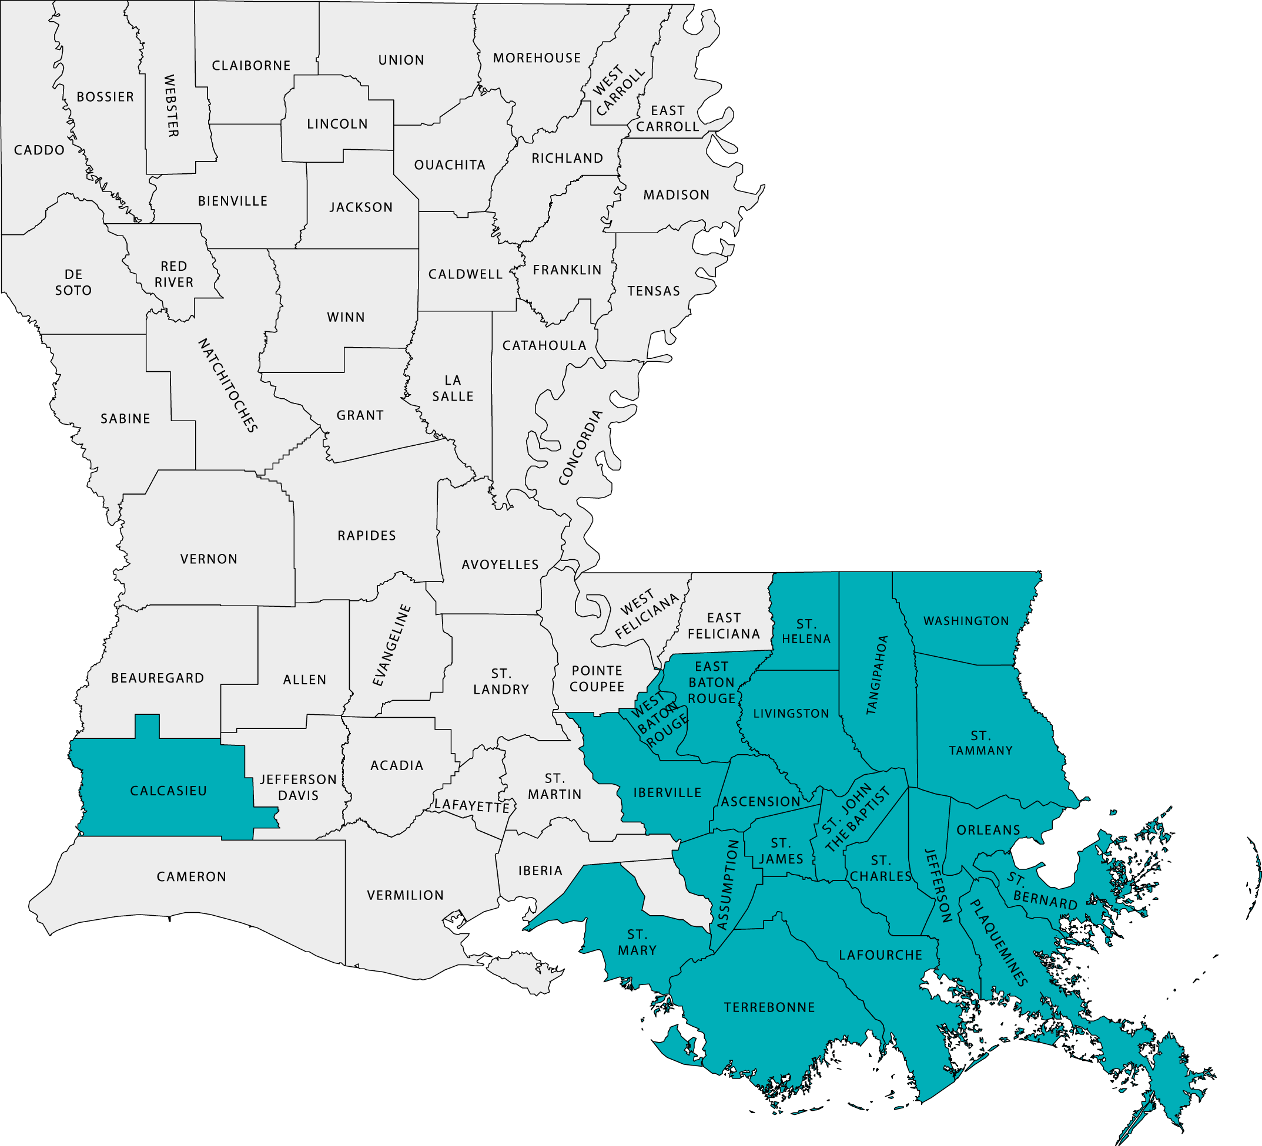
Program
eligibility
Most Impacted & Distressed Areas:
Hurricane Ida and May 2021 Floods*
Ascension
Assumption
Calcasieu
East Baton Rouge
Jefferson
Lafourche
Livingston
Orleans
Plaquemines
St. Bernard
St. Charles
St. Helena
St. James
St. John the Baptist
St. Mary
St. Tammany
Tangipahoa
Terrebonne
Washington
Iberville (Only 70764 & 70788)
West Baton Rouge (Only 70767)
FUNDS
*As defined by HUD

Slide 12
OWNERSHIP REQUIREMENTS BY ELIGIBLE BORROWERS
ANY PUBLIC, PRIVATE, FOR-PROFIT, OR NON-PROFIT ENTITY MUST OWN THE SUBJECT PROPERTY AT THE TIME OF APPLICATION
FUNDS
TITLE SUBMITTED MUST REMAIN IN THE NAME OF THE BORROWER UNTIL THE END OF THE AWARDS PROCESS, UP TO AND INCLUDING EXECUTION OF CLOSING DOCUMENTS
ALL OWNERS MUST SIGN THE APPLICATION, LOAN AND PROGRAM DOCUMENTS

Slide 13
PROPERTY ELIGIBILITY REQUIREMENTS
MUST BE LOCATED IN ONE OF THE ELIGIBLE PARISHES
MUST BE A SITE-BUILT
OR MODULAR HOME THAT MEET THE LOCAL AND STATE BUILDING CODES
FUNDS
MUST BE A RESIDENTIAL RENTAL STRUCTURE NOT-TO-EXCEED 7 UNITS
PROPERTIES WITH MORE THAN 7 UNITS CONTAINED WITHIN A SINGLE STRUCTURE ARE INELIGIBLE
ALL ASSISTED UNITS MUST HAVE BEEN VACANT AS OF FEB. 27, 2023, AND MUST REMAIN VACANT THROUGHOUT THE APPLICATION AND CONSTRUCTION PERIOD

Slide 14
Minimum construction requirements
FOR ALL UNITS
MUST BE WELL-BUILT WITH RESOURCE-EFFICIENT, HEALTHY, AND DURABLE SYSTEMS, FENCING, OPEN SPACE AND LANDSCAPING, PARKING, AND IN-UNIT FEATURES
MUST BE 3 FT ABOVE THE NEAREST ROAD CENTERLINE ELEVATION AND SHOULD NOT BE LOCATED WITHIN OR PARTIALLY WITHIN THE SPECIAL FLOOD HAZARD AREA
FUNDS
ALL UNITS MUST INCLUDE A WASHER, DRYER, AND DISHWASHER
MUST BE EQUIPPED WITH NETWORKS TO PROVIDE CABLE TV, AND TELEPHONE AND INTERNET ACCESS IN LIVING AREA AND BEDROOMS.
Notes:
ADDITIONAL RESILIENCY STANDARDS:
The building footprint may be in Zone B or X-Shaded (500-YR)
Irrespective of FIRM designation, the application must clearly establish whether the proposed building footprint experienced flooding in the Hurricanes Laura, Delta, Ida, and/or the May 2021 Floods; if the footprint was flooded, the plan must clearly address how such risks are mitigated, either through elevation above the BFE, flood proofing, or both.

Slide 15
Minimum construction requirements (CONT.)
FOR ALL UNITS
MUST CONTAIN AT LEAST ONE OPERABLE, LIFE-LONG, SEALED BATTERY CARBON MONOXIDE (CO) DETECTOR
ALL UNITS MUST ADHERE TO THE GREEN BUILDING STANDARDS AS OUTLINED IN THE FEDERAL REGISTER, AND SPECIFIC ENERGY EFFICIENCY REQUIREMENTS
FUNDS

Slide 16
ADDITIONAL requirements
FOR NEW CONSTRUCTION AND RECONSTRUCTION PROJECTS
MUST OBTAIN CERTIFICATION BY IBHS FOR “FORTIFIED ROOF”
FUNDS

Slide 17
Affordability period
The RRDP requires all Qualified Projects to maintain property and flood insurance through the affordability period and place eligible tenants in the residential housing units by or within 90 days of the Conversion Date for a specified period based on the type of proposed construction:
A period of five (5) complete calendar years for all rehabilitation
A period of ten (10) complete calendar years for all reconstruction and new construction
A period of twenty (20) complete calendar years for all new construction consisting of 5 or more units in accordance with HOME program standards of 24CFR92.252(e)

Slide 18
Affordability period
Forgiveness of the take-out loan will be calculated as follows:
AFFORDABILITY PERIOD | FORGIVENESS BEGINS | FORGIVENESS RATE
5 YEARS | End of 5th Year | 100%
10 YEARS | End of 6th Year | 20% Per Year for Years 6-10
20 YEARS | End of 10th Year | 10% Per Year for Years 11-20

Slide 19
Qualified projects with more than four residential housing units are required to occupy a specified number of units with lower income households for set affordability period
Occupancy and set aside unit requirements
>4

Slide 20
AFFORDABILITY PERIOD SET ASIDES
RESIDENTIAL HOUSING UNITS | QUALIFIED HOUSEHOLD INCOMES | SET ASIDE UNITS
4 OR FEWER | 80% AMI and below | None
5 | 80% AMI and below | One (1) for 50% AMI Household
6-7 | 80% AMI and below | Two (2) for 50% AMI Household

Slide 21
Program awards
THE FOLLOWING RESTRICTIONS WILL APPLY TO ALL RRDP APPLICATIONS SUBMITTED BY FOR-PROFIT ENTITIES PROPOSING NEW CONSTRUCTION:
RRDP funding is not intended to cover 100% of the total development costs
Total development costs that are equal to the maximum new construction award amount for the project type will only be eligible for 75% of the maximum award amount
If the total development costs are 25% or higher than the maximum new construction award amount, the for-profit entity will be eligible for the maximum award type for the project type

Slide 22
Maximum award
RECONSTRUCTION AND NEW CONSTRUCTION
NUMBER OF UNITS PER BUILDING | MAXIMUM TAKE-OUT ASSISTANCE
1 | $197,500
2 | $355,000
3 | $482,500
4 | $570,000
5 | $655,000
6-7 | $725,000
FINAL AWARD WILL BE THE LESSER OF THE COST OF CONSTRUCTION OR THE MAXIMUM AMOUNT OF ASSISTANCE PER UNIT

Slide 23
Maximum award
REHABILITATION
NUMBER OF UNITS PER BUILDING | MAXIMUM RRDP TAKE-OUT ASSISTANCE
1 | $118,200
2 | $213,000
3 | $289,500
4 | $342,000
5 | $393,000
6 | $435,000
7 | $460,000

Slide 24
Award process and calculation
Owner rental award will be provided as a take-out loan at 0% in return for provision of housing for eligible LMI households at restricted rent
If all terms are met at the end of the affordability term, the loan will be completely forgiven
A duplication of benefits review will be conducted during the underwriting process – including SBA and NFIP funds
The maximum amount of RRDP funding is based on the number of units in each building

Slide 25
funding
Eligible Borrowers must do one of the following:
Partner with a qualified commercial lender that provides a commitment contingent upon receipt of a RRDP loan; or
Fully fund all development costs of the Qualified Project with the Borrower’s own funds
APPLICATIONS MUST INCLUDE PROOF OF FINANCING OR PROOF OF PERSONAL FUNDS THAT IS AT LEAST EQUAL TO THE TOTAL DEVELOPMENT COSTS OF THE QUALIFIED PROJECT

Slide 26
Financing guidelines
LENDER CONSTRUCTION LOAN TERMS
A Lender’s Construction Loan may accrue interest at a not-to-exceed rate of interest required by the Lender and as approved by the LHC during construction. A Lender’s Construction Loan must provide that:
Unit construction or renovation will be completed within a not-to-exceed fixed budget containing all not-to-exceed closing fees and closing costs as approved by the lender and LHC
Unit construction must be completed by the date agreed upon by LHC and the lender within the construction quote and/or contract
CONSTRUCTION LOANS MUST BE STRUCTURED WITH A PROMISSORY NOTE SECURED BY A MORTGAGE THAT WILL BE NEGOTIATED AND ASSIGNED BY THE CONSTRUCTION LENDER TO LHC FOLLOWING COMPLETION OF CONSTRUCTION OR RENOVATION OF A RESIDENTIAL HOUSING UNIT AND UPON RECEIPT BY THE LENDER OF A GUARANTEED PAYMENT BY LHC.

Slide 27
Award process: take-out PERIOD
IF THE PERMANENT LOAN IS IN THE SENIOR LIEN POSITION, THE CONVERSION DATE WILL BE THE LATER OF:
The date a certificate of occupancy of the Qualified Project is delivered to the Construction Lender and LHC
The date the Construction Lender receives payment in full pursuant to the Take-Out Commitment
IF THE PERMANENT LOAN IS IN THE SUBORDINATE LIEN POSITION:
The Conversion Date will not occur until all residential units in the Qualified Project are occupied by a Qualified Household.

Slide 28
Required application documents:
NEW CONSTRUCTION
Site plan
Floor plan
Front, side, and rear elevations
Preliminary checklist indicating “Green Building” compliance with appropriate standard
Certification Regarding Sources and Use of Funds Statement and No Duplication of Funds
Evidence that project meets zoning requirements

Slide 29
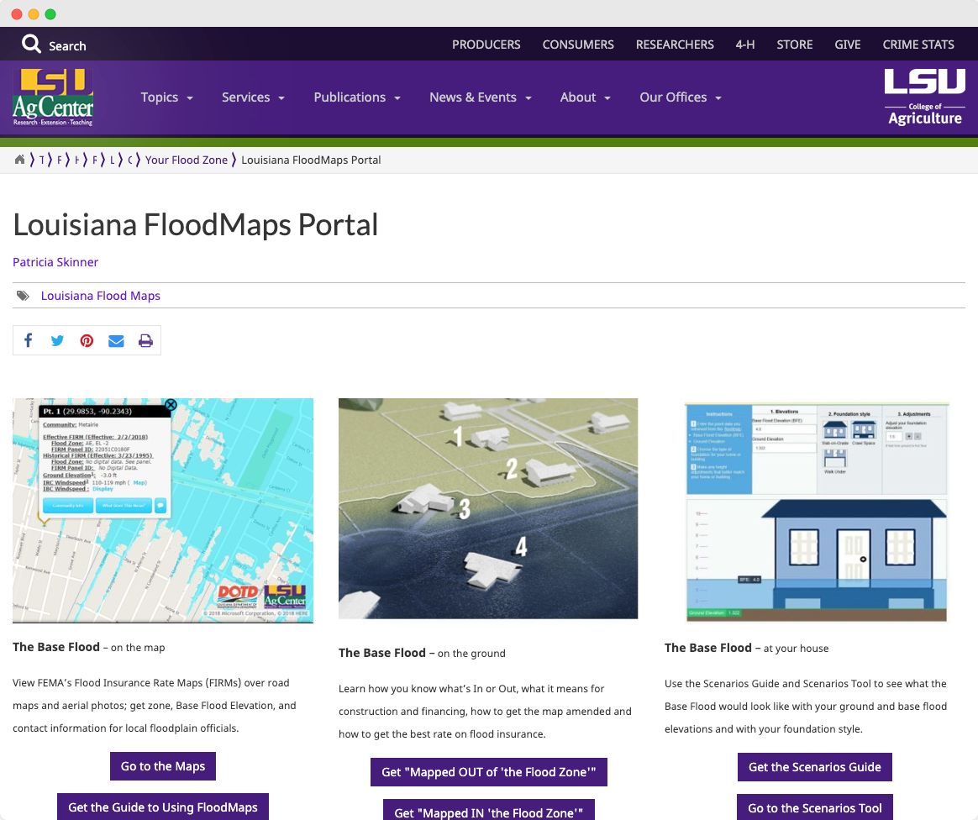
Required application documents:
NEW CONSTRUCTION
Evidence that the proposed housing unit is not in a special flood hazard area
This can be an elevation certificate or print out from the LSU Ag Center Flood Map Site
Construction Contract
Stop Work Order Provision Document
Commitment contingent upon receipt of RRDP
This should be a lender commitment letter or equivalent
Ownership Document (Merchantable Title)
lsuagcenter.com/floodmaps

Slide 30
Required application documents:
REHABILITATION
Site plan
Photos of front, rear, and sides of exterior
Photos of each room
Proposed compliance alignment of the scope of work with HUD CPD Green Building Retrofit Checklist
Ownership Document (Merchantable Title)

Slide 31
Required application documents:
REHABILITATION
Certification regarding Sources and Uses of Funds Statement and No Duplication of Funds
Evidence of commitment and availability of all permanent and duplicative funding sources necessary to complete the project (Please provide any SBA or NFIP paperwork associated with the unit)
Lead inspection if housing unit is pre-1978
Evidence that project meets zoning requirements

Slide 32
Required application documents:
REHABILITATION
Evidence that the housing unit is either not in a special flood hazard area or is at an elevation one foot (1’) above the DFIRM elevation requirement
If the property was substantially damaged as determined by local code enforcement officials
An elevation certificate or a printout from the LSU Ag Center Flood Map Site
Vacancy certification
Construction contract (if work has started on units)
Construction quote (if work hasn’t started on units)
Stop Work Order Provision Document
lsuagcenter.com/floodmaps
Tenant Certification
Commitment contingent upon receipt of RRDP
Lender commitment letter or equivalent

Slide 33
timeline
DATE | EVENT
2/27 | Application Guidelines published
4/14 | Questions due to rrdp@lhc.la.gov by COB
4/28 | NOFA FAQs posted
5/1 | Application Intake Begins
7/31 | Application Intake Deadline
8/31 | Commitment Letters issued continuously after this date

Slide 34
QUESTION AND ANSWER PERIOD
SUBMIT QUESTIONS TO RRDP@LHC.LA.GOV BY APRIL 14, 2023.

Slide 35
LHC.LA.GOV
Thank you!
LHC.LA.GOV/RRDP
For more information:

